Slide 1
Observations and modelling combine to inform network developments.
Gordon Brailsford, Sara Mikaloff Fletcher, Dan Smale, Zoë Buxton, Kay Steinkamp, Sylvia Nichol, Tony Bromley, Sally Gray
National Institute of Water and Atmospheric Research (NIWA) New Zealand
Gordon.Brailsford@niwa.co.nz

Slide 2
Regional goals for the New Zealand GHG network
Establish a CO₂ and CH₄ emissions and uptake verification system, underpinned by high precision GHG data from a network of atmospheric observing stations and an atmospheric transport model
  National emissions inventory is currently calculated from national emission activity data and emissions factors.
  These provide little capability to assess the impact of GHG emission reduction programmes on city-wide to regional scales
  A prototype study, based on CO₂ measurements in the atmosphere, suggests that NZ’s land biosphere absorbs much more carbon than predicted from current approaches, especially forested lands.

Slide 3
An Independent Approach to Estimate CO₂ Uptake
Bottom-up: involves determining carbon uptake at a network of land study sites, which are then upscaled to larger areas.
Top-down: involves measuring CO₂ concentrations at surface stations and linking changes in CO₂ to sources and sinks.
→For Top-down we need knowledge about transport/dispersion history of CO₂ in the atmosphere to establish that link
Observation
Wind
Source region

Slide 4
New Zealand: A special case for atmospheric measurements and models to verify inventories
The stakes are high. During the Kyoto period, forestry offset 20% of NZ total emissions.
COP21: Land carbon uptake included, but specific accounting and transparency rules to be negotiated
“All land use” accounting system allows direct comparisons
Island far from other terrestrial sources
The carbon community is small and keen to work closely to improve both methods

Slide 5
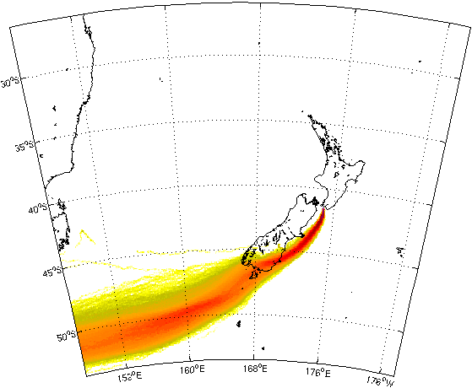
The Model
NAME Lagrangian model (UK Met Office)
Winds from NZLAM (12 km resolution, 70 vertical levels)
10,000 particles released from the station over the course of an hour, and allowed to run backwards in time for four days

Slide 6
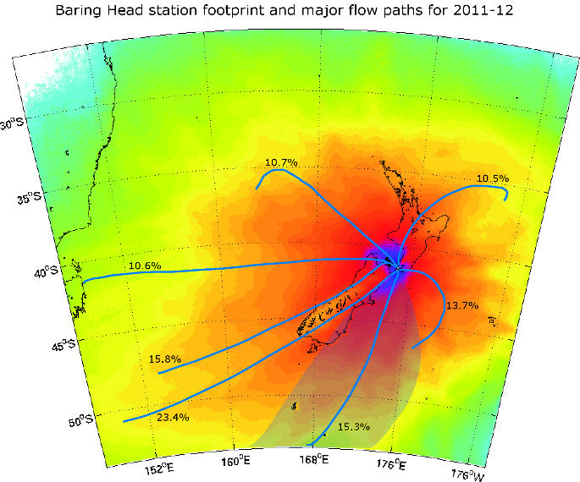
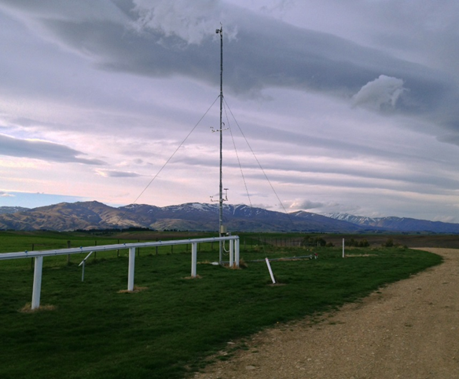
Two Years of Lagrangian Simulations
Baring Head
Rapidly changing meteorology means a single site is able to receive information from a large cross section of New Zealand
Overlapping footprints give greater confidence to our ability to separate regions.
Gaps remain in our observing network
Lauder
Lauder

Slide 7
Currently the GHG in situ observation network consists of 3 stations:
Rainbow Mountain
Baring Head
Lauder

Slide 8
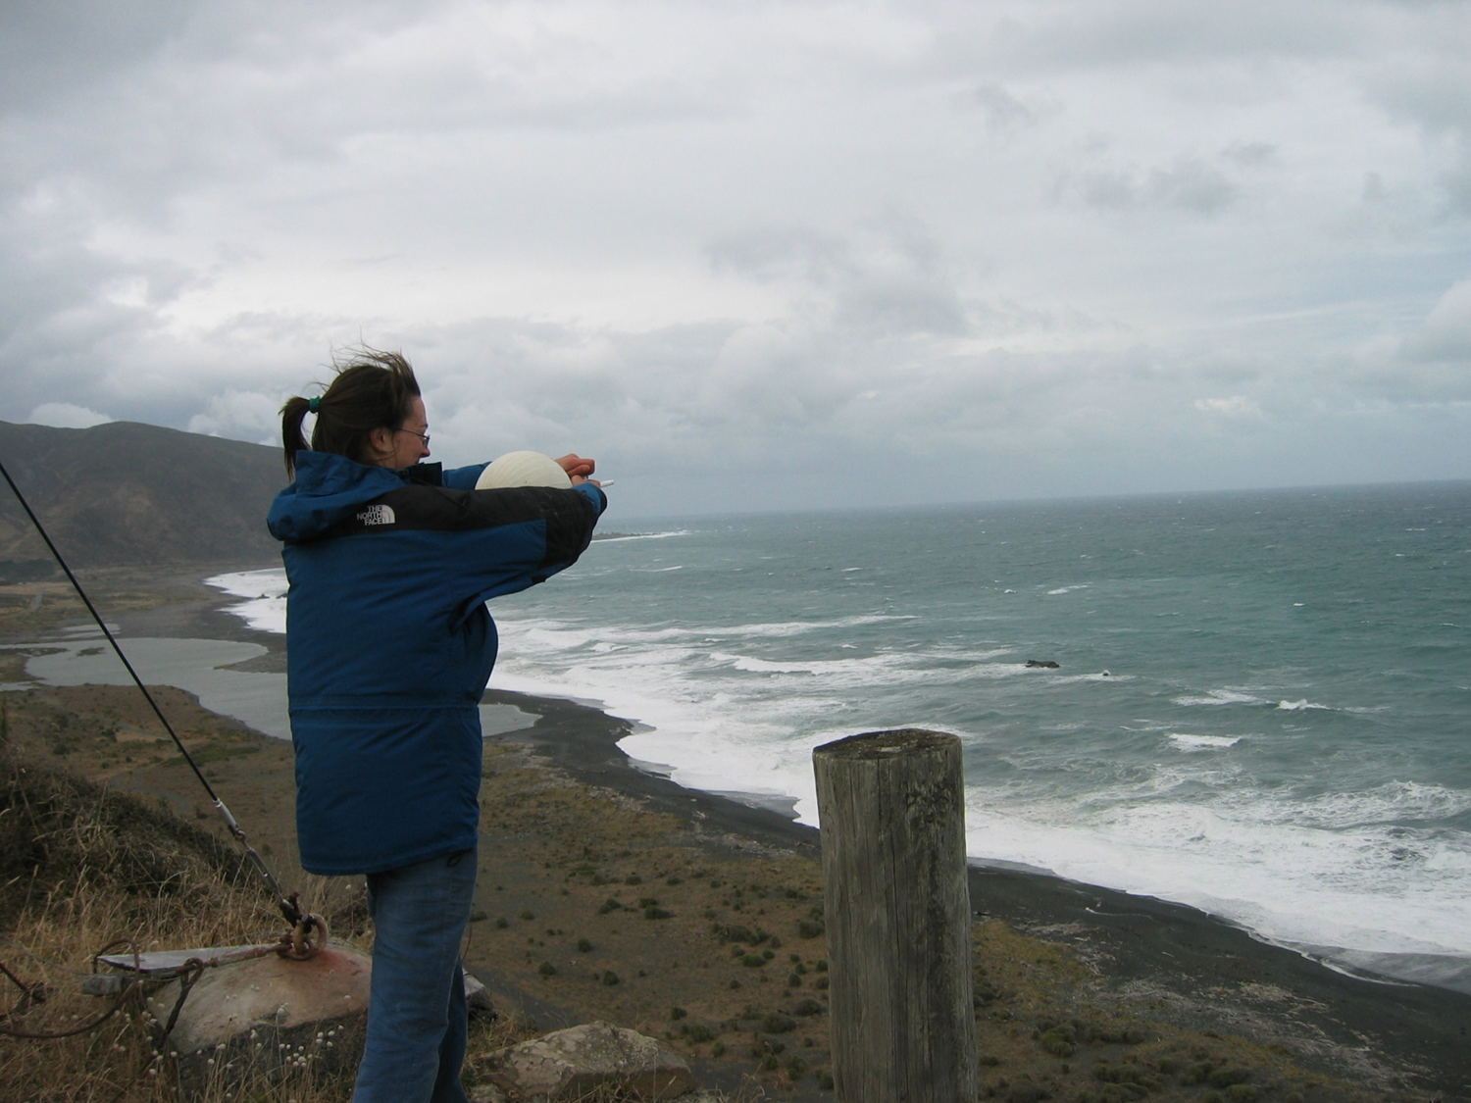
Currently the GHG observation network consists of 3 stations:
Baring Head (BHD)
  Lower North Island
  Most observes oceanic signals
  Baseline to the south
Lauder (LAU)
  Lower South Island
  Inland
  Observes both lower South Island interior and clean oceanic
Rainbow Mountain (RBM)
  Central North Island
  Observes large forested and farmed regions

Slide 9
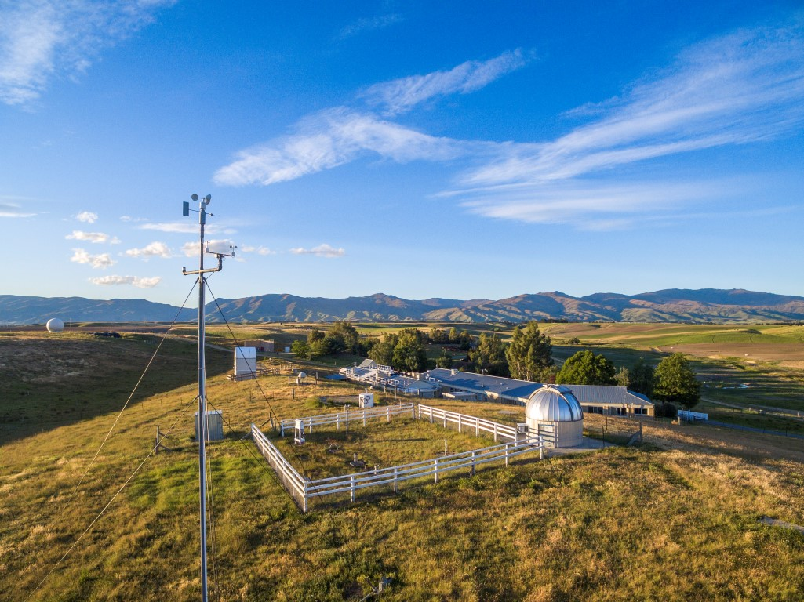
Currently the GHG observation network consists of 3 stations:
Baring Head (BHD)
  Lower North Island
  Most observes oceanic signals
  Baseline to the south
Lauder (LAU)
  Lower South Island
  Inland
  Observes both lower South Island interior and clean oceanic
Rainbow Mountain (RBM)
  Central North Island
  Observes large forested and farmed regions

Slide 10
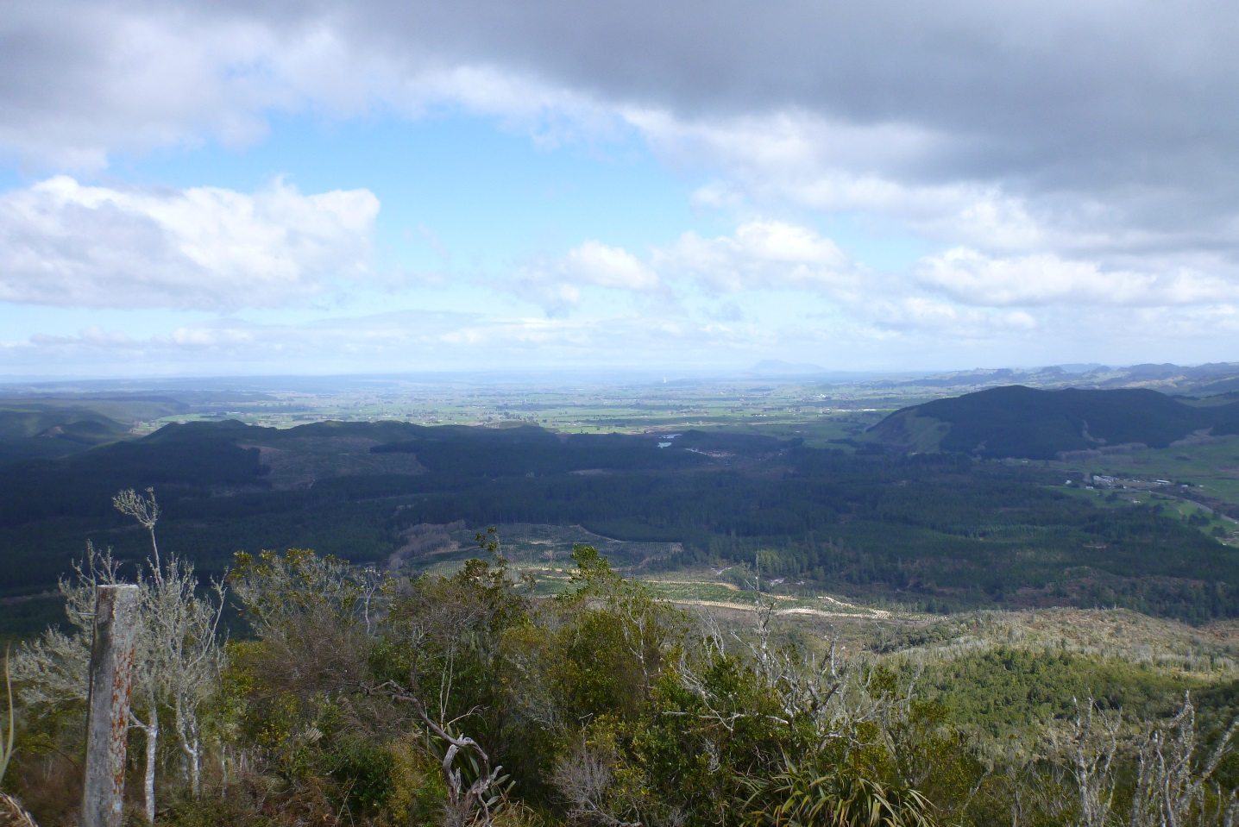
Currently the GHG observation network consists of 3 stations:
Baring Head (BHD)
  Lower North Island
  Most observes oceanic signals
  Baseline to the south
Lauder (LAU)
  Lower South Island
  Inland
  Observes both lower South Island interior and clean oceanic
Rainbow Mountain (RBM)
  Central North Island
  Observes large forested and farmed regions

Slide 11
NAME model for network sites
Model indicates the areas contributing to the observed CO₂
Capture background air to the south and west (BHD)
Central North Island (RBM) and large parts of the South Island (LAU)
Indications of areas (yellows) with minimal coverage from existing network

Slide 12

New stations needed
Upper North Island - Auckland
  Tasman sea input
  Outflow from Auckland (biggest city 1.4 m people)
Canterbury
  Large arable farming region
Southland
  Intensive farming area with farming practice changes
  Large native forested area to west in Fiordland
  Inverse modelling indicates a sink process not captured in the inventories
1
2
3

Slide 13
Criteria for selecting new stations
Logistics
  Accessible
  Existing facilities preferable
Topography and Meteorology
  Wind Speed: Air arriving at the site will come from a large area
  Local terrain not over complicating analysis
Modelling
  Areas missing from the current network are observed
  Inverse modelling capable of identifying source/sink components

Slide 14
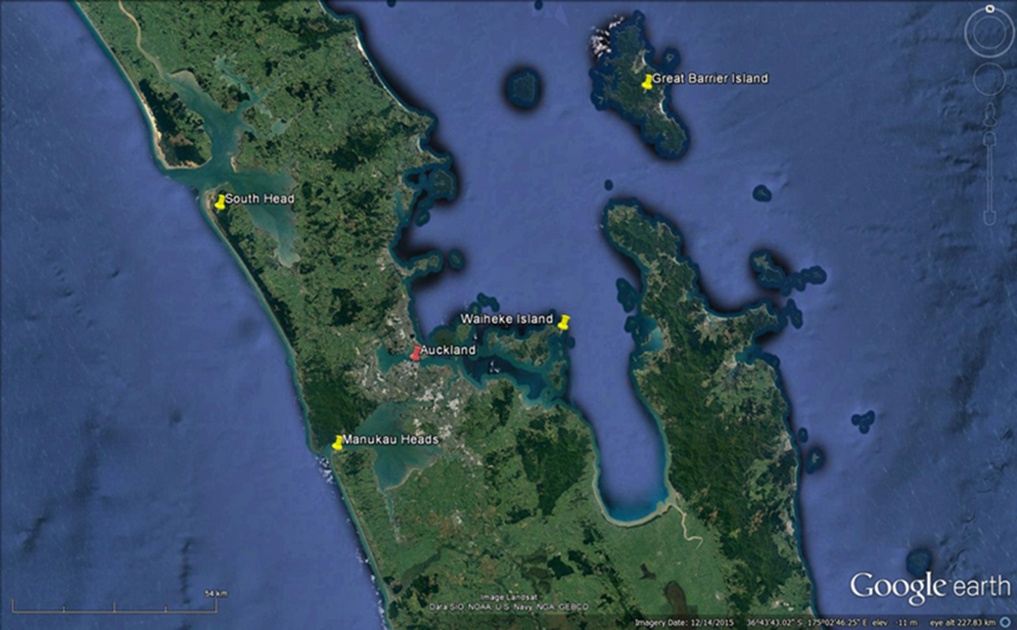
Auckland case study
Within the Auckland area we select 4 potential sites
Each has existing infrastructure and is accessible
They all appear to have good exposure to broader areas.

Slide 15
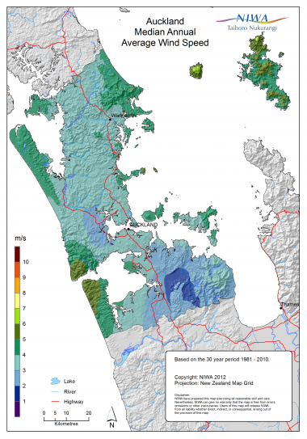
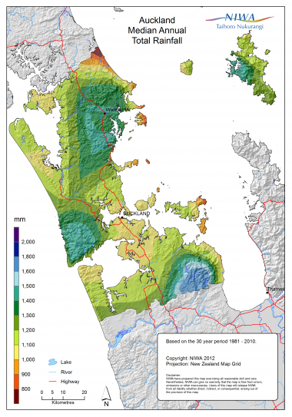
Auckland Meteorology
Average Wind Speed
Average total rainfall
Highest wind speeds on the west
Low wind speeds to the east
Topography indicated by rainfall

Slide 16
Auckland winds
Winds are generally from SW
Stronger winds are from the SW
Western coast has greatest exposure

Slide 17
Auckland back trajectories
For each of the prospective site we ran Hysplit back trajectories
A day with a general North-westerly flow into the area
  This air originates to the south of Australia (4 days)
  A larger scale westerly flow.
  Local signals to the north of the sites would be observed
A strong south-west flow into the area
  Flow is across the upper South Island and the western portion of the North Island
  Capture two areas not well observed in current network.
Northwest condition
Southwest condition

Slide 18
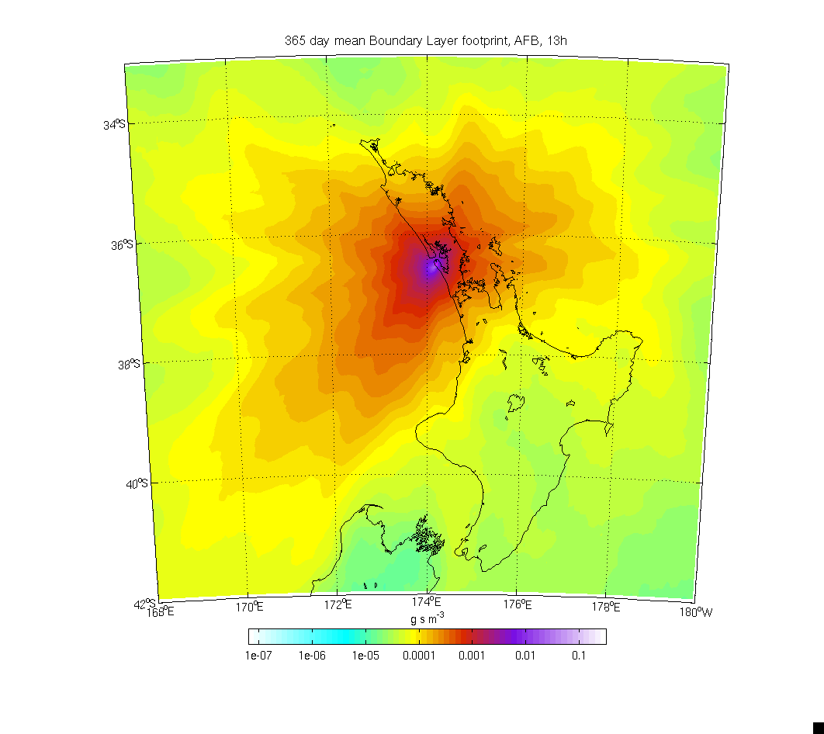
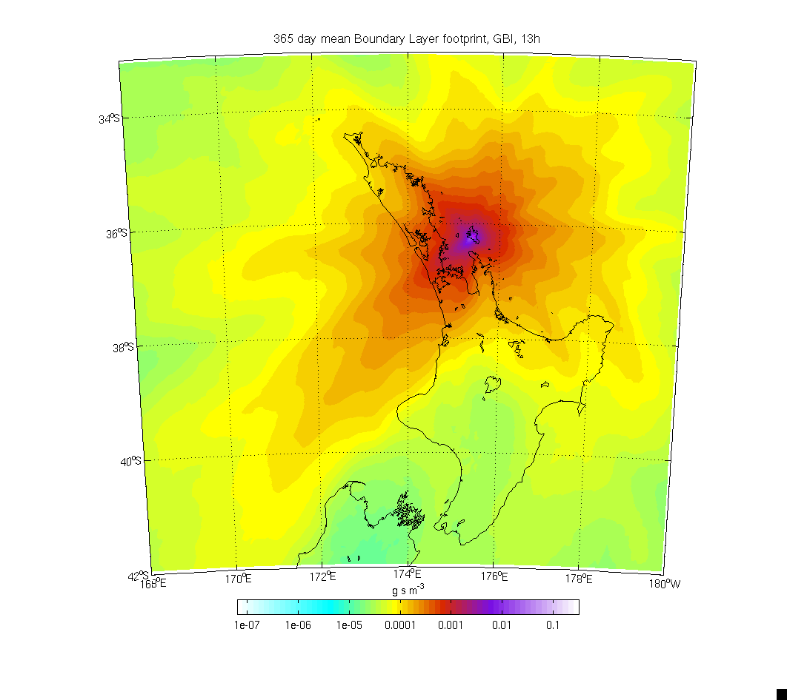
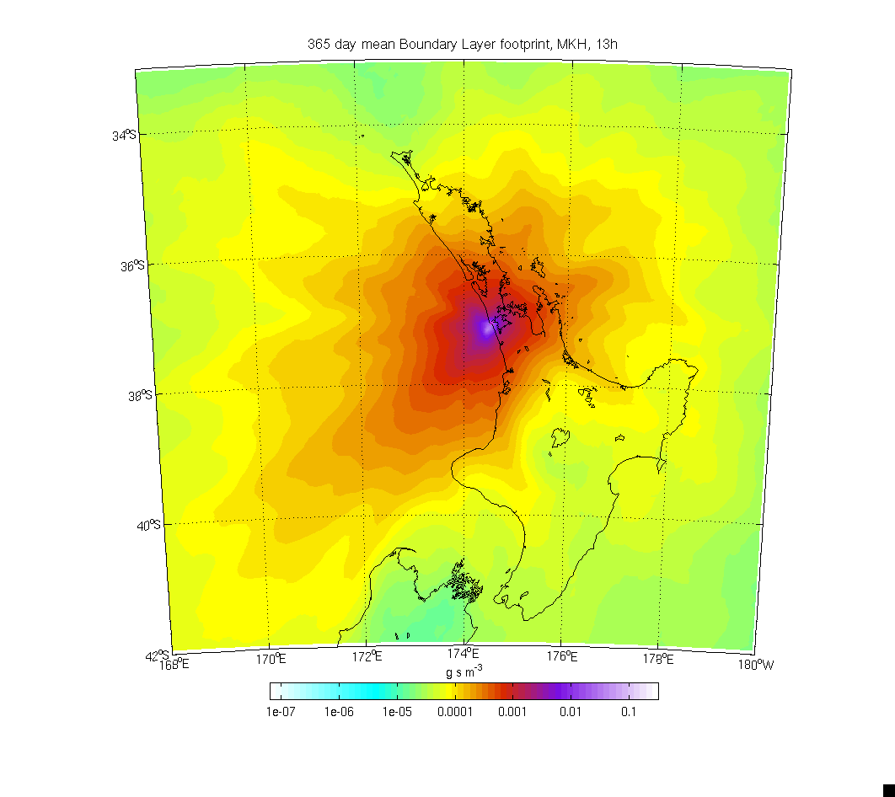
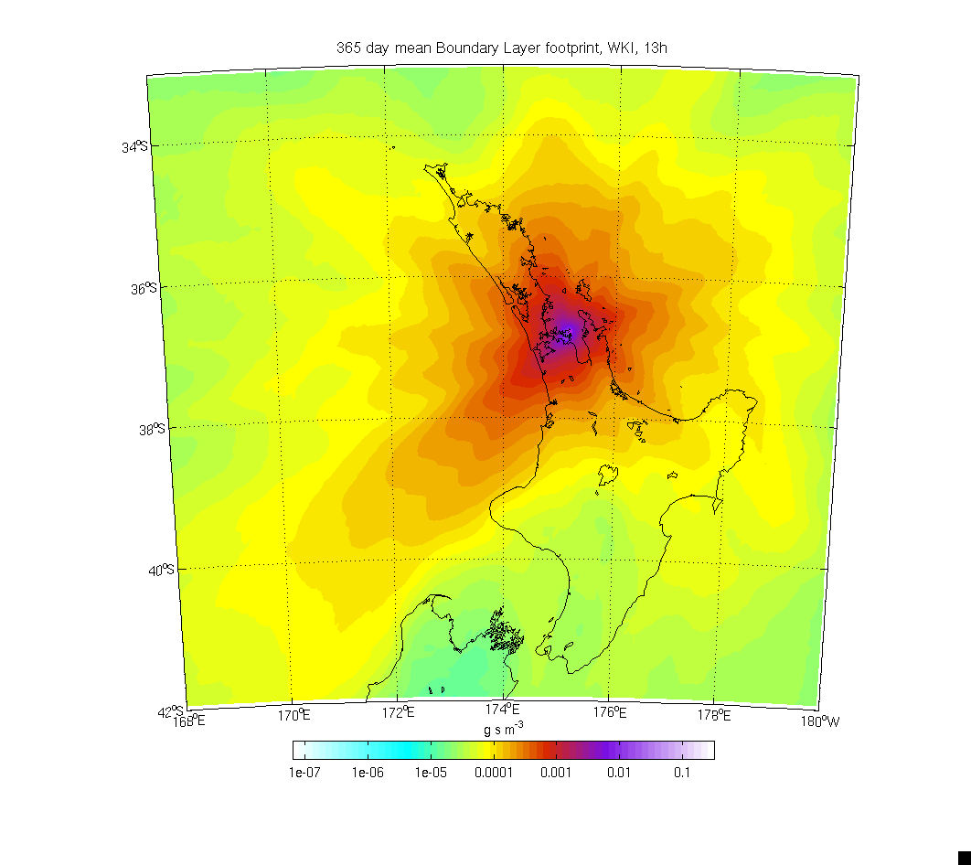
Auckland Area Inverse models
Daily simulations for a 1 year period
Each potential site has a south west component due to the prevailing winds
Local topography shadows some sites

Slide 19
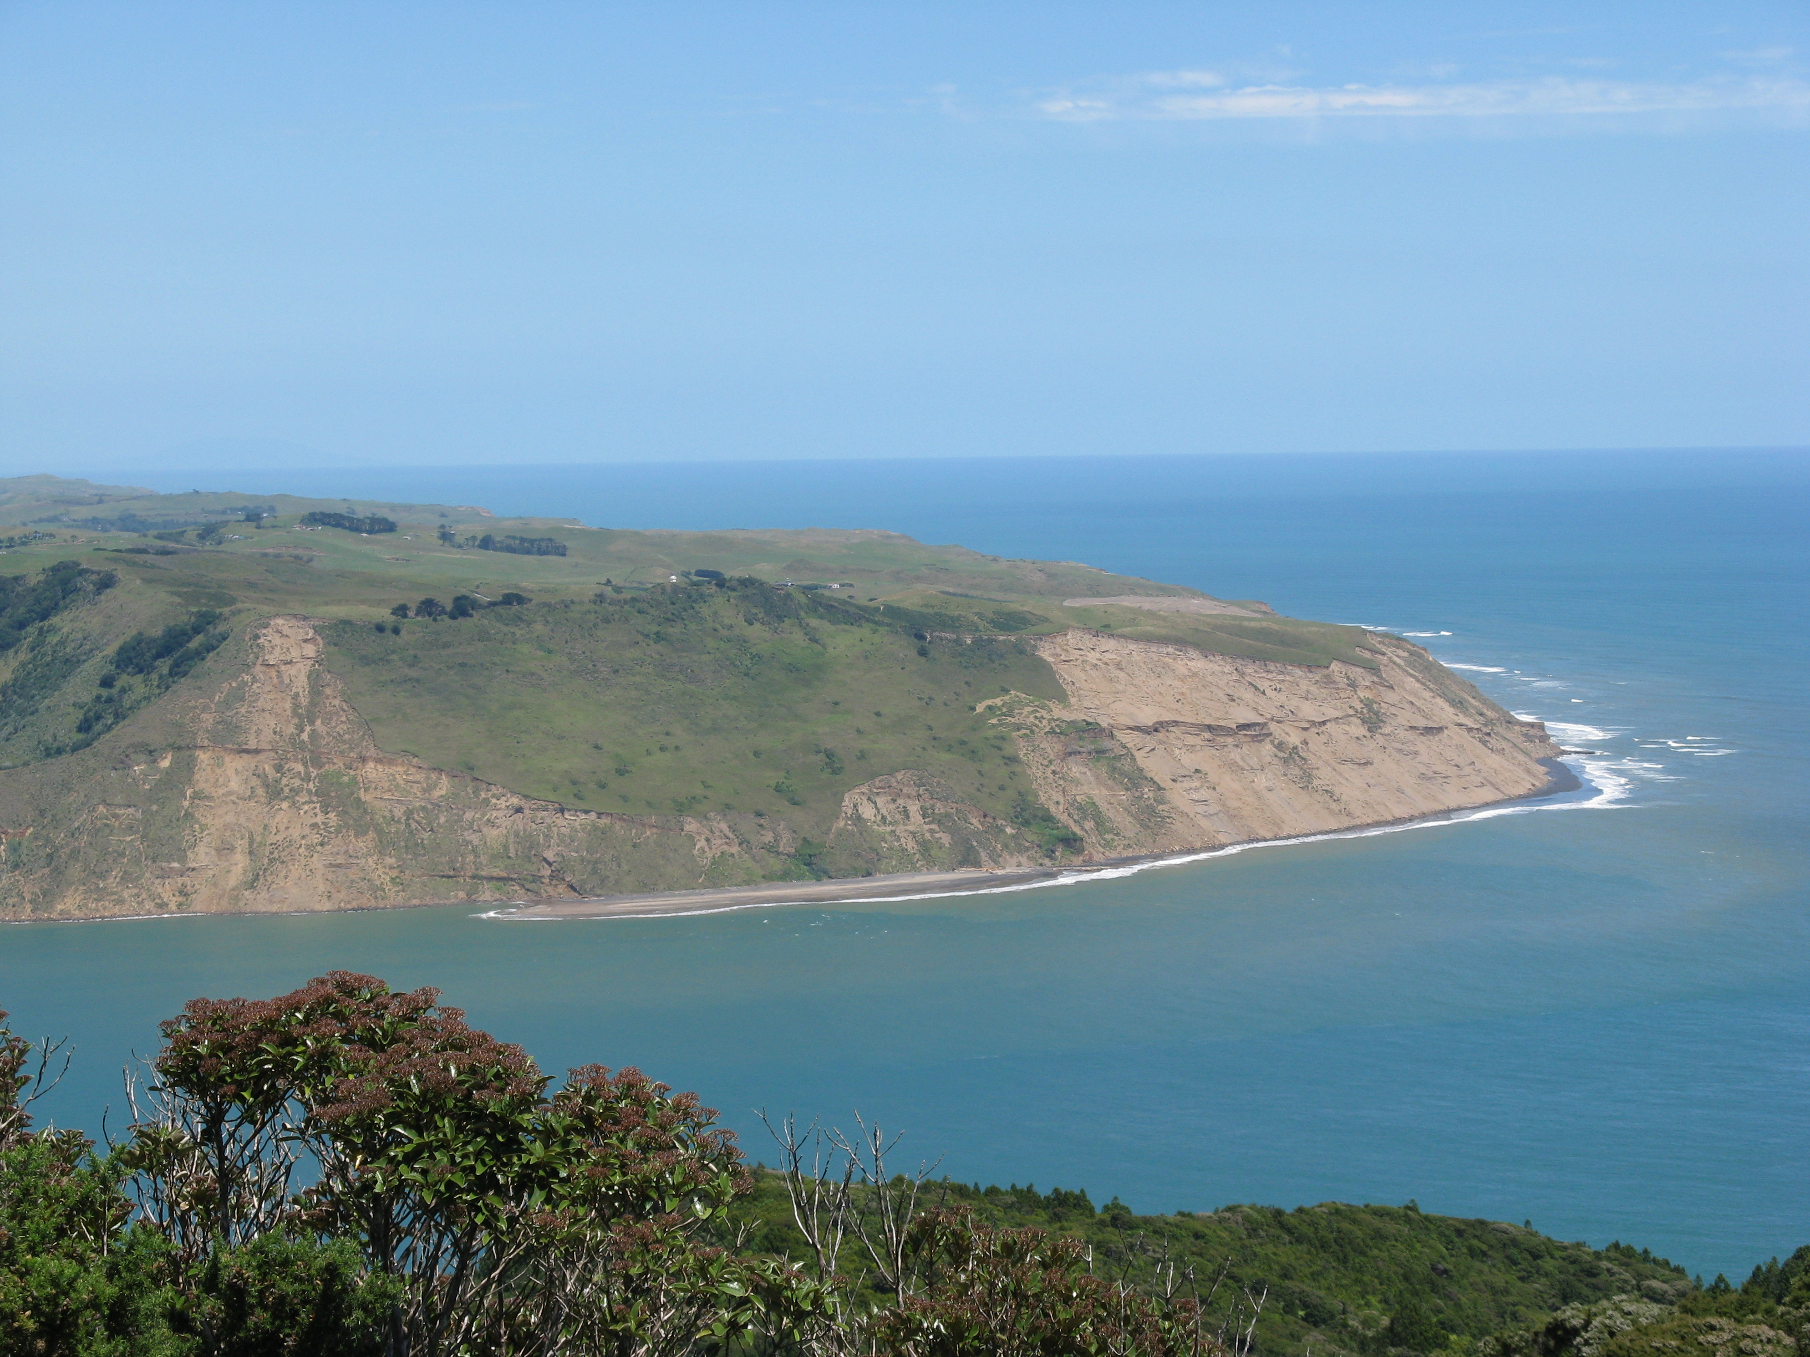
Auckland Area Inverse models
Indications are that of the potential sites the Manukau Heads site on the west coast and to the west of Auckland city will be most ideal. It would observe
  Background air off the Tasman sea
  Some Auckland outflow
  Some greater regional footprints
  Is remote direct local effects

Slide 20
CO2 – source/sink modelled daily for BHD and LAU

Slide 21
Summary
Observation station additions have been assessed to enhance the New Zealand GHG network.
The inclusion of inverse modelling improves the selection process by indicating areas not yet observed, (and simulating what would be observed)
The potential of an enhanced network to verify inventories from the top-down will provide active feedback on reductions and compliment bottom-up methods
Methane is a significant GHG for New Zealand, by adding CH₄ to these verification methods will speed up mitigation processes.

Slide 22
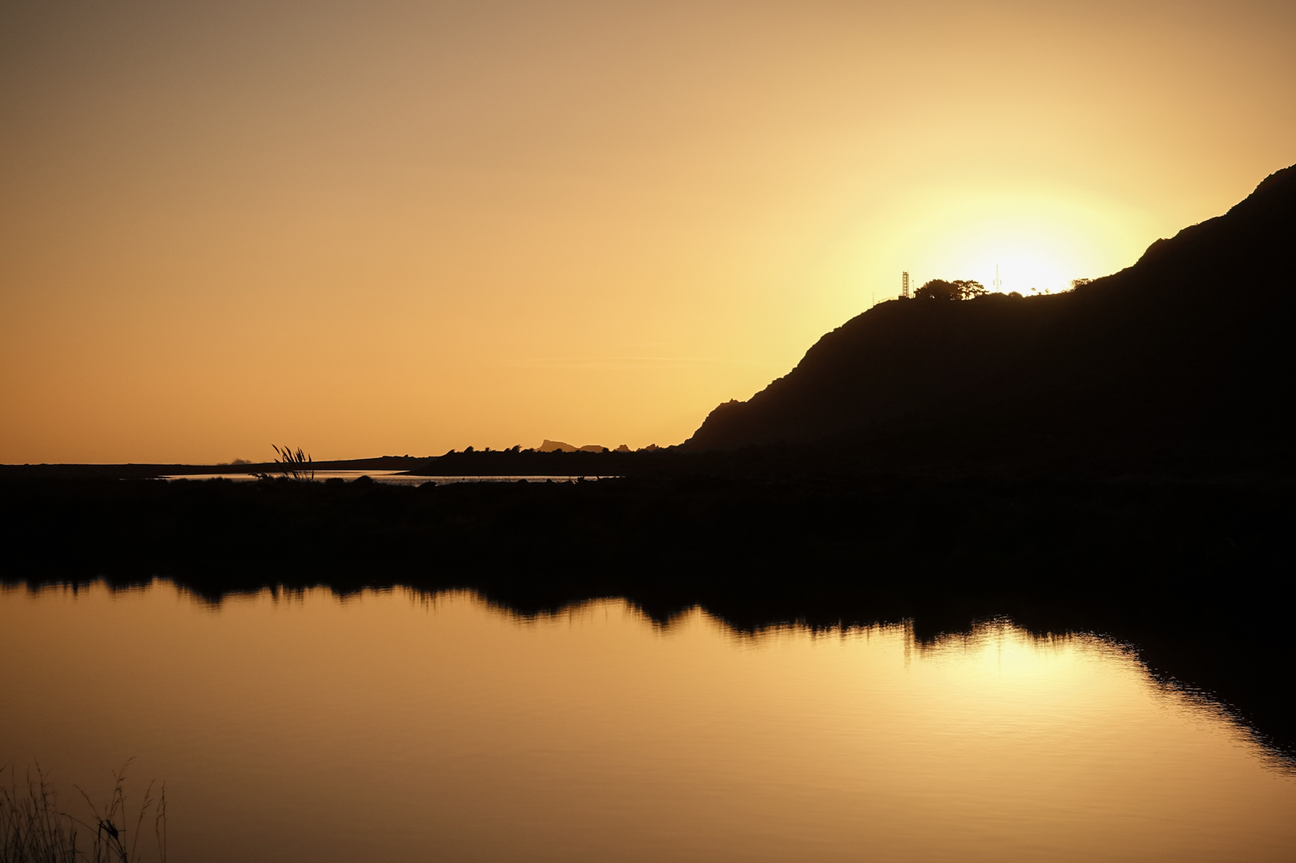
Thankyou

