Slide 1
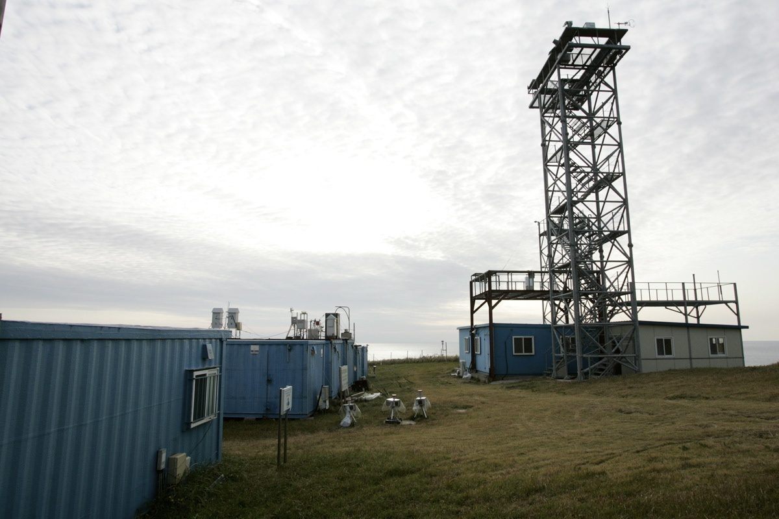

Toward resolving the mysterious budget discrepancy of ozone-depleting CCl₄: Top-down emissions in China
The 8TH Asia-Pacific GAW Workshop on Greenhouse Gases
Oct. 2016
Sunyoung Park
Kyungpook National University
Gosan Station (Jeju Island, Korea)
Shanlan Li, Sunyoung Park, Mi-Kyung Park, Chon Ok Jo, Jens Mühle, Ray F. Weiss, Ronald G. Prinn

Slide 2
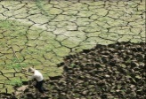

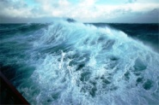



What is ‘Carbon Tetrachloride (CCl₄)’?
Ozone Depletion Substances (ODSs) and Greenhouse Gases (GHGs)
Any chemical containing Cl and/or Br that can be transported to the stratosphere, where it breaks down releasing reactive Cl and/or Br that can significantly destroy stratospheric O₃ in the context of the “Montreal Protocol”
Montreal Protocol: an international agreement designed to protect the stratospheric ozone layer by controlling ODS production and consumption. There are more than 100 ODSs identified for regulation under the protocol.
CCl₄: Dry cleaning and fire-extinguishing agent

Slide 3
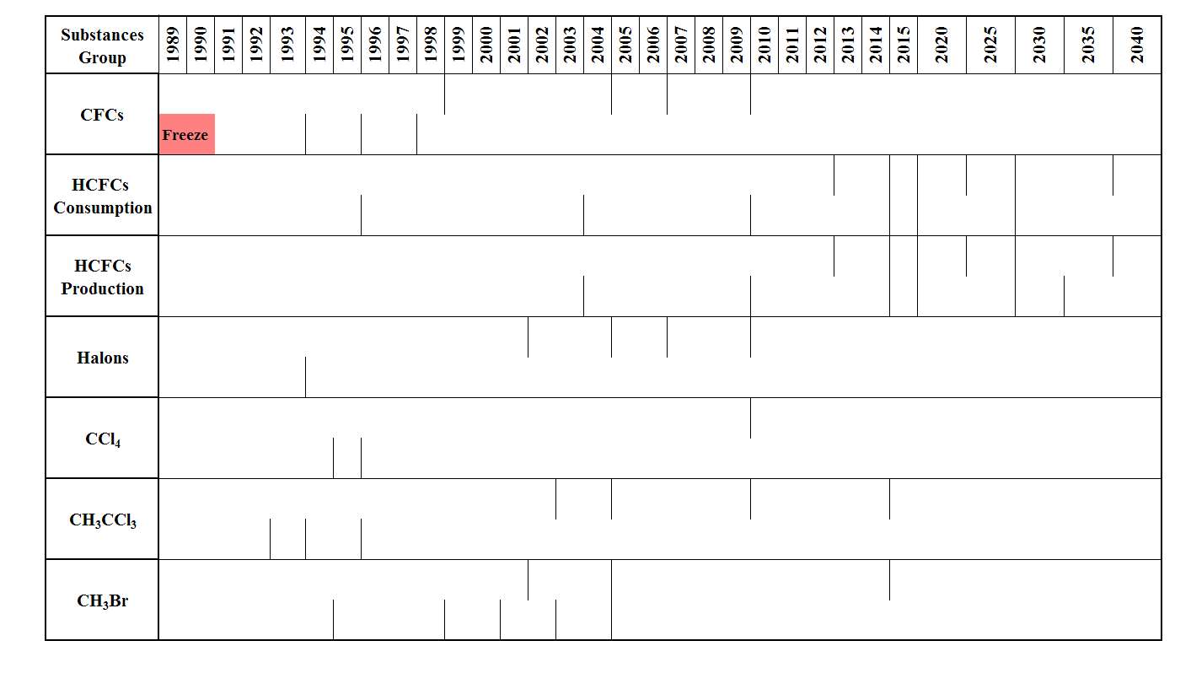
Phase-out of CCl₄ under the Montreal Protocol
Freeze
-100%
CFCs
Freeze
-100%
HCFCs
consumption
HCFCs
production
Halons
CCl₄
CH₃CCl₃
CH₃Br
Developed ( ) and developing ( ) countries for the purposes of the protocol
Production and consumption of CCl₄ are frozen along with CFCs, other halogenated solvents, and halons under the Montreal Protocol and its Amendments
UNEP 2008

Slide 4
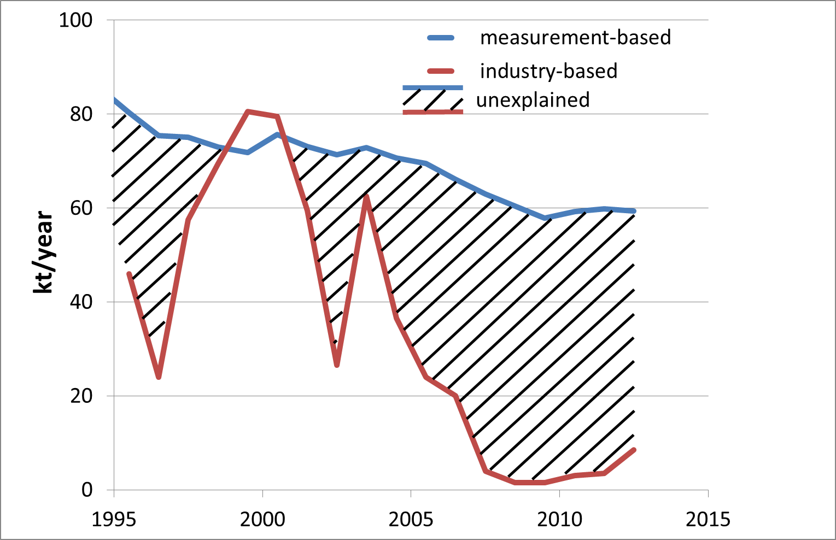
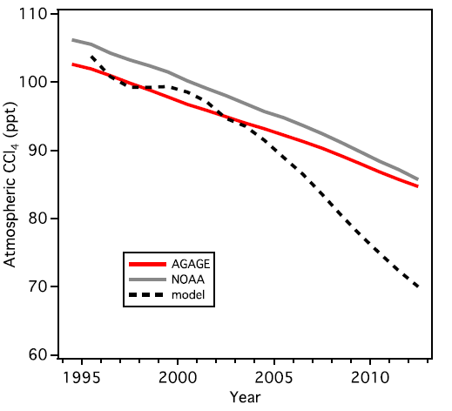
Mystery of CCl₄?
reality
industry-based emissions
WMO/UNEP Ozone Assessment 2014
Parties to the Montreal Protocol reported zero new CCl₄ emissions between 2007-2012.
Worldwide emissions of CCl₄: still approx. 30% of peak emissions prior to the international treaty [Liang et al., 2014]
There are either unidentified industrial leakages, large emissions from contaminated sites, or unknown CCl₄ sources!
Notes:
With zero CCl4 emissions reported between 20072012, atmospheric concentrations of the compound should have declined at an expected rate of 4
percent per year. Observations from the ground showed atmospheric concentrations were only declining by 1 percent per year.

Slide 5
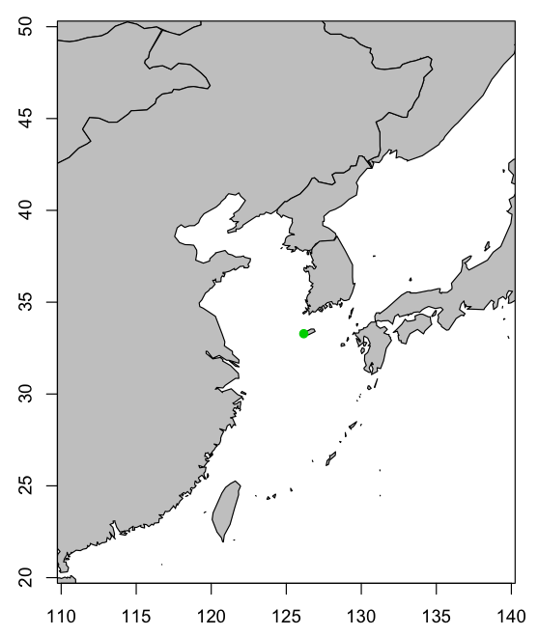

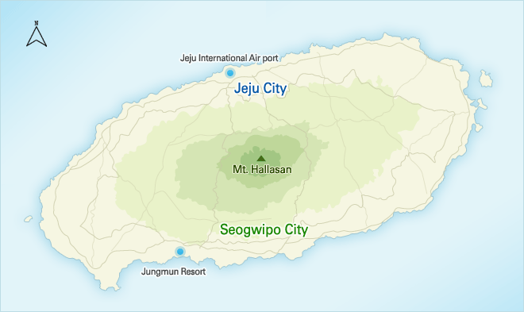
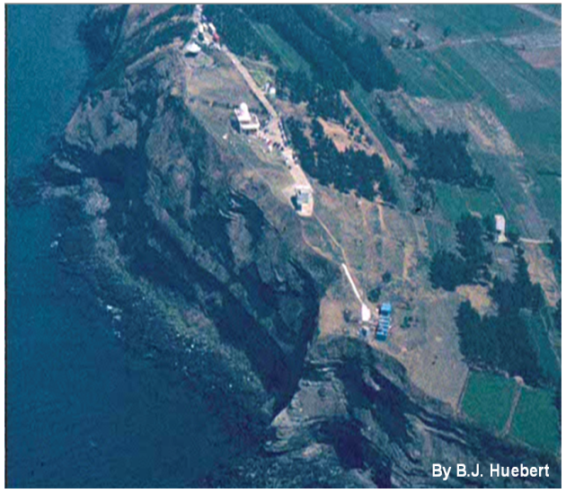
Gosan, Jeju Island – GHGs & ODSs monitoring station
Significant emissions of CCl₄ from growing non-reporting economies (e.g. East Asia) should also be verified through direct atmospheric measurements carrying out “top-down” assessment!
GOSAN
Jeju Island
Korean first monitoring station for natural and synthetic GHGs and ODSs in global networks (e.g., CO₂ networks, GLOBALVIEW, and WMO-GAW, AGAGE etc)

Slide 6
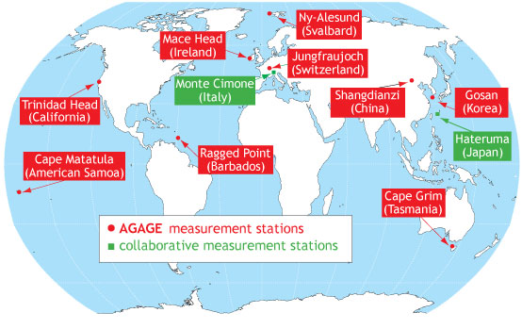

Gosan, Jeju Island – GHGs & ODSs monitoring station
AGAGE Network: (Advanced Global Atmospheric Gases Experiment) ALE (1978) - GAGE - AGAGE
Gosan (Korea):
Ideally located to monitor both background and polluted air masses
Hateruma (Japan):
far from pollution source regions
Shangdianzi (China):
Too close to pollution source regions near Beijing
“AGAGE is distinguished by its capability to measure over the globe at high frequency almost all of the important species in the Montreal Protocol (e.g. CFCs and HCFCs) to protect the ozone layer and almost all of the significant non-CO₂ gases in the Kyoto Protocol (e.g. HFCs, PFCs, and nitrous oxide) to mitigate climate change.”
- AGAGE brochure

Slide 7
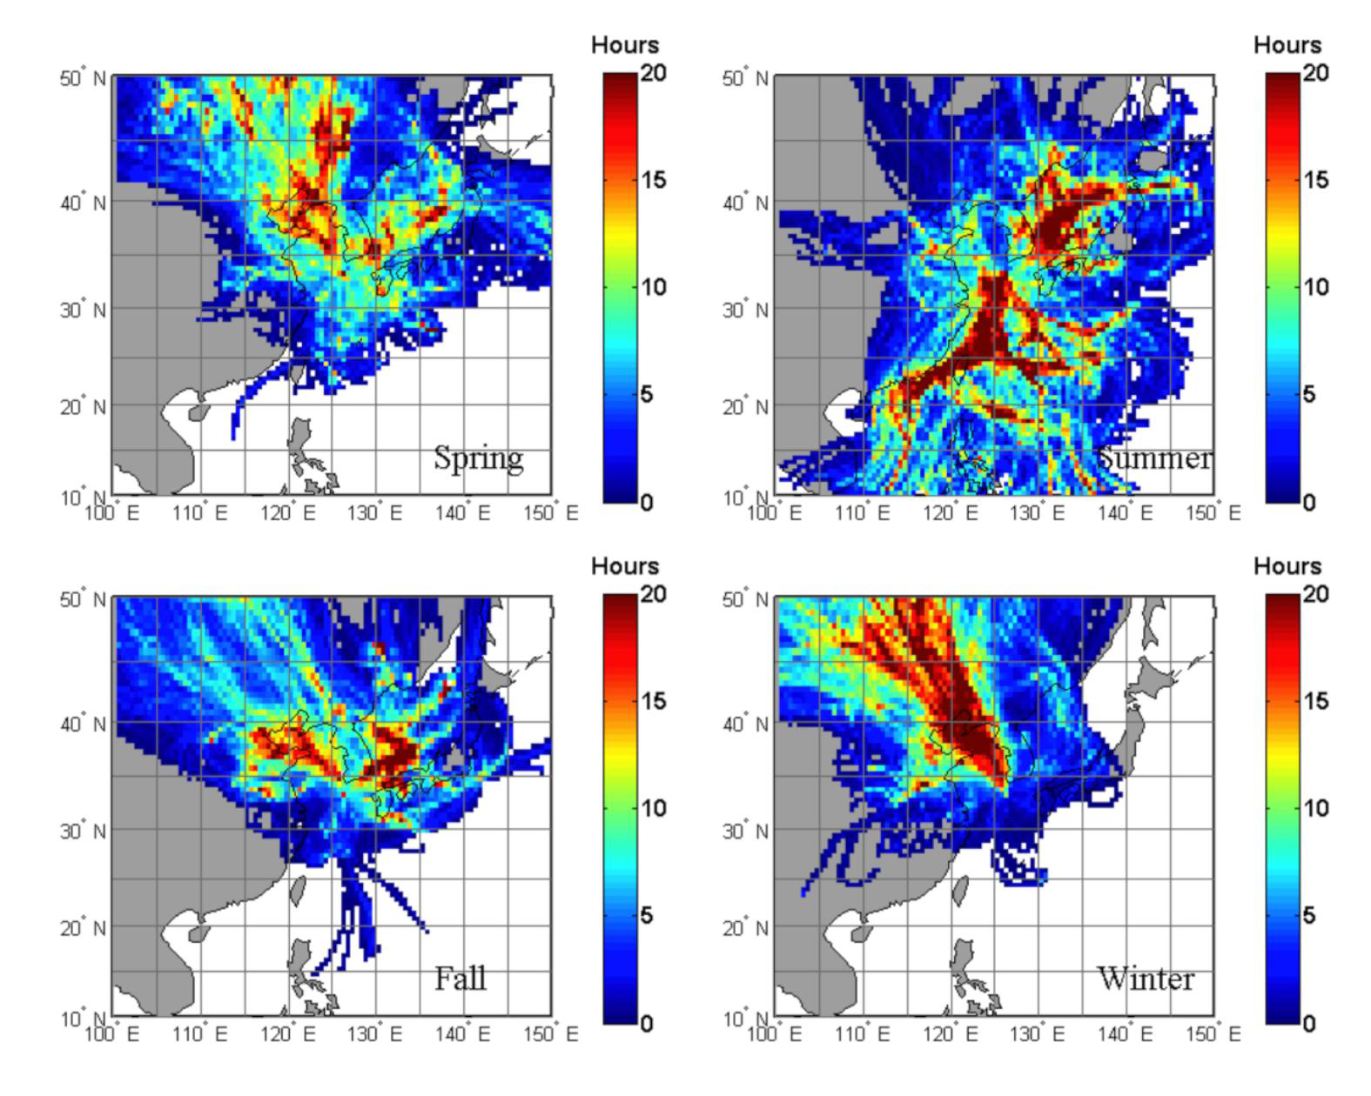
Gosan, Jeju Island – GHGs & ODSs monitoring station
Ideal location for monitoring both NH background air masses and Asian continental outflows!
Regional background: clean air from Pacific Ocean in summer and from Siberia in winter
Regional pollutions: air masses crossing over China, Korea, and Japan
Spring
Summer
Fall
Winter
Seasonal wind patterns
HYSPLIT residence time analysis for 2008

Slide 8
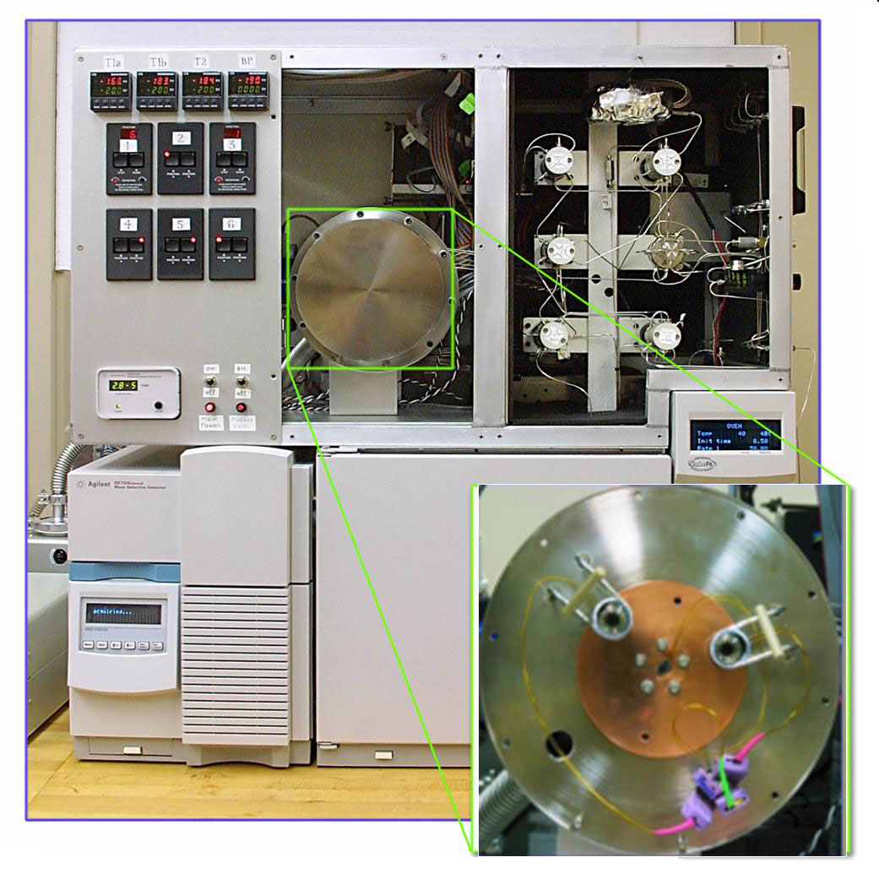
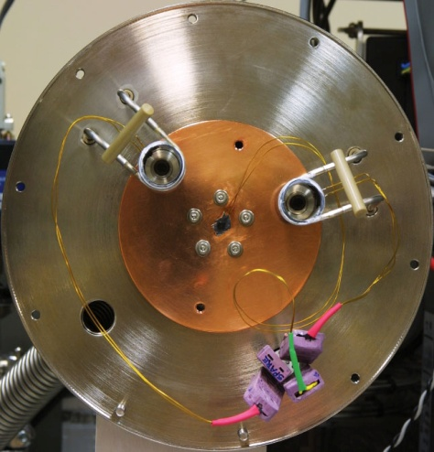
Measurements of Halogenated Compounds
Medusa GC-MS
GC-MS with a pre-concentration system, Medusa
  Simultaneous measurements of > 40 species with better than 1% of precision
  Automated to measure air samples every two hours.
  Calibrated on the SIO calibration scale.
  Operated under the AGAGE Network
Agilent 5973
Cryogenic vacuum chamber

Slide 9

CCl₄ at Gosan
Mace Head
(Ireland)
Gosan
(Korea)
Cape Grim
(Tasmania)
Used as a solvent or a feedstock for production of CFCs and their replacements.
Regulated under the Montreal Protocol; but feedstock uses are not regulated.

Slide 10
CCl₄ at Gosan: Pollutions
Mace Head
(Ireland)
Gosan
(Korea)
Cape Grim
(Tasmania)
Pollution events correspond to outflow of polluted air masses from the Asian continent.
Notes:
2012년의 AGAGE baselines의 포인트는 거의 없음 → 확인요망, 알고리즘의 오류가 있는 듯 함.

Slide 11

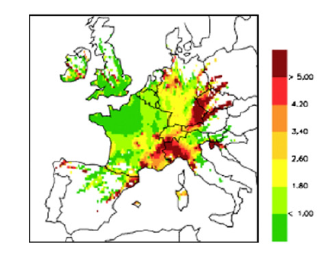
Regional distributions of CCl₄ emission sources
Discussions
Identification of Potential Source Strength: Trajectory Statistics
ppt
Gosan
Reimann et. al. (2008)
HFC-134a potential source strength (ppt)
from measurements at Jungfraujoch
2008 − 2011
Assume that the elevated concentrations at an observation site are proportional to a residence-time-weighted mean concentration on the grid cells that air masses have travelled over.
Notes:
Compute a residence-time-weighted mean concentration on all the grid cells where trajectories have been passing over
Assume that the elevated concentrations at an observation site are proportional to the mean concentration on the grid cells that air masses have travelled over.
Potential source regions investigated by enhanced pollution concentration at Gosan with statistical trajectory model, using HYSPLIT model.

Slide 12
Regional distributions of CCl₄ emission sources
Discussions
Identification of Potential Source Strength: Trajectory Statistics
ppt
Shandong
Henan
Jiangsu.
Gosan
Hubei
Zhejiang
Reimann et. al. (2008)
HFC-134a potential source strength (ppt)
from measurements at Jungfraujoch
2008 − 2011
Assume that the elevated concentrations at an observation site are proportional to a residence-time-weighted mean concentration on the grid cells that air masses have travelled over.
Southern China near Zhejiang, Shandong and Jiangsu (where large chemical factories are located) provinces and the interior region (e.g. Henan and Hubei provinces) can be main source regions for CCl₄ enhancements observed at Gosan.
Notes:
Compute a residence-time-weighted mean concentration on all the grid cells where trajectories have been passing over
Assume that the elevated concentrations at an observation site are proportional to the mean concentration on the grid cells that air masses have travelled over.
Potential source regions investigated by enhanced pollution concentration at Gosan with statistical trajectory model, using HYSPLIT model.

Slide 13
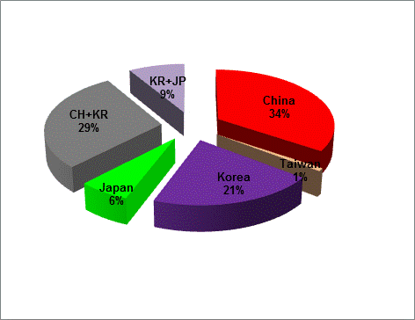
Back trajectory analysis: air-mass classification
Even contribution throughout the period
China
Observed in summer
Taiwan
Trajectory domains
CCl₄ [ppt]
Observed throughout the period
Korea
Relatively evenly distributed
Japan
2009
Analysis of back-trajectories that arrived at Gosan staying under the surface boundary layer of 2 km high
The air masses of which trajectories have passed through two regions, are classified as blended air.
Notes:
In order to calculate the emissions for each country, we need to classify the measurement data by the regional influence. Look at the figure, we defined regional grid boxes representing each country, and if a trajectory stayed below the planetary boundary layer for more than 1 hour in one of the four regional grid boxes, the air mass were retained in analysis. Periods with mixed air events were excluded from further analysis.
This figure shows an example of our trajectory-based origin separation, SF6.
Most pollution events were monitored when air mass originated from China mainland. The important consideration is the seasonal distribution of measurement data by region. Transport from China mainland and Korea was distributed over all throughout the year. Transport from the Taiwan region is restricted to summer.

Slide 14
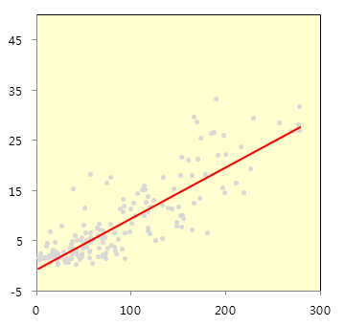
Top-down estimates of country-based emissions
Tracer-tracer correlation analysis on Chinese source pollution data
A reference compound with well-defined country-scale emissions
Based on compact empirical correlations of the reference compound with others, emissions of the other compounds can be estimated.
Slope=0.11±0.02
R²= 0.7
CCl₄ [ppt]
E_{x} = E_{R} ⅹ Δ C_{x}/ΔC_{R} ⅹ M_{x}/M_{R}
HCFC-22 [ppt]
What can be REFERENCE compounds?
Well-defined emission rates
Good correlations with as many as other species
emission
of reference
empirical
slope
Li et al., EST, 2011
Notes:
위 그림은 6년 반의 모든 자료가 들어있나요? 다음 슬라이드의 2014자료를 보면 위 그림에는 없는 듯 한데…
일단 compact하다는 인상을 주기에는 좀 부족함. X축의 scale을 300까지 하고, y축도 -10에서 45정도까지 올리는 것 나을 듯.
그리고 p< ???? 이런 것도 넣어주면 좋겠음.
전체 그림이 가능한 정사각형이 되도록 조정 바람.
* 사용한 HCFC22의값은???
포인트들의 색을 좀 흐린 쪽으로 선택하고 circle 사이즈도 줄일 것, 대신 라인은 좀 더 굵고, 진하게 바꿀 것.

Slide 15
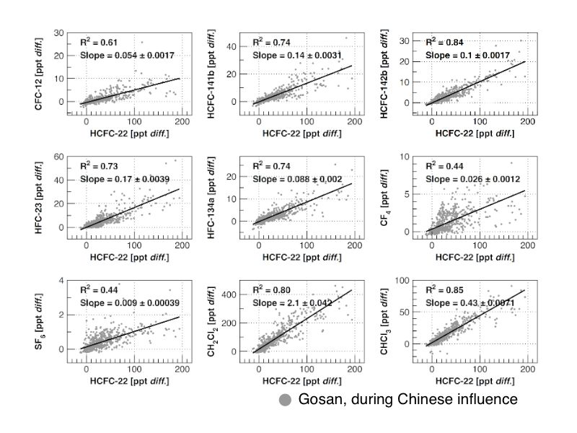
Top-down estimates of country-based emissions
Empirical interspecies correlations for China
ΔC_{X}
ΔC_{Reference}
Li et al., EST, 2011

Slide 16
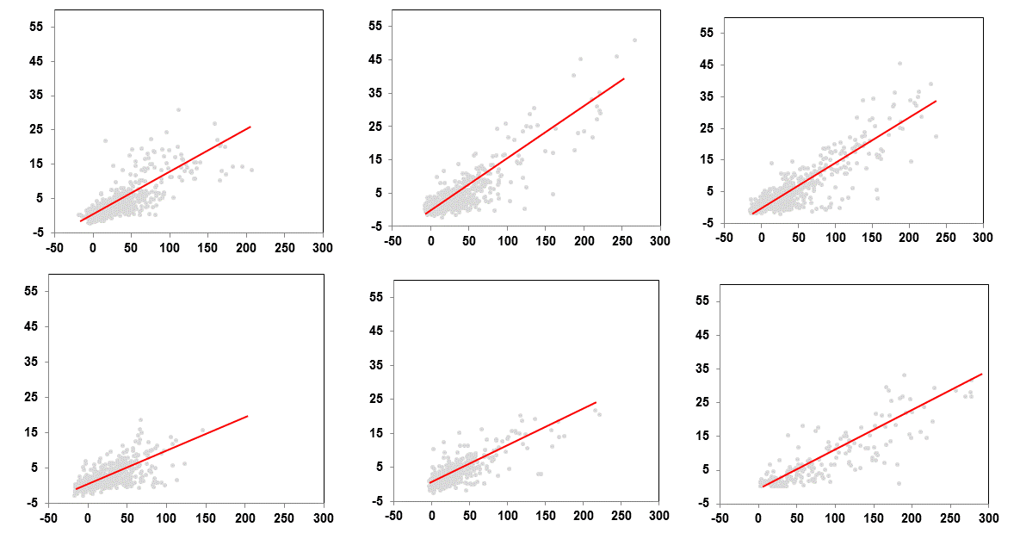
Top-down estimates of country-based emissions
Tracer-tracer correlation analysis on Chinese source pollution data
2008
2009
2010
Slope = 0.13±0.01
P <0.01
Slope = 0.16±0.01
Slope = 0.15±0.01
CCl₄ [ppt]
Slope = 0.10±0.02
Slope = 0.10±0.01
Slope = 0.11±0.02
2011
2012
2013
HCFC-22 [ppt]
HCFC-22 is a reference compound for China.
Pre-2010 vs. post-2010 correlations are statistically different, implying emission decline by ca. 30% from 2010 to 2011 when constant emission of HCFC-22 is assumed.
Notes:
마찬가지로 포인트들의 색을 좀 흐린 쪽으로 선택하고 circle 사이즈도 줄일 것, 대신 라인은 좀 더 굵고, 진하게 바꿀 것.
중요: slope값의 변화가 결국 ccl4 emission의 연 변동으로 연결되려면 결국, HCFC22의 연배출량이 2008년부터 2013년까지 거의 변화가 없다는 가정 혹은 근거 자료가 필요함
아니면, Fang의 FLEXPART 연 산출값을 사용했는지…??
Slope과 함께 배출량을 적어두는 것이 좋겠음.
슬라이드의 wording들은 그래프 완성후 다시 정리할 것임.

Slide 17
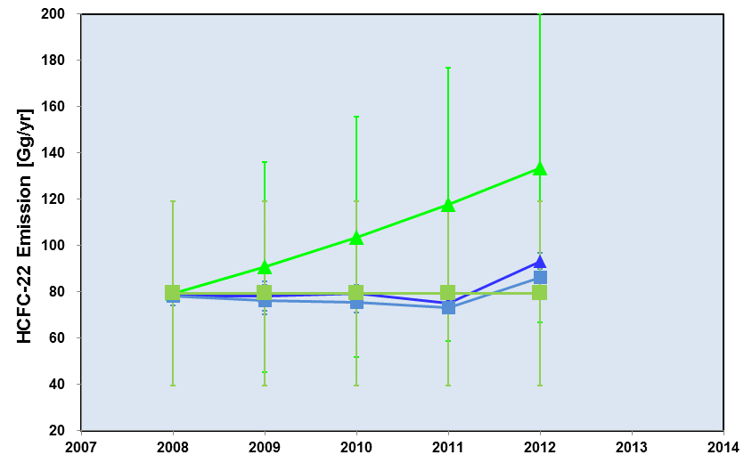
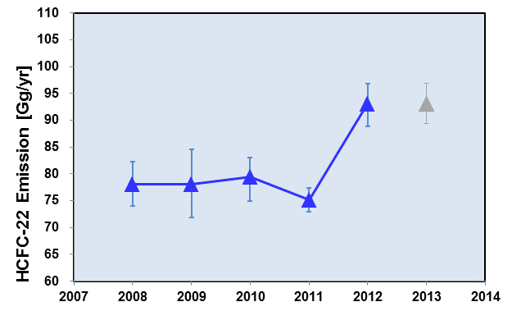
Top-down estimates of country-based emissions
Tracer-tracer correlation analysis on Chinese source pollution data
HCFC-22 emissions
A priori (Wan et al., 2009)
A posteriori (Fang et al., 2013)
(b)
80.8 ± 4.0 Gg yr⁻¹ (a)
A posteriori from varying a priori
Fang et al., 2013
A priori: constant
A posteriori from constant a priori
Annual Chinese emissions of HCFC-22 were determined by an inverse model (FLEXPART, Stohl et al., 2010)
For estimation of Chinese CCl₄ emissions, (a) average of 80.8 ± 4.0 Gg/yr of HCFC-22 emission from 2008 to 2012; (b) yearly varying HCFC-22 emissions are used.
Notes:
위 그림은 6년 반의 모든 자료가 들어있나요? 다음 슬라이드의 2014자료를 보면 위 그림에는 없는 듯 한데…
일단 compact하다는 인상을 주기에는 좀 부족함. X축의 scale을 300까지 하고, y축도 -10에서 45정도까지 올리는 것 나을 듯.
그리고 p< ???? 이런 것도 넣어주면 좋겠음.
전체 그림이 가능한 정사각형이 되도록 조정 바람.
* 사용한 HCFC22의값은???
포인트들의 색을 좀 흐린 쪽으로 선택하고 circle 사이즈도 줄일 것, 대신 라인은 좀 더 굵고, 진하게 바꿀 것.

Slide 18
Top-down estimates of country-based emissions
CCl₄ emissions
Palmer et al. (2003)
This study (b)
Vollmer et al. (2009)
This study (a)
Wan et al. (2009)
Preliminary results
CCl₄ emissions in China between 2008 and 2010 were in the range between 18.7 ± 2.9 and 23.3 ± 2.7 Gg yr⁻¹.
Post-2010 bottom-up emissions of CCl₄ in China have been reported to be near zero (Wan et al., 2009). However, top-down estimates after the year of 2011 are still significant in the range between 13.8 ± 3.1 Gg yr⁻¹ and 18.7 ± 4.9 Gg yr⁻¹

Slide 19
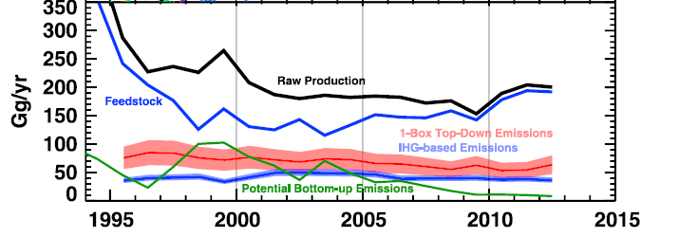
Top-down estimates of country-based emissions
Liang et al., 2014
Chinese emissions from 2008 to 2013 are about 26% and 46% of the global emissions estimated based on a 1-box top down approach (25 years of lifetime) and on an inter-hemispheric gradient method (35 years of lifetime) using AGAGE and NOAA GMD measurements, respectively.

Slide 20
Top-down estimates of country-based emissions
Liang et al., 2014
One-box top-down emissions
IHG based emissions
China’s emissions (b)
China’s emissions (a)
Bottom up emissions
Preliminary results
Chinese emissions from 2008 to 2013 are about 26% and 46% of the global emissions estimated based on a 1-box top down approach (25 years of lifetime) and on an inter-hemispheric gradient method (35 years of lifetime) using AGAGE and NOAA GMD measurements, respectively.

Slide 21


Identification of industry-based CCl₄ emission sources
Positive Matrix Factorization (PMF) analysis
on the time series of 20 halogenated compounds
PMF: a weighted least-squares optimization equation to convert data to a set of profile
A weighted least-square fit to the measurement data to determine the optimal values of p (the number of source factors), g (%, the compound fraction in each source factor) and f (ppt, the contribution of each source factor to the observed totals)
Optimization of the three terms above until the model residuals (Q values) reaches its minimum
Seven major industrial sources (p = 7) were identified from the enhanced concentrations of 20 HCs observed at Gosan.
Notes:
For this we applied the Positive Matrix Factorization model. This method is optimizing a weighted least square to obtain a best fit to the measurement data following this mathematical equation. In the PMF analysis, we should resolve the number of factors (p). The optimal value of p is determined when Q is minimized following equations.

Slide 22
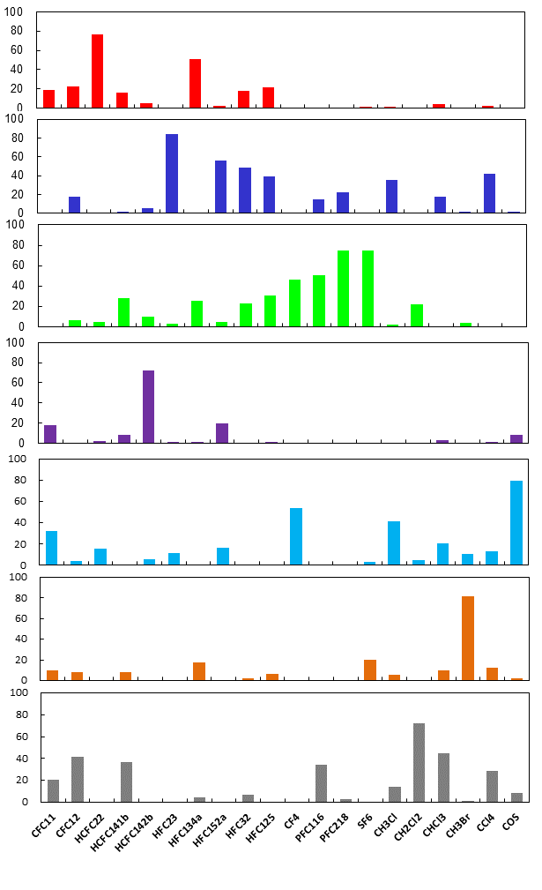
Identification of industry-based CCl₄ emission sources
CFCs
HCFCs
HFCs
PFCs & SF₆
Others
[1]
Refrigeration Replacement:
HCFC-22 and HFC-134a
[2]
Fugitive emissions from HCFC/HFC refrigerant production: HFCs (HFC-23)
Source contribution (%)
[3]
Semiconductor/electronic industry:
PFCs (SF₆ and C₃F₈)
[4]
Foam blowing: HCFC-142b
[5]
Aluminium production: CF₄ and COS
[6]
Fumigation: CH₃Br
[7]
Solvents usage: CH₂Cl₂
CFC-11
CFC-12
HCFC-22
HCFC-141b
HCFC-142b
HFC-23
HFC-134a
HFC-152a
HFC-32
HFC-125
CF₄
C₂F₆
C₃F₈
SF₆
CH₃Cl
CH₂Cl₂
CHCl₃
CH₃Br
CCl₄
COS
Li et al., EST, 2014
Notes:
The seven factors were statistically resolved in measurement data after operating this model. And We should identify the seven industrial sources of halocarbons combined with the bottom up emissions information of each species. We choose the relative higher contributions as tracer to identifying these factors. For example, the first factor is characterized by relatively high contribution to HCFC-22 and HFC-134a. HCFC-22 and HFC-134a most widely employed for refrigeration and air conditioning systems as replacement of CFCs. Thus indication that the first source factor must be more related to refrigeration replacement. Other source factors were identified in the same way,

Slide 23
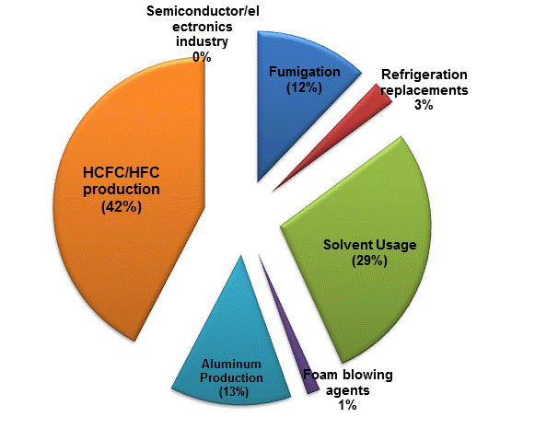
Factor 1
Identification of industry-based CCl₄ emission sources
Preliminary results
Fugitive emissions from HCFC/HFC production are the most significant contribution to the total CCl₄ concentration enhancements at Gosan (42.2±3.3%)
29.8% of the enhanced observations are explained by solvent usage.
Notes:
The seven factors were statistically resolved in measurement data after operating this model. And We should identify the seven industrial sources of halocarbons combined with the bottom up emissions information of each species. We choose the relative higher contributions as tracer to identifying these factors. For example, the first factor is characterized by relatively high contribution to HCFC-22 and HFC-134a. HCFC-22 and HFC-134a most widely employed for refrigeration and air conditioning systems as replacement of CFCs. Thus indication that the first source factor must be more related to refrigeration replacement. Other source factors were identified in the same way,

Slide 24
Summary: Preliminary Results
‘Top-down’ estimation of CCl₄ country-based emission in China using inter-species correlation analysis
  Top-down estimate of China’s emission of CCl₄ shows ~26−46% of contribution to the global totals.
  Post-2010 top-down estimates in China are still significant in the range between 13.8 ± 3.1 Gg yr⁻¹ and 18.7 ± 4.9 Gg yr⁻¹.
Identification of CCl₄ emission sources in East Asia using positive matrix factorization analysis.
  Fugitive emissions from HCFC/HFC production are the most significant source, explaining 42.2±3.3% of the total CCl₄ concentration enhancements observed at Gosan from 2008 to 2013.
  29.8% of the enhanced observations are contributed by solvent usage.
  Shandong, Jiangsu, Zhejiang, Henan and Hubei provinces in China could be potential source regions for CCl₄ enhancements observed at Gosan
Thank you

