Slide 1
Greenhouse Gas Monitoring in Bukit Kototabang
By
Yosfi Andri

Slide 2
Outline
Global GAW Station Bukit Kototabang
Monitoring of Greenhouse Gasses
Wildfire

Slide 3
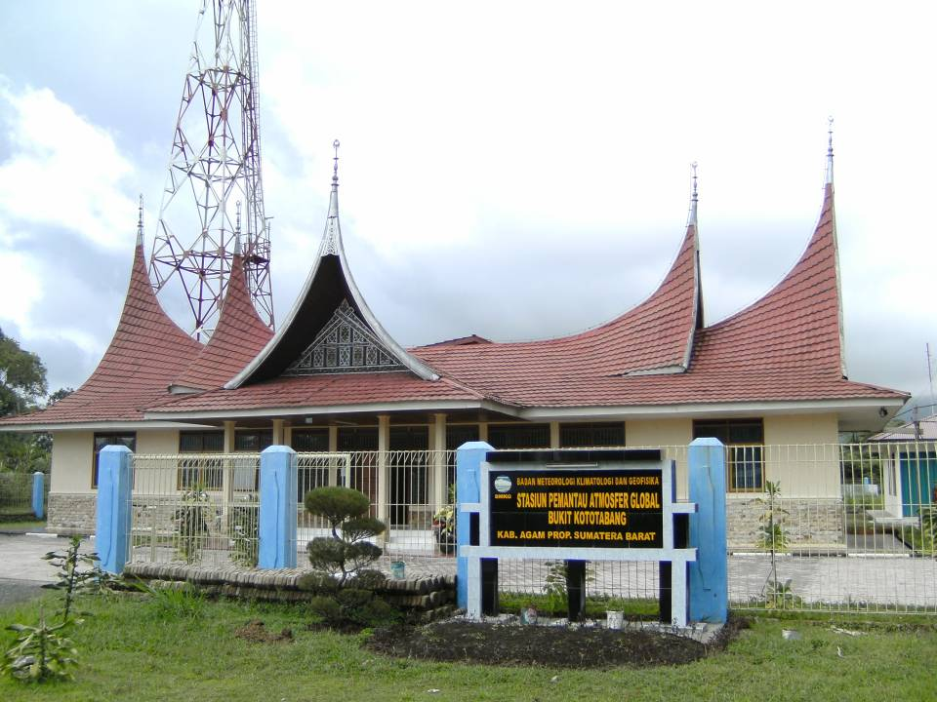
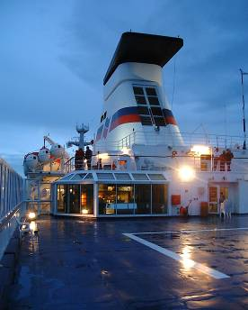
Picture slide
Global GAW Station Bukit Kototabang
Bullet 1
Bullet 1

Slide 4
Picture slide
Bullet 1
Bullet 1

Slide 5
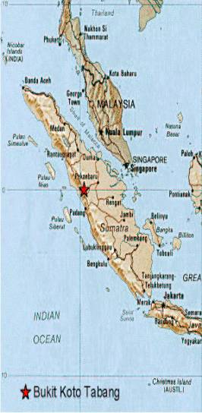
Latitude : S 0,20
Longitude : E 100,32
Province : West Sumatera
Regency : Agam
Nearest City : Bukittinggi

Slide 6
Rain Forest

Slide 7
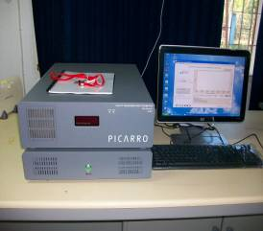
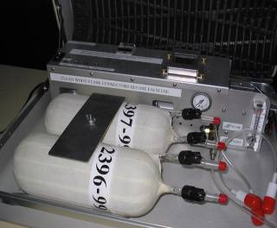
Instruments
PICARRO G1301
FLASK SAMPLING

Slide 8
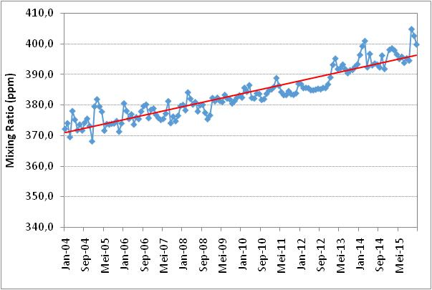
CO2 Concentration at Bukit Kototabang
Growth Rate ± 2 ppm/year

Slide 9
CO2 Concentration at Bukit Kototabang

Slide 10
CH4 Concentration at Bukit Kototabang
Growth Rate : ± 6 ppb/year

Slide 11
N2O Concentration at Bukit Kototabang
Growth Rate : ± 1 ppb

Slide 12
SF6 Concentration at Bukit Kototabang
Growth Rate : ± 0,3 ppt

Slide 13
Wildfire
Bullet Point
Bullet Point
Sub Bullet

Slide 14
Hotspot in Sumatera 2015

Slide 15
Regional Haze Situation

Slide 16
Thank You

