Slide 1
Recent progress on greenhouse gas measurements at Mt. Lulin and Dongsha Island, Taiwan
Chang-Feng Ou-Yang¹, Neng-Huei Lin¹, Jia-Lin Wang², Russell C. Schnell³
¹Department of Atmospheric Sciences, National Central University
²Department of Chemistry, National Central University
³NOAA/ESRL/GMD

Slide 2
History of baseline GHG measurements in Taiwan
CFC/VOC measurements
started at Lulin
2013 November
Mt. Lulin opened
2006 April
Typhoon Morakot
2009 August
Picarro restored
2016 September
2006 August
Mt. Lulin joined
NOAA/CCGG
2010 March
Dongsha joined
NOAA/CCGG
2011 February
In-situ measurements of
CO₂ and CH₄ started
at LABS by Picarro
2015 April
Picarro G1301
stopped
2017
New sites/
instruments

Slide 3
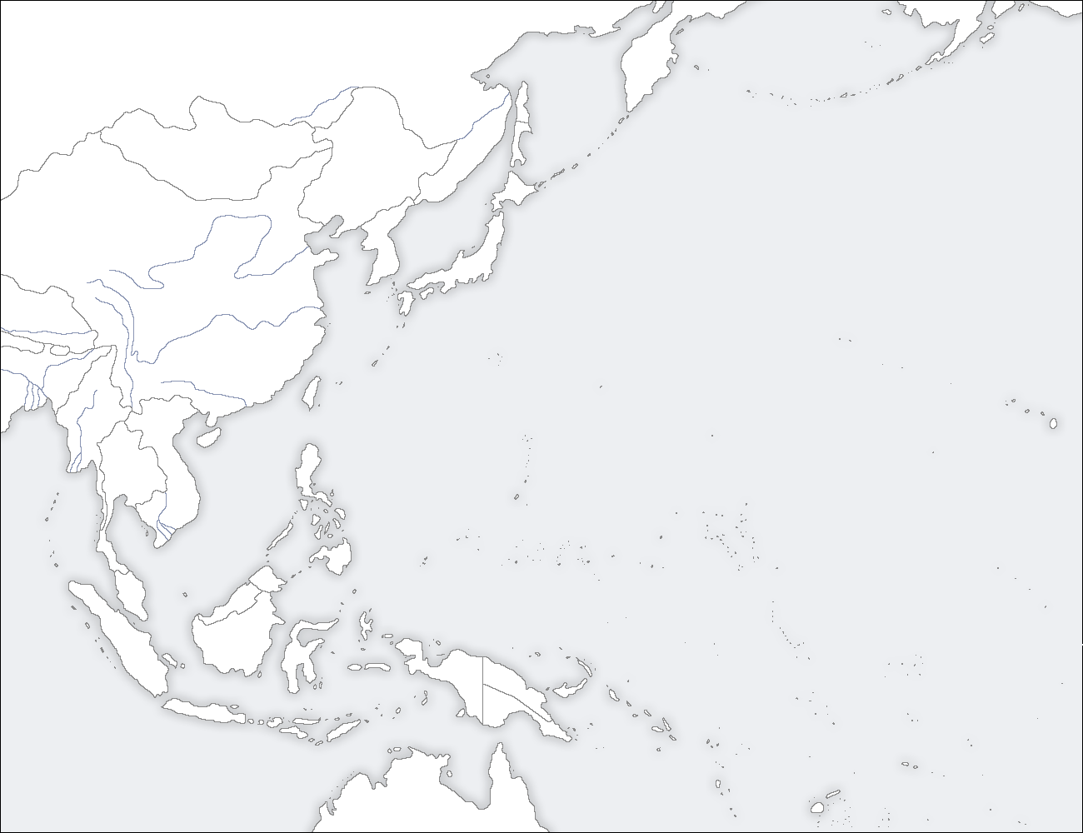
Locations
Korea
Japan
China
Lulin:
23.47°N, 120.87°E; 2862 m a.s.l.
(Free troposphere)
Dongsha:
20.70°N, 116.73°E; 5 m a.s.l.
(Sea-level)
Taiwan
Lulin Mountain (LLN)
Vietnam
Dongsha Island (DSI)
Thailand
Philippines

Slide 4
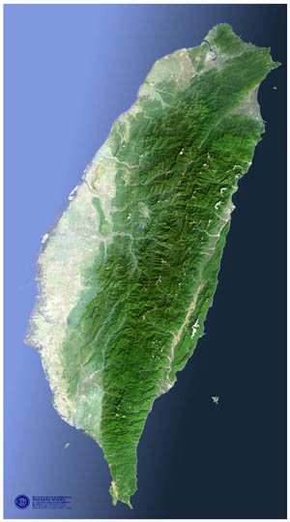
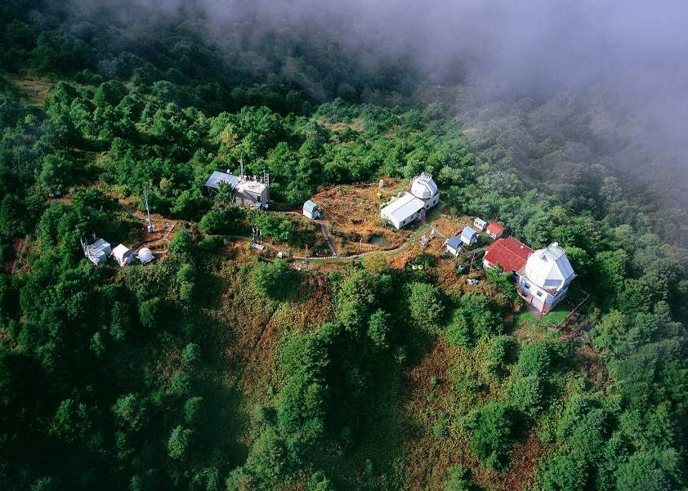
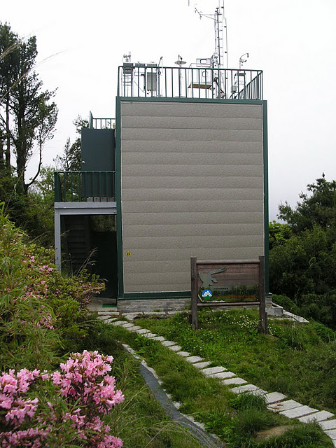
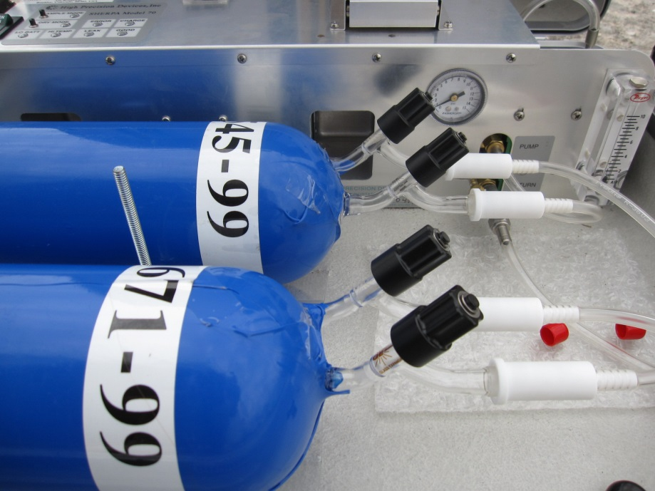

Mt. Lulin
Taiwan
(23.47°N, 120.87°E, 2862 m a.s.l.)
LLN
LLN
In-situ measurements of gases:
O₃, CO, SO₂, CO₂, CH₄
Flask air sampling (Weekly):
CO₂, δ¹³C_CO₂, δ¹⁸O_CO₂, CH₄, N₂O, SF₆, CO, H₂,
CFCs, VOCs

Slide 5
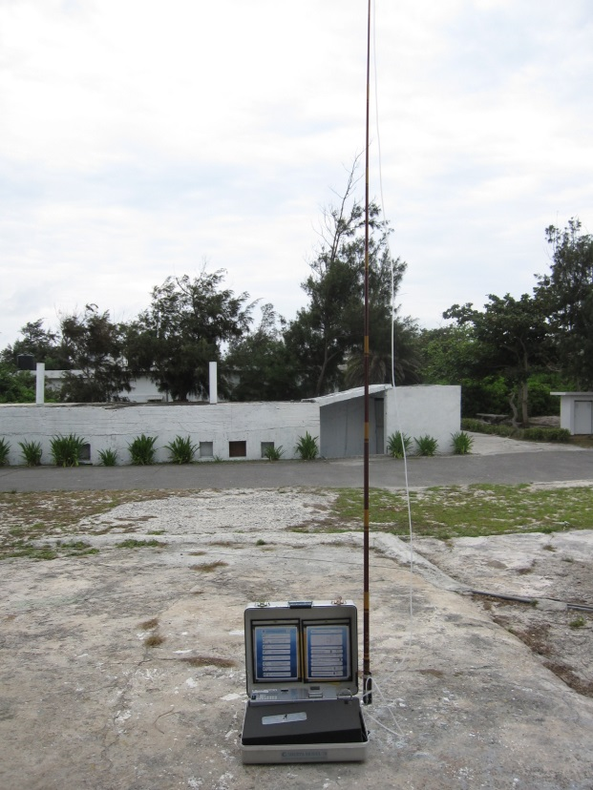
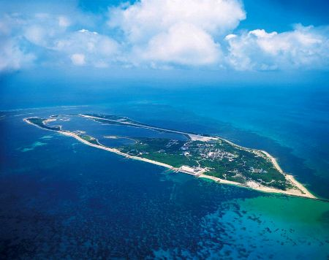
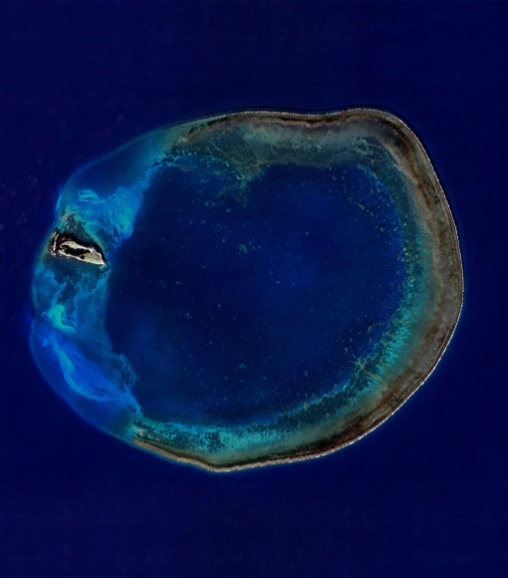
Dongsha Island
(20.70°N, 116.73°E, 5 m a.s.l.)
DSI
Flask air sampling (Weekly):
CO₂, δ¹³C_CO₂, δ¹⁸O_CO₂, CH₄, N₂O, SF₆, CO, H₂

Slide 6
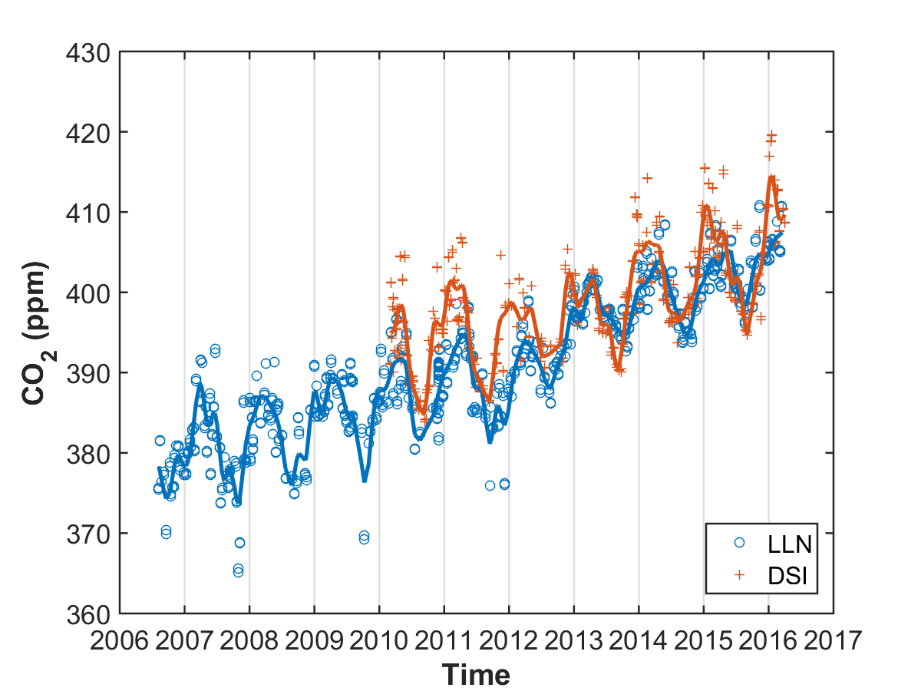
CO₂
2015
DSI:
404.60±5.28 ppm
(+2.10 ppm yr⁻¹)
LLN:
402.61±3.11 ppm
(+2.69 ppm yr⁻¹)
Notes:
MLO growth rate = 2.21 ppm yr-1

Slide 7
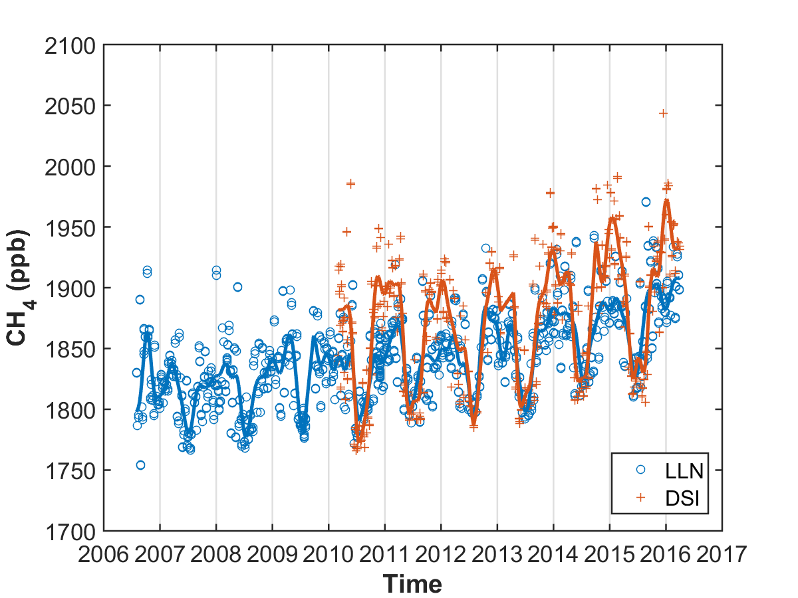
CH₄
2015
DSI:
1894.4±55.0 ppb
(+6.4 ppb yr⁻¹)
LLN:
1877.2±36.7 ppb
(+6.9 ppb yr⁻¹)

Slide 8
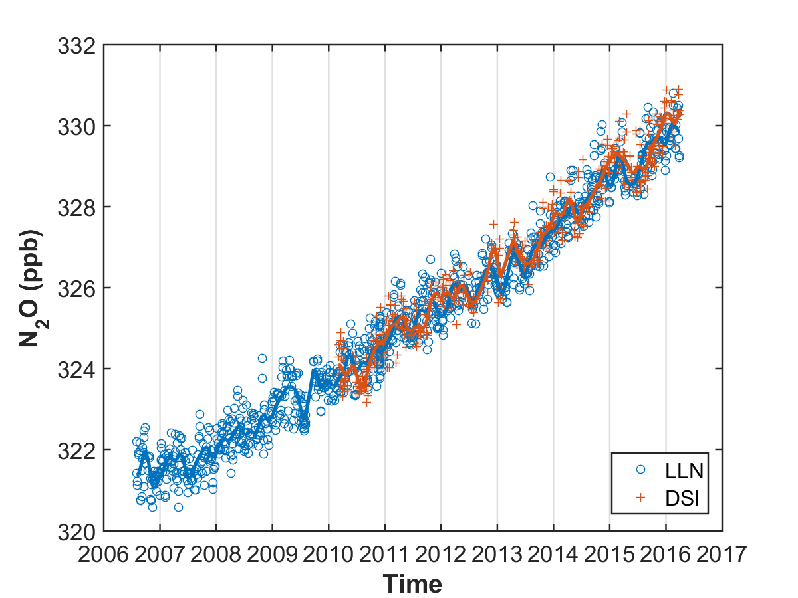
N₂O
2015
DSI:
329.3±0.6 ppb
(+1.1 ppb yr⁻¹)
LLN:
329.2±0.6 ppb
(+0.9 ppb yr⁻¹)

Slide 9
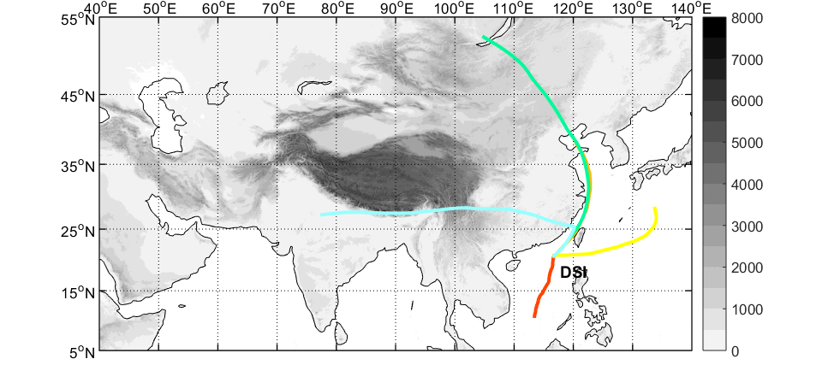
Cluster analysis of backward trajectories at Dongsha Island
16%
Winter monsoon
31%
7%
19%
27%

Slide 10
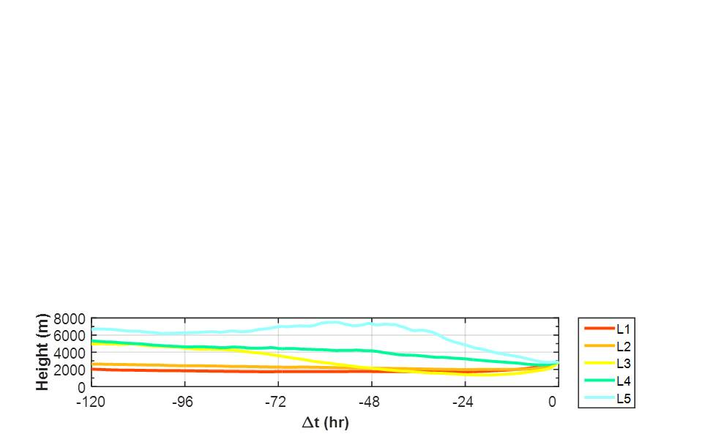
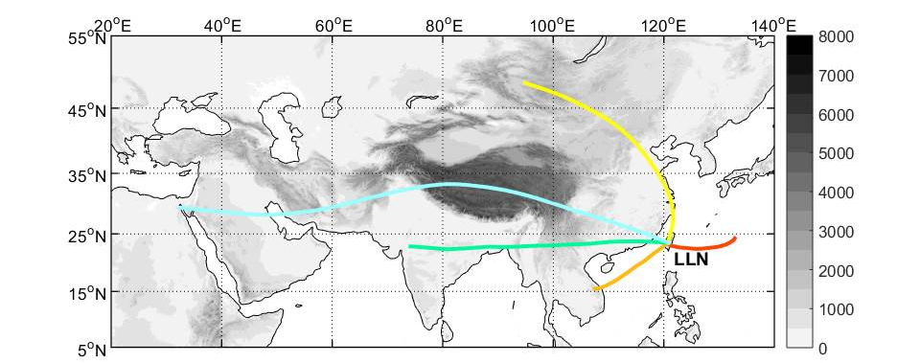
Cluster analysis of backward trajectories at Mt. Lulin
11%
4%
13%
32%
40%

Slide 11
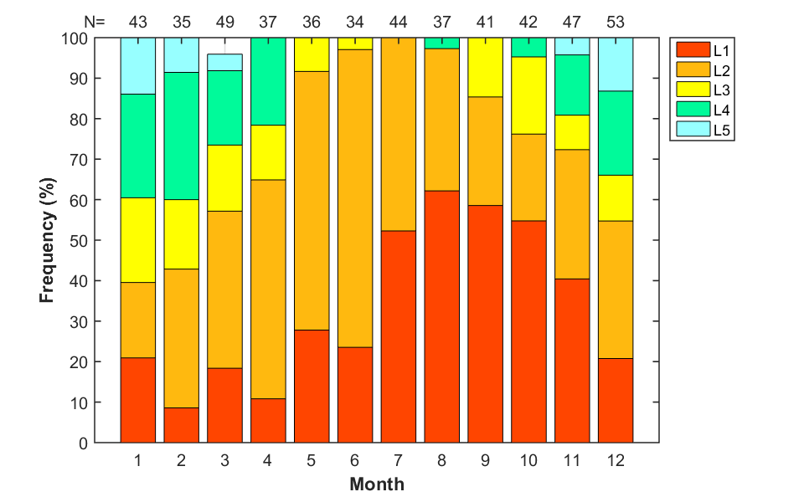
Frequency
from Southeast Asia
from East China
from South China Sea
from Pacific

Slide 12
Contributions
 | N | % | CO₂ (ppm) | CH₄ (ppb) | N₂O (ppb)
L1 (Pacific) | 225 | 32% | 389.2±8.9 | 1832±34 | 324.8±2.5
L2 (South China Sea) | 278 | 40% | 390.6±7.6 | 1833±37 | 324.8±2.4
L3 (East China) | 77 | 11% | 395.3±12.2 | 1875±31 | 326.9±3.0
L4 (Southeast Asia) | 92 | 13% | 393.1±6.9 | 1859±25 | 325.2±2.2
L5 (Others) | 30 | 4% | 393.9±6.4 | 1860±28 | 325.3±2.2
L3
L5
L4
L1
L2

Slide 13
Cluster analysis of backward trajectories in periods
Joined NOAA/CCGG
2006 August
Typhoon Morakot
2009 August
2012 September
2016 March
Period 1
(N = 162)
Period 2
(N = 161)
Period 3
(N = 173)

Slide 14
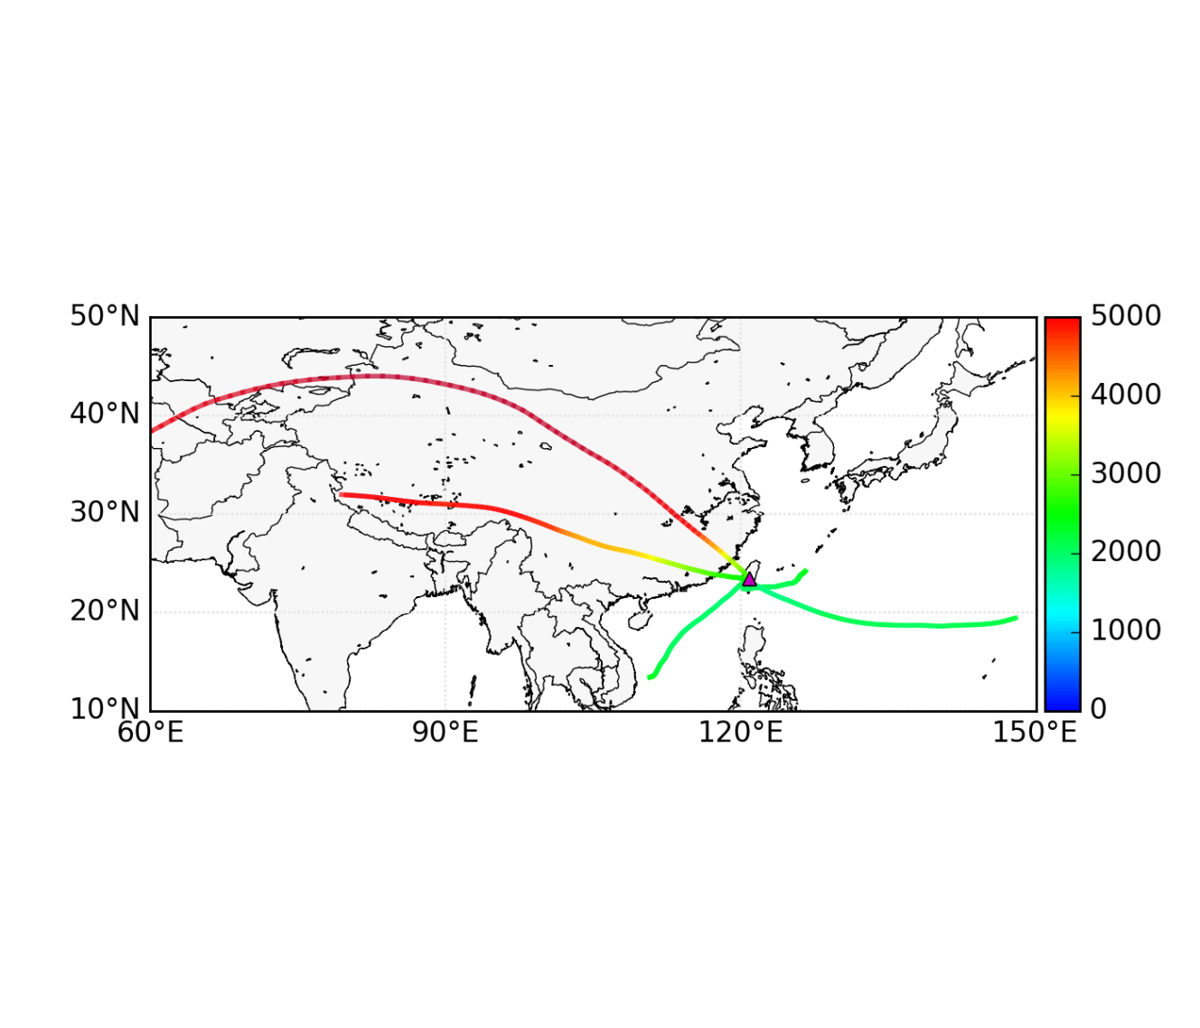
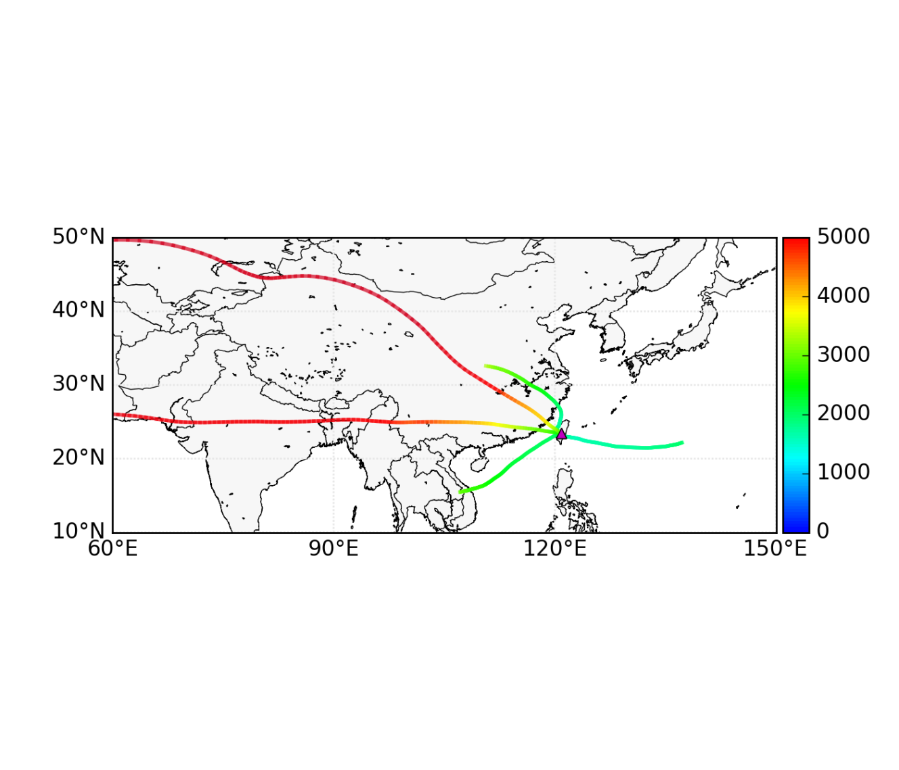
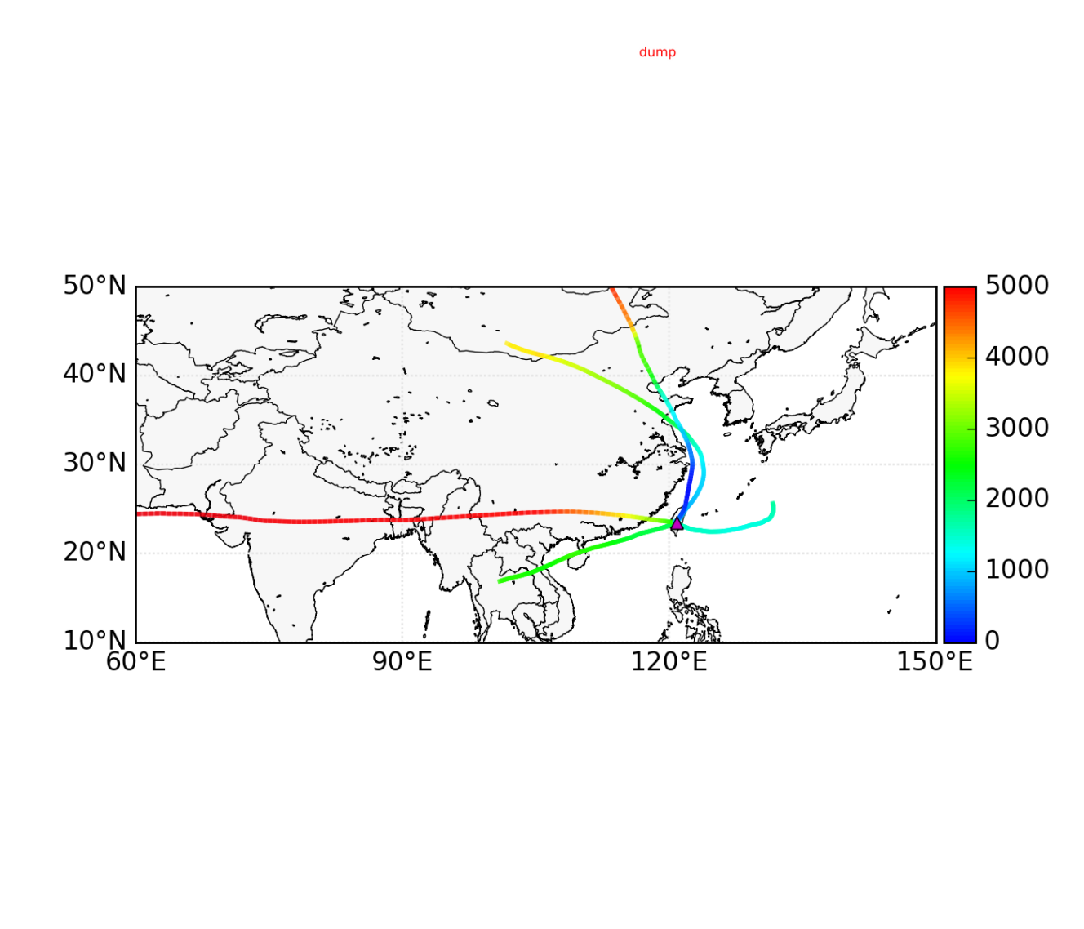
L5
L4
L3
L1
Period 1
L2
L5
L3 (15%)
L3
CO₂ (ppm) | CH₄ (ppb) | N₂O (ppb)
∆1.2±7.6 | ∆12±15 | ∆0.2±1.0
L4
L1
Period 2
L2
L3
L5
L3 (20%)
CO₂ (ppm) | CH₄ (ppb) | N₂O (ppb)
∆2.7±5.2 | ∆22±24 | ∆0.8±1.3
L4
L1
L2
Period 3

Slide 15
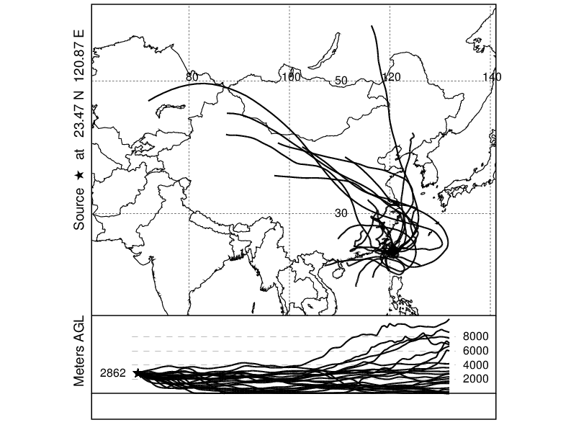
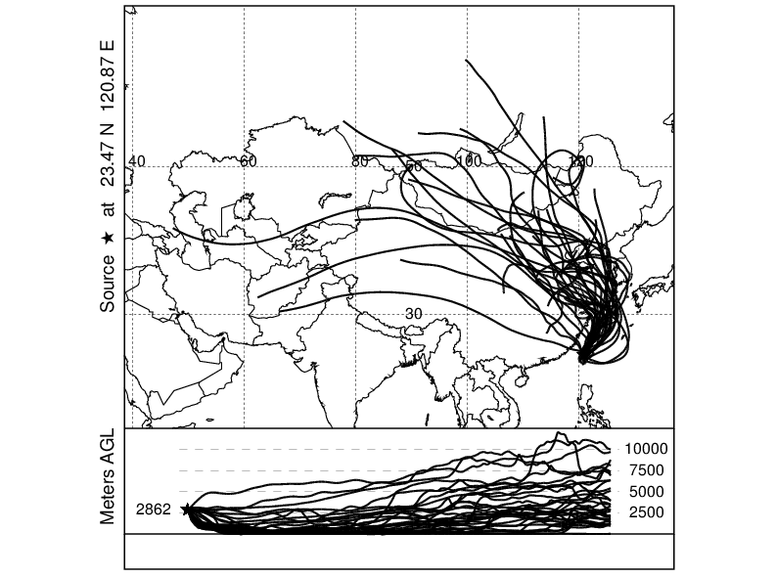
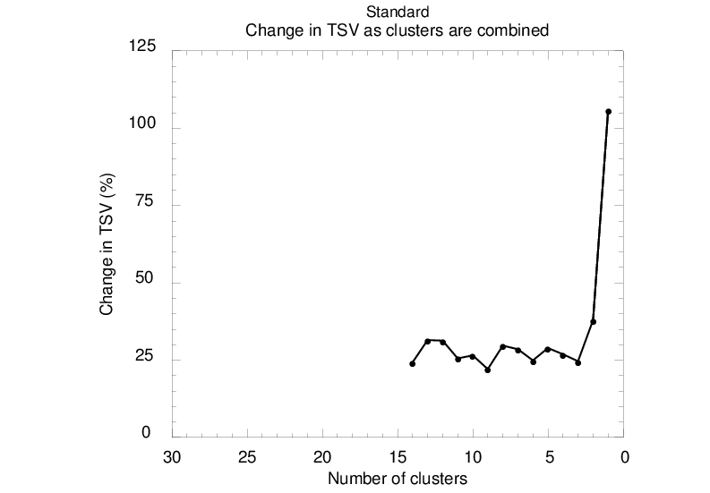
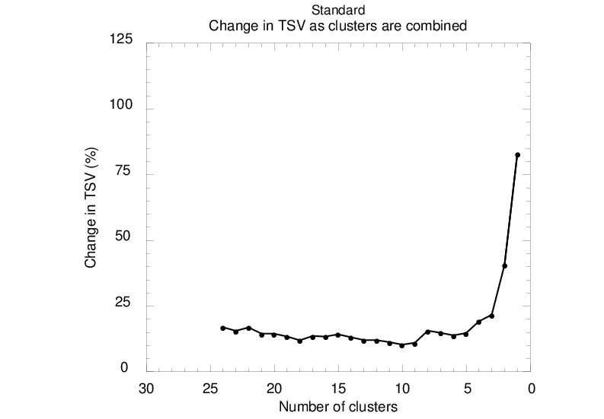
Period 2
Period 3
Total Spatial Variance
Total Spatial Variance

Slide 16
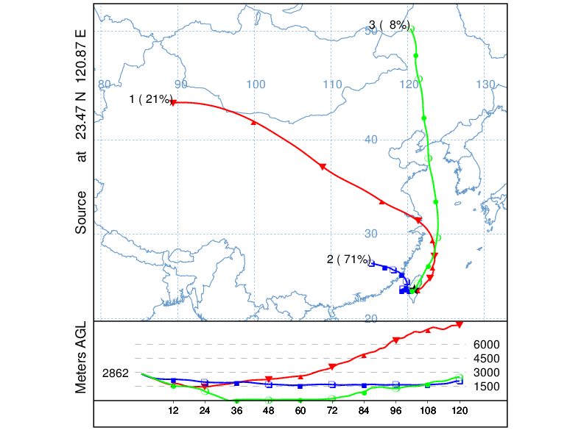
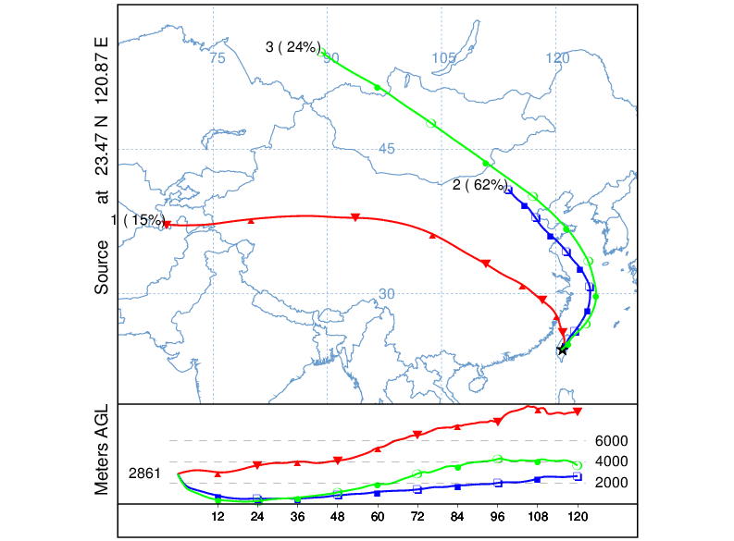
Air masses from East China
Period 2
Period 3

Slide 17
In-situ measurements of CO₂ and CH₄ at Mt. Lulin
Mean difference: 0.59±1.61 ppm CO₂
Mean difference: 0.24±8.61 ppb CH₄

Slide 18
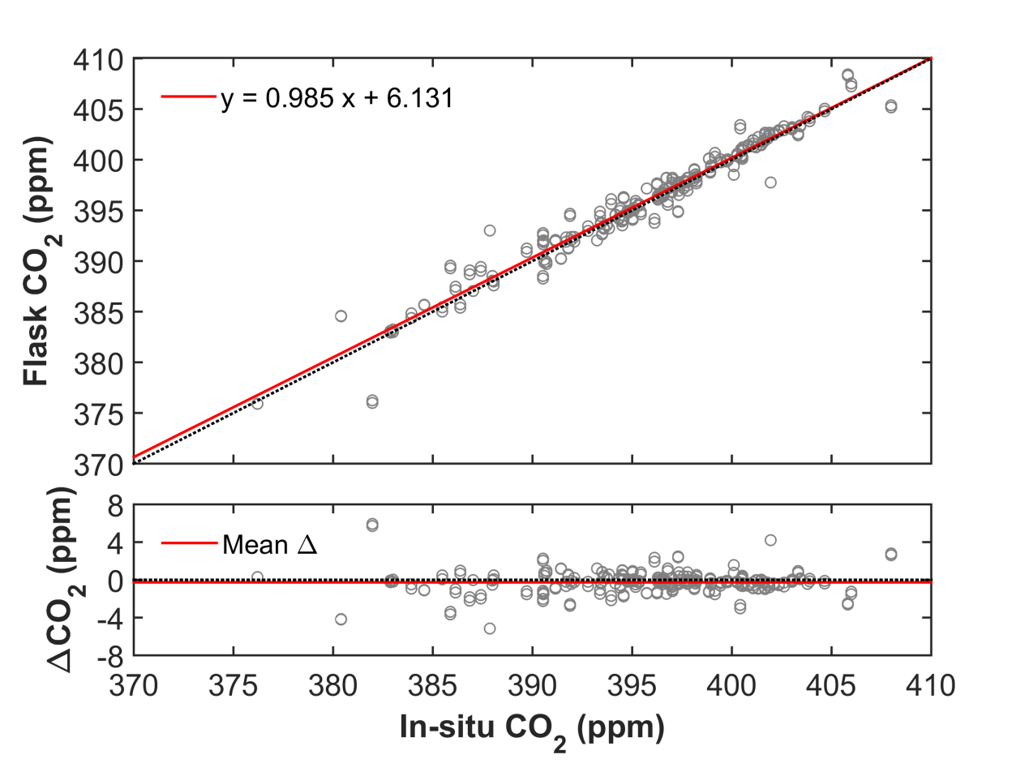
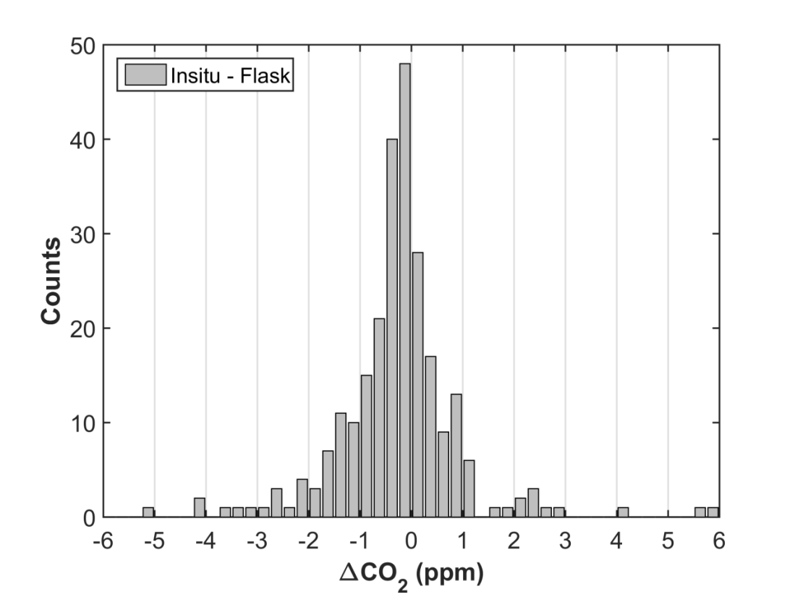
Inter-comparisons of CO₂

Slide 19
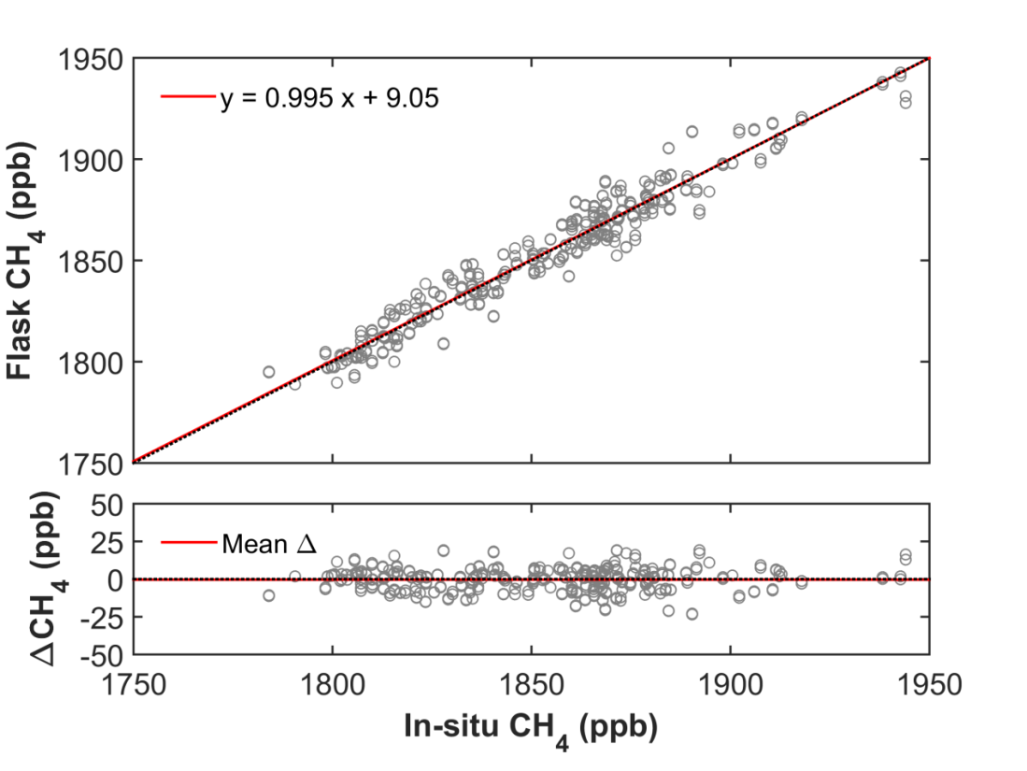
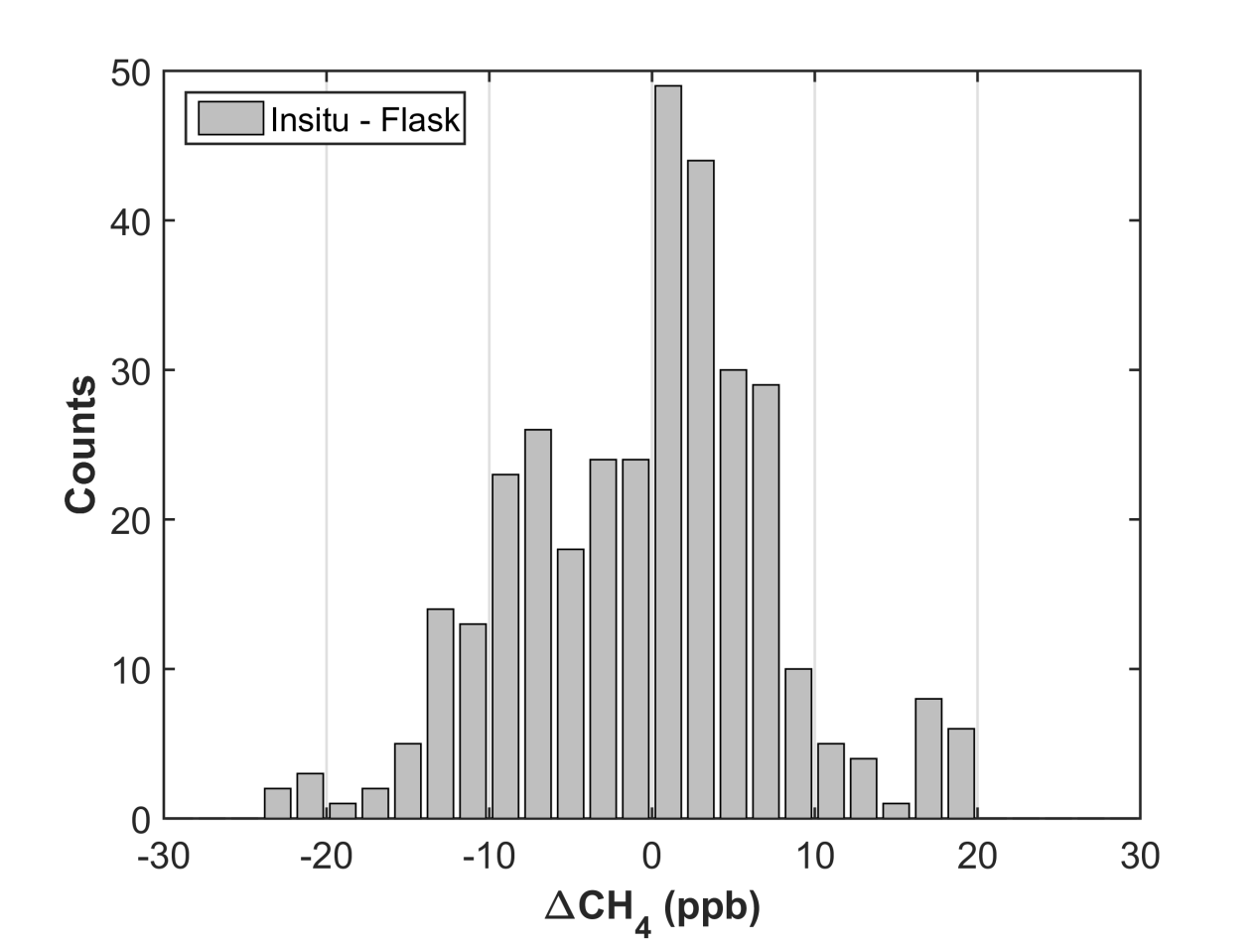
Inter-comparisons of CH₄

Slide 20
Diurnal variations of CO₂ and CH₄

Slide 21

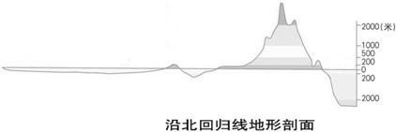
Mountain-valley breezes
Sun
Nighttime
Lulin
3000 m
Daytime
1500 m
0 m

Slide 22
Diurnal spectrum

Slide 23
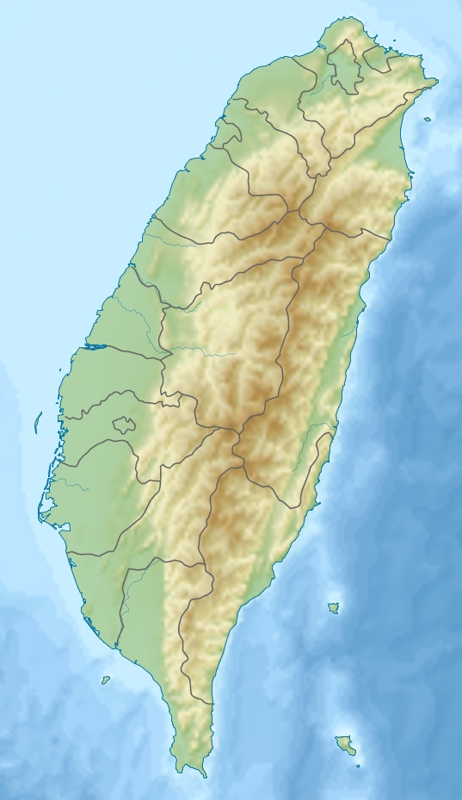
Future Plan: GHG Network
Mt. Bamboo
Korea
Japan
China
Taiwan
Mt. Yushan
(Mt. Lulin)
Mt. Lulin (LLN)
Vietnam
Dongsha Island (DSI)
Thailand
Philippines
Lanyu Island
Taiping Island

Slide 24
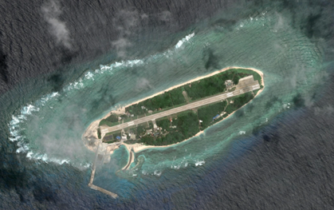
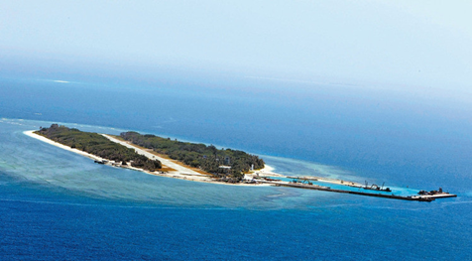
Taiping Island
10.37°N, 114.37°E

Slide 25
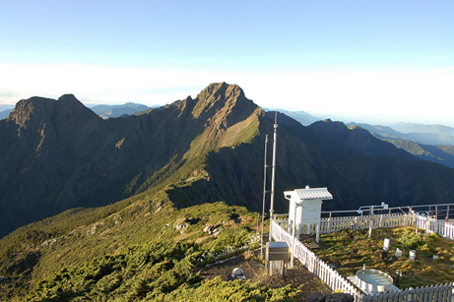
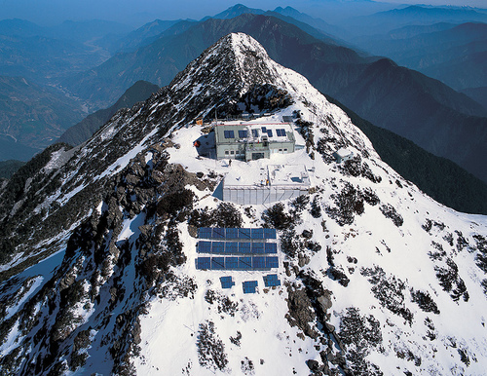
Mt. Yushan
Mt. Yushan (3952 m a.s.l.)
Yushan weather station (3845 m a.s.l.)
9.2 km away from Mt. Lulin
983 m higher than Mt. Lulin

Slide 26
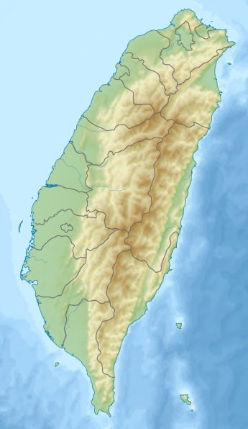
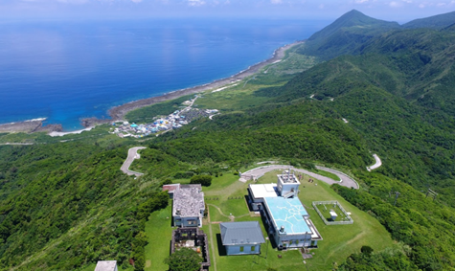
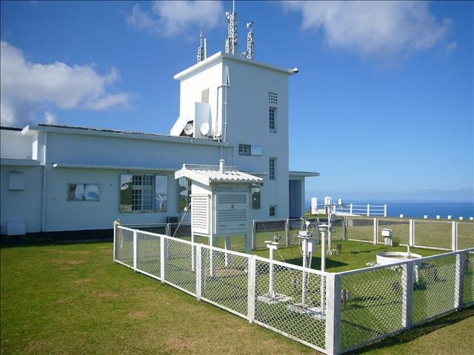
Lanyu Island
22.04°N, 121.55°E, 324 m a.s.l.
CO₂ measurement since 1995

Slide 27
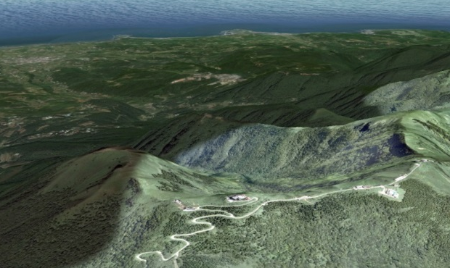
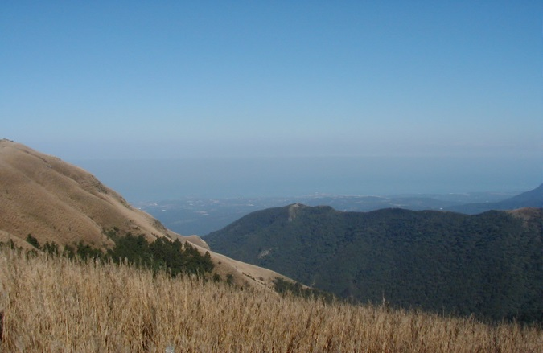
Mt. Bamboo
25.19°N, 121.55°E, 1103 m a.s.l.
Mt. Bamboo
View from the site

Slide 28
Summary
Clear increasing trends for CO₂, CH₄, and N₂O were found.
Annual mean of CO₂ at Mt. Lulin and Dongsha Island exceeded 400 ppm in 2015 and 2014, respectively.
Distinguished seasonal and diurnal cycles for CO₂ and CH₄ were observed.
Cluster analysis of trajectories has shown that the air masses originated from East China are found with highest levels of greenhouse gases.
4 new monitoring sites for GHGs proposed.

Slide 29




Acknowledgements
NOAA/GMD
Contact: cfouyang@cc.ncu.edu.tw

