Slide 1


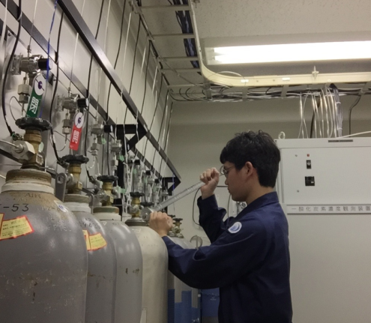
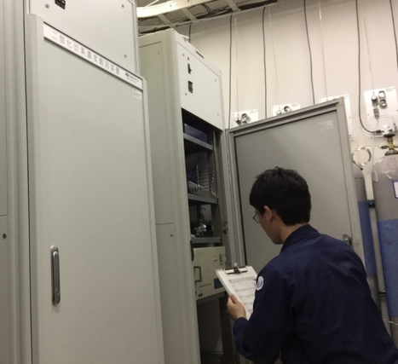
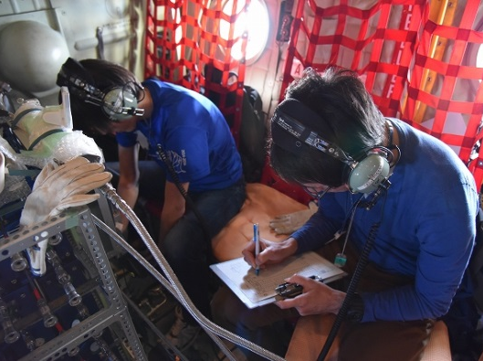
The evaluation of JMA’s standard gas scale for measurements of atmospheric methane
*Shuichi Hosokawa¹, Teruo Kawasaki¹, Yuji Esaki¹, Atsushi Takizawa¹, Shinya Takatsuji¹, Susumu Hashimoto¹, Kohshiro Dehara¹,
Kentaro Kozumi¹,Hidekazu Matsueda², Yousuke Sawa²,
Kazuhiro Tsuboi² and Yosuke Niwa²
1. Japan Meteorological Agency, Tokyo, Japan,
2. Meteorological Research Institute, Ibaraki, Japan

Slide 2
Today’s Topic
（１） CH4 calibration method and standards in JMA
・JMA calibrates CH4 with GC/FID (Gas Chromatography with Flame Ionization Detector) using by 5 standard gases.
・JMA has used 2 Generation series (1G and 2G) of standard gases since 2006.
（２）Long-term Activity of JMA/WCC
・ JMA manage World Calibration Center for CH4 in Asia and the South-West Pacific (WCC), and has carried out reference gases inter-comparisons (Round Robin) object to identify the differences of their standard scales as well as to monitor the long-term stability of standard gases.
（３）Pre-study for replacing JMA calibration system with CRDS
・JMA plans to replace the CH4 calibration system to CRDS
(Cavity Ring Down Spectroscopy) .
・In advance, we tested of GC/FID and CRDS.

Slide 3
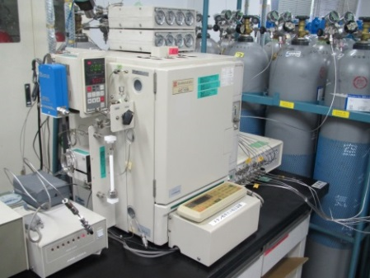
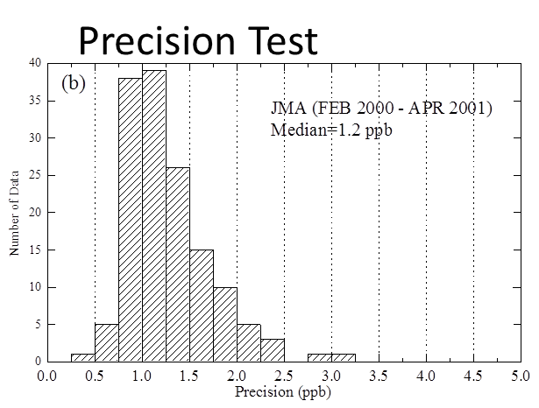
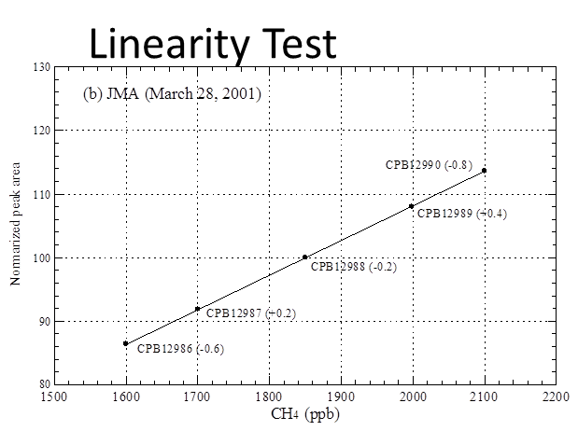
(1) JMA CH₄ Calibration System with GC/FID
Matsueda et al., PMG [2004]
※GAW Compatibility Goal : ±2ppb

Slide 4
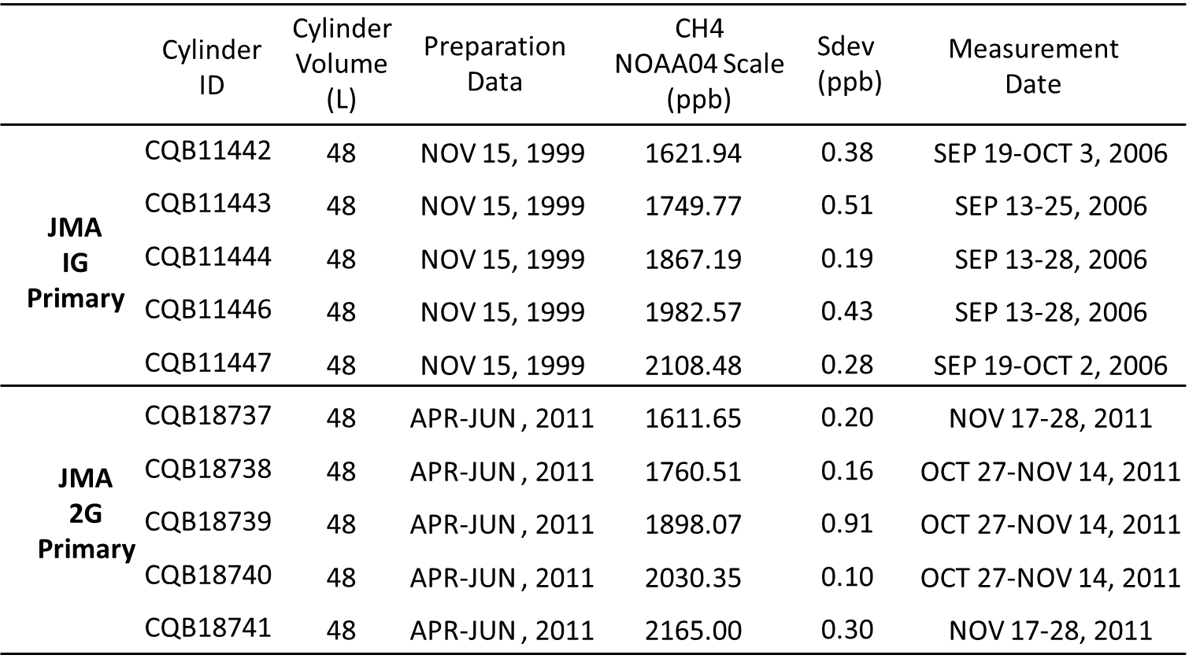
JMA’s CH4 Standard gases

Slide 5
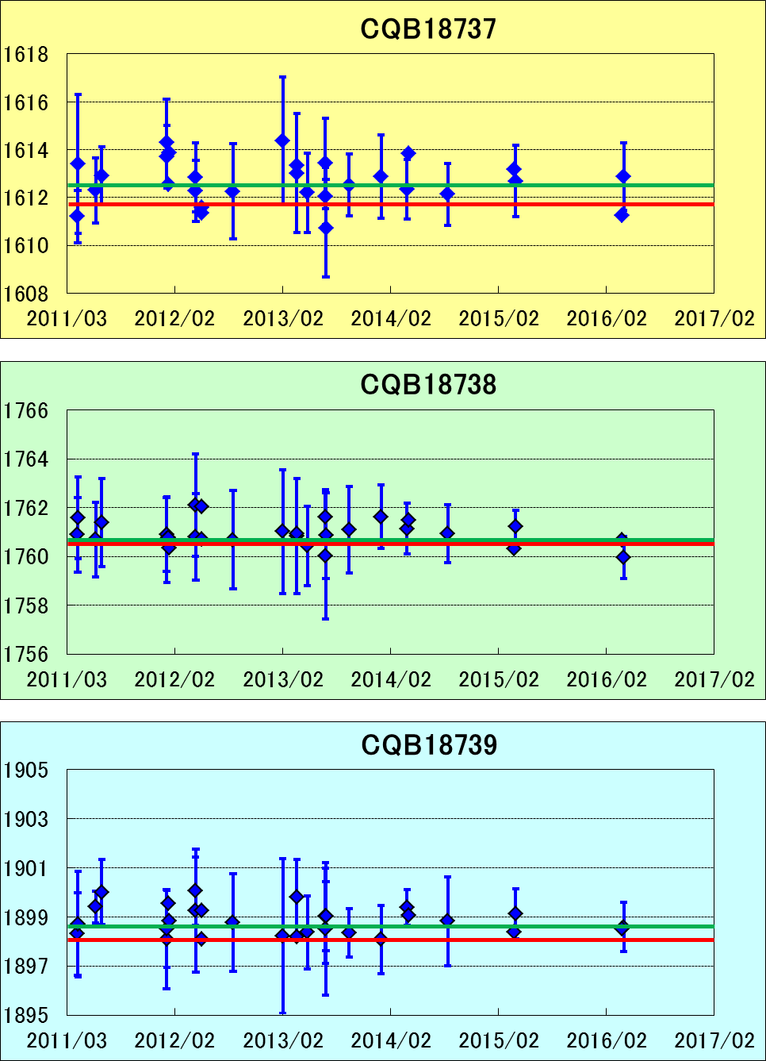
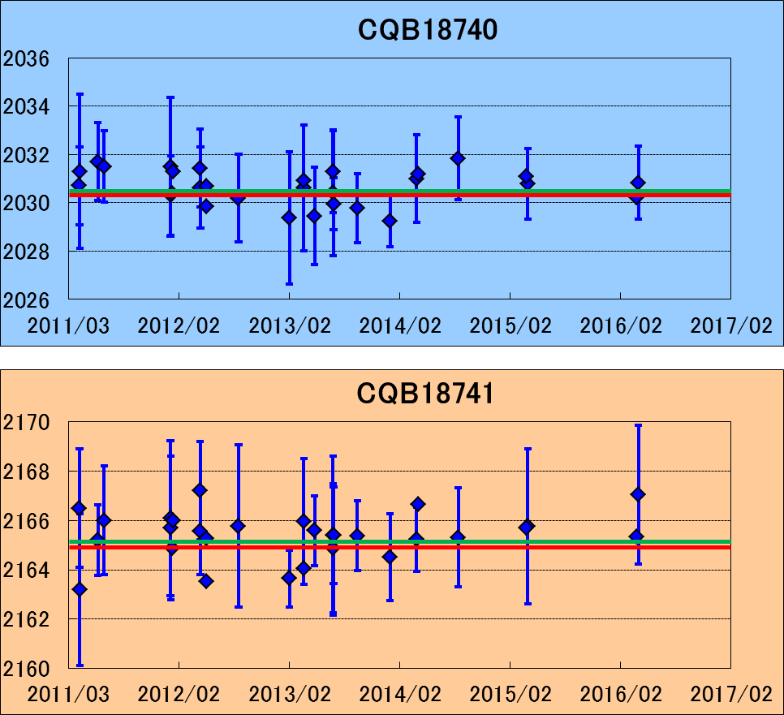
Traceability of JMA Standard 1G→2G
D =0.96
D =0.27
D =0.47
D =0.41
D =0.73
D = Difference ( Measured – Assigned )[ppb]
: NOAA calibration
: Average of concentration
measured by 1G

Slide 6
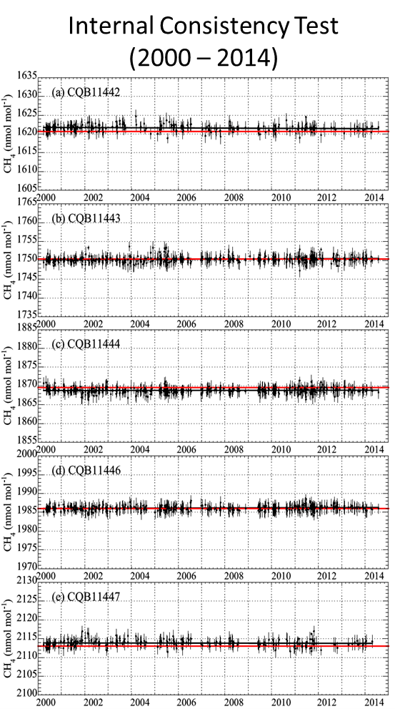
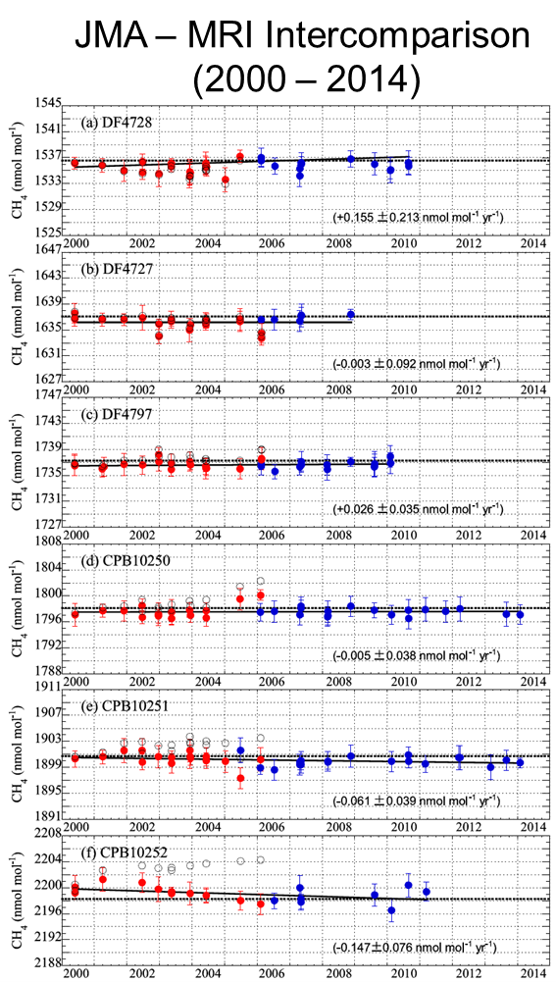
Long-term stability of JMA/1G standards
Tsuboi et al., PMG [2016]

Slide 7
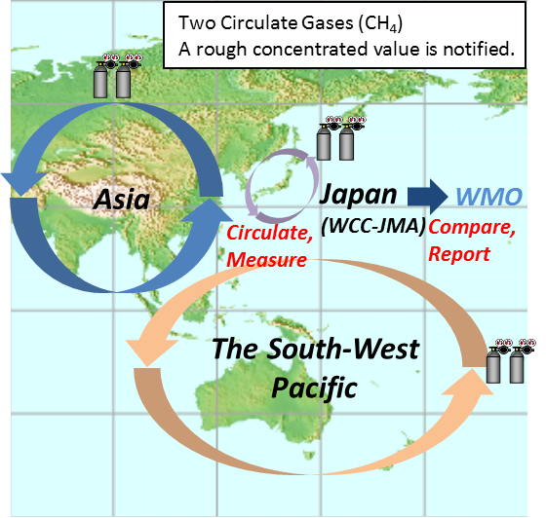
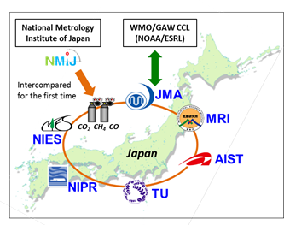
(2) JMA/WCC Round Robin and iceGGO
JMA/WCC
Round Robin
IceGGO
Inter-Comparison Experiments for Greenhouse Gases Observation
You can see the result of JMA/WCC Round Robin.
http://ds.data.jma.go.jp/gmd/wcc/ch4/com_annex2.html

Slide 8

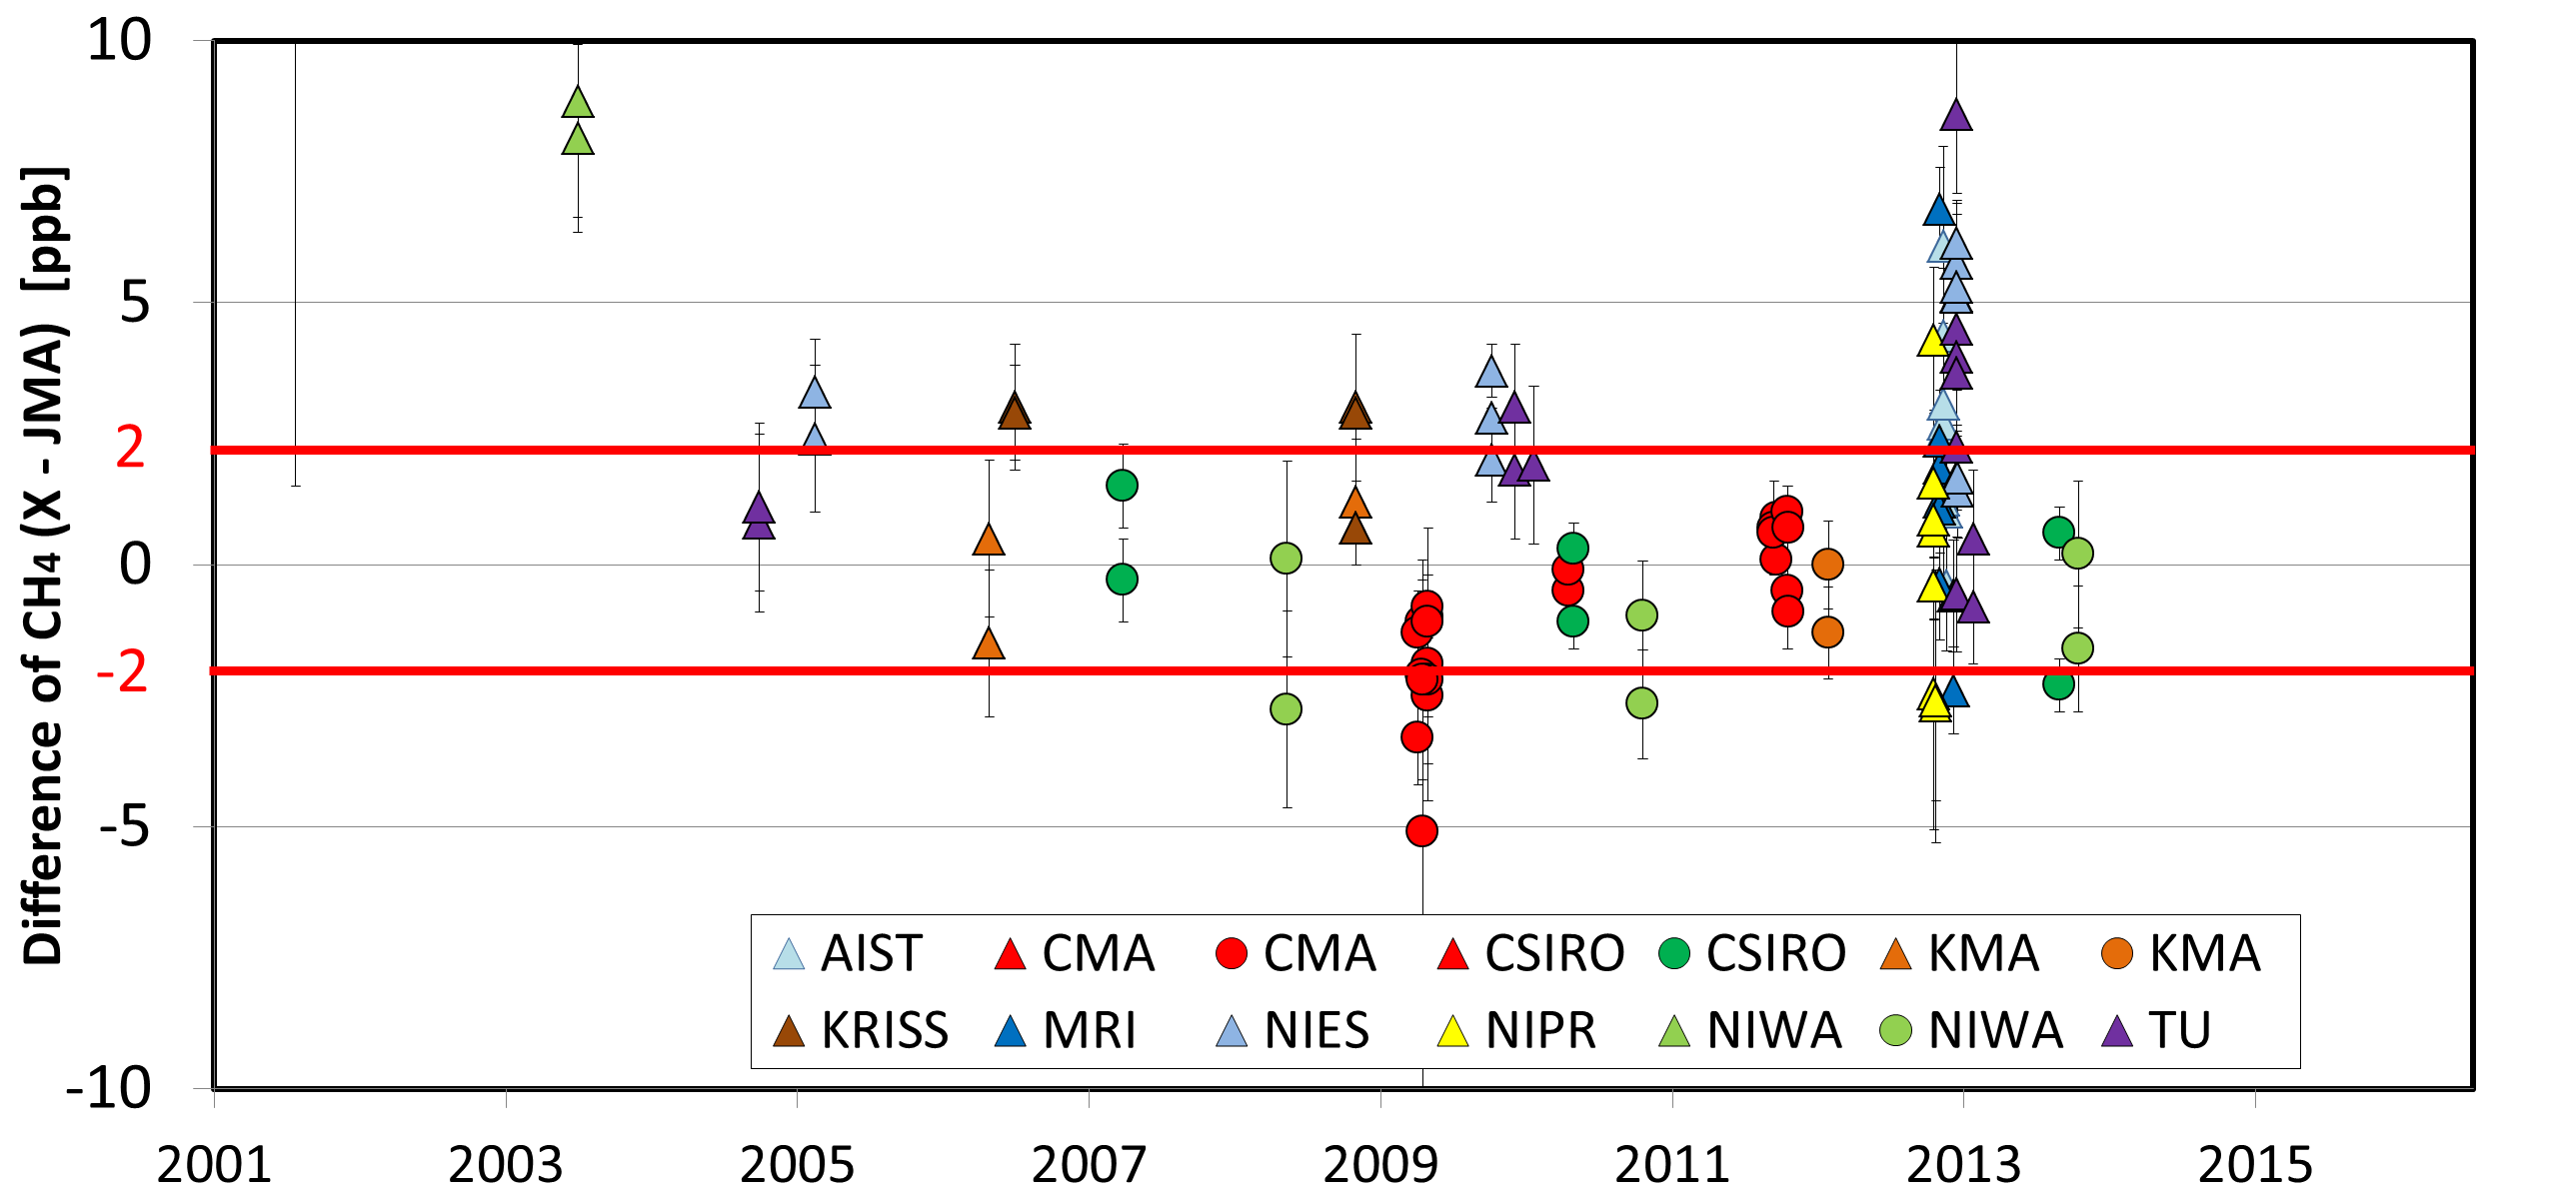
JMA/WCC Round Robin and iceGGO
※GAW Compatibility Goal : ±2ppb

Slide 9
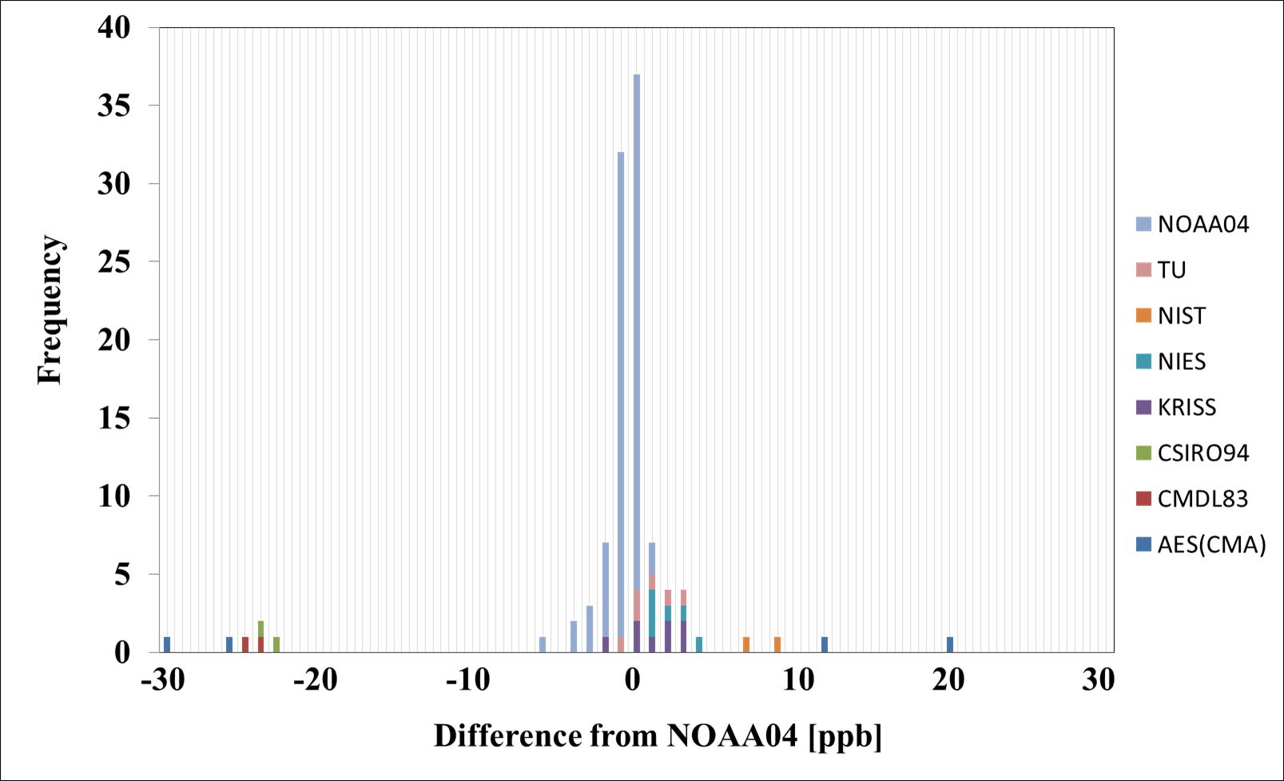
JMA/WCC Round Robin and iceGGO
Kawasaki et al., GGMT[2015]
※GAW Compatibility Goal : ±2ppb

Slide 10
Converted each scale to NOAA
Example for iceGGO experiments
● CSIRO94 and NIST94 scale converted to
NOAA04 scale using by Dlugokencky E.J.
et al. , 2005, and WMO DATA SUMMARY.
● TU/MRI/AIST/NIES/NIPR each scale and
NOAA2004 scale have linear relationship.
→Convert every data to NOAA04 scale.
Tsuboi et al., PMG [2016]

Slide 11
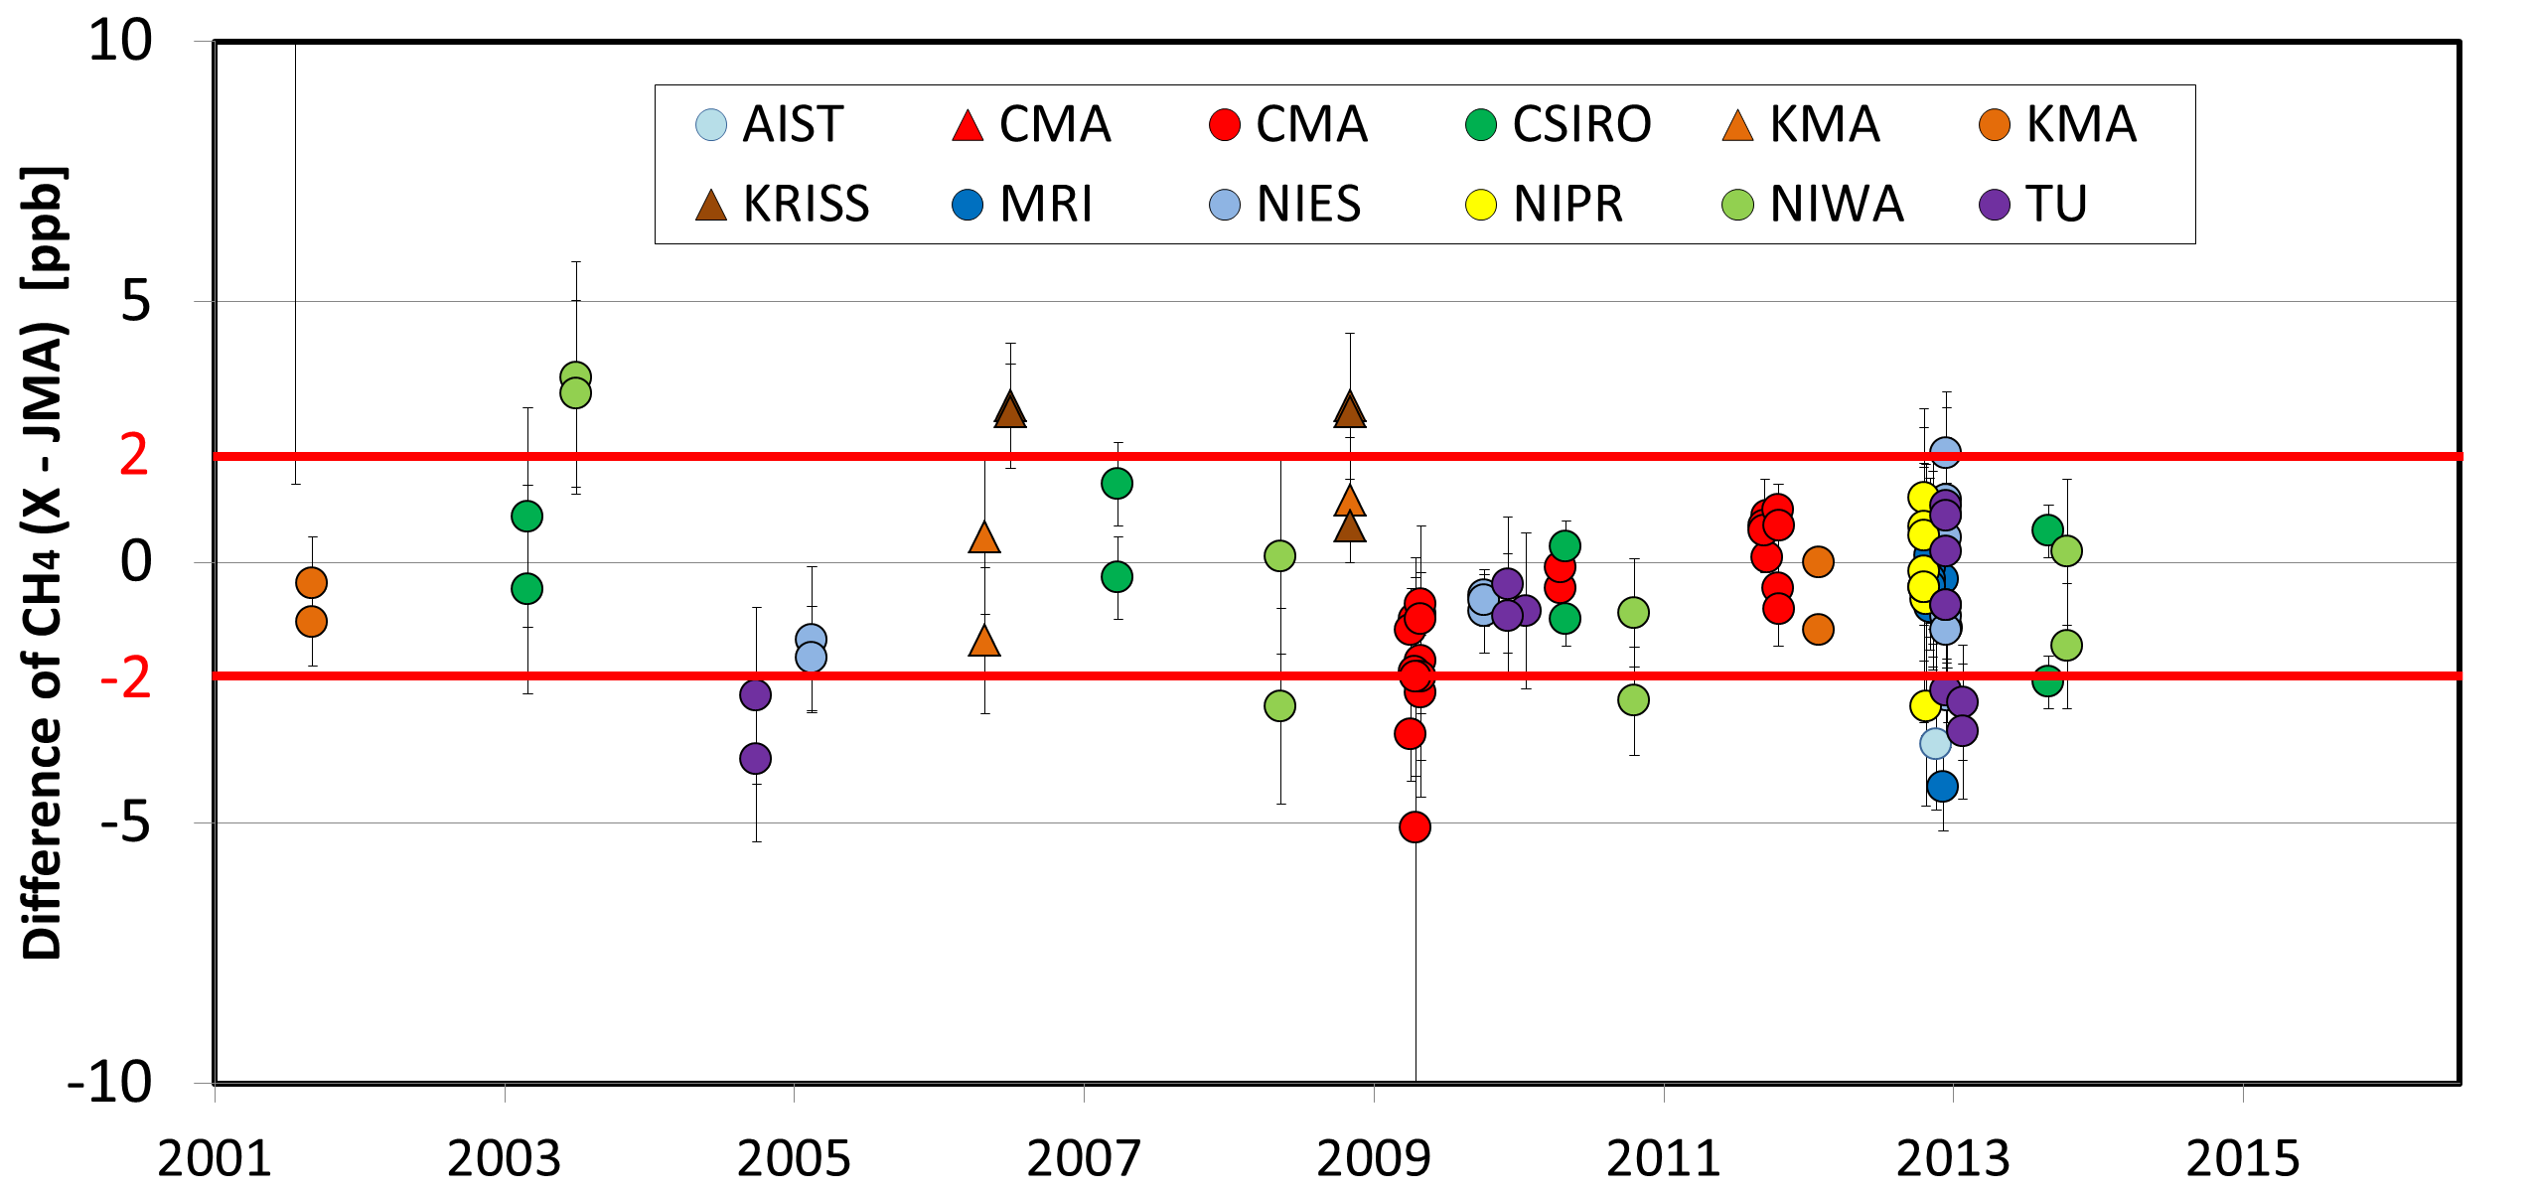
JMA/WCC Round Robin and iceGGO
※GAW Compatibility Goal : ±2ppb

Slide 12
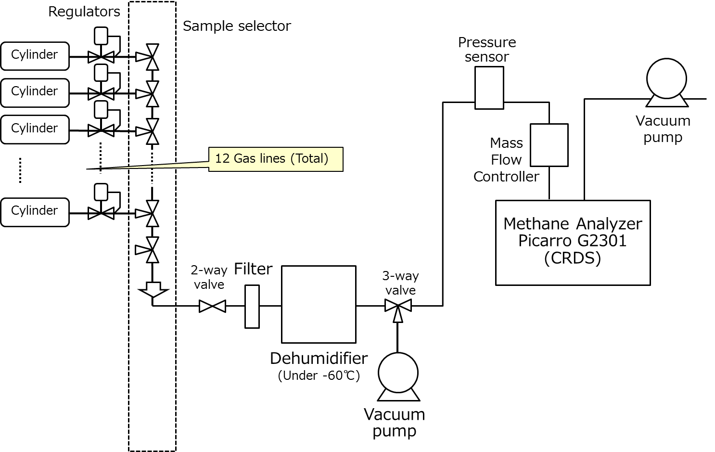
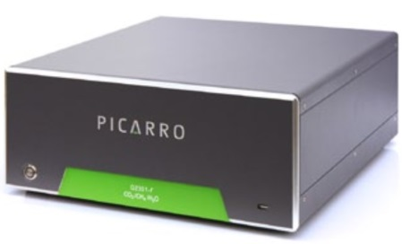
（３）Planning to replace of calibration system
JMA plans to replace the calibration system
from GC/FID to CRDS.
Schematic diagram of
the methane calibration system (plan)

Slide 13
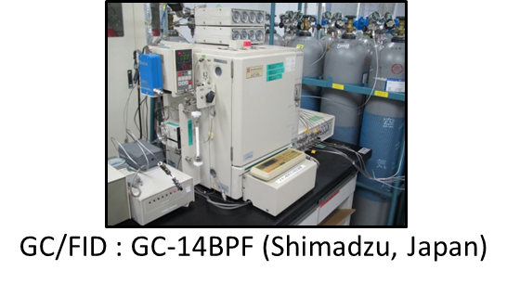
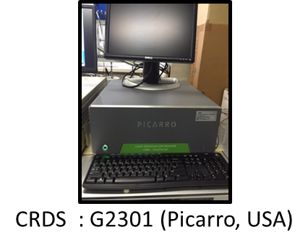
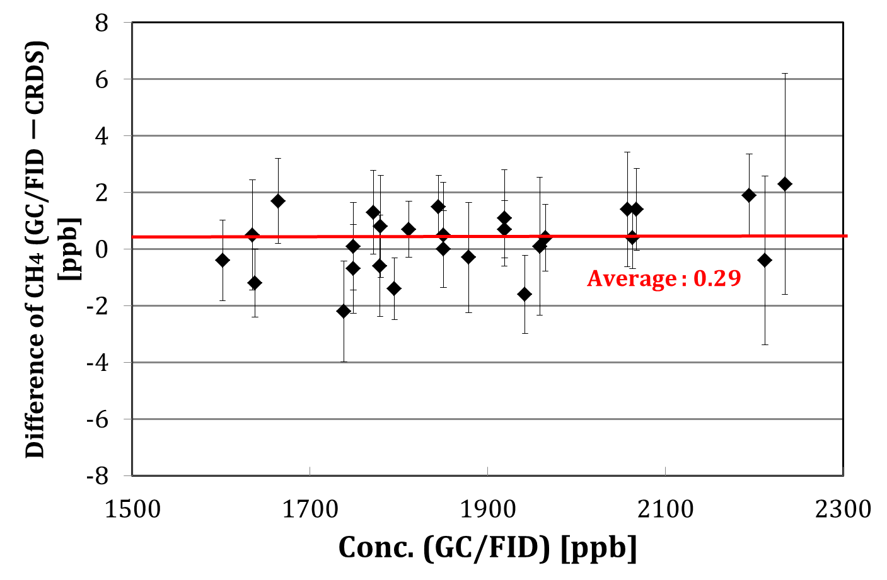
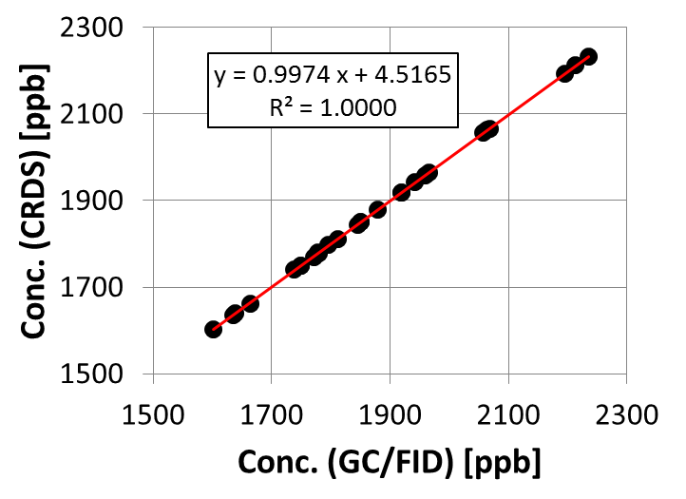
GC/FID vs CRDS
〜 Laboratory Experiment 〜
※GAW Compatibility Goal : ±2ppb
Measure some cylinders by GC/FID and CRDS
Relationship of these methods is linear.
88% of these difference is within ±2ppb.

Slide 14
Conclusion
The stability and traceability of JMA’s CH₄ standard gases have been ensured.
Converting scales, JMA/WCC activity and iceGGO is consistent with each other.
We tested the difference of GC/FID and CRDS. We will operate much comparing tests with actual analyzer and replace the calibration system from GC/FID to CRDS carefully.

Slide 15
Reference
Tsuboi et al.(2016), Scale and stability of methane standard gas in JMA and comparison with MRI standard gas; Papers in Meteorology and Geophysics Vol.66 15-24, doi: 10.2467/mripapers.66.15
Kawasaki et al.(2016), Inter-comparison experiments of standard gases for JMA/WCC activity; GAW Report 104-109
Matsueda et al.(2004), Methane standard gases for atmospheric measurements at the MRI and JMA; Papers in Meteorology and Geophysics Vol.54 91-113
Dlugokencky et al. (2005): Conversion of NOAA atmospheric dry air CH4 mole fractions to a gravimetrically prepared standard scale, J. Geophys. Res., 110, D18306, doi:10.1029/2005JD006035.

