Slide 1
The 8th Asia-Pacific GAW Workshop on Greenhouse Gases
The GAW Training and Education Centre (GAWTEC) & German GAW activities and monitoring
Mirella Glor
German Environment Agency/
Environmental Research Station Schneefernerhaus
gawtec@schneefernerhaus.de

Slide 2
OVERVIEW
The GAW Training and Education Centre (GAWTEC) & German GAW activities and monitoring
1 GAWTEC
1.1 GAW & GAWTEC
1.2 Statistics
1.3 Main Topics
1.4 Objectives
1.5 Application & costs
1.6 GAW Station Information System (GAWSIS)
2 German gaw activities & monitoring
2.1 German Contribution to GAW
2.2 Global Stations – monitoring program
2.3 Regional Stations – monitoring program

Slide 3
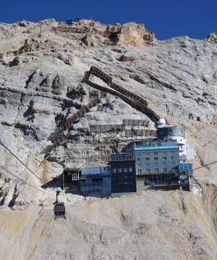
1.1 GAW & GAWTEC
The GAW Training and Education Centre (GAWTEC) & German GAW activities and monitoring
GAW community → Data quality objectives (DQOs) for all participating stations
“Training and education are critical to the long-term success of the GAW programme.”
(WMO/GAW Strategic Plan: 2008-2015, GAW Report 172)
“It [GAWTEC] has played an important role in the training of station personnel for more than 15 years and building the technical expertise within the
countries and in establishing international networking.”
(GAW implementation plan 2016-2023 p. 33)
figure 1: GAW Global Stations (in October 2016)
https://www.wmo.int/pages/prog/arep/gaw/measurements.html
figure 2: Environmental Research Station Schneefernerhaus (UFS), GAW Global Station Zugspitze
Notes:
- The GAW community has set high data quality objectives that should be met by all participating stations
Training and Education for GAW station personnel are therefore an integral part of the GAW program and critical to the long-term success of the GAW program *strategic plan* 2008/2015
as a part of the WMOs capacity building strategy, the german Quality Assurance/ Science Activity Centre, funded by the German Environment Agency, and the Bavarian State Ministry of the Environment and Consumer Protection has established in 2001 the GAW Training and Education Centre
-It [GAWTEC] has played an important role in the training of station personnel for more than 15 years and building the technical expertise within the countries and in establishing international networking.
GAW Implementation Plan 2016-2023 p. 33
GAWTEC is located at the Environmental Research Station Schneefernerhaus, Mount Zugspitze, Bavaria, Germany

Slide 4
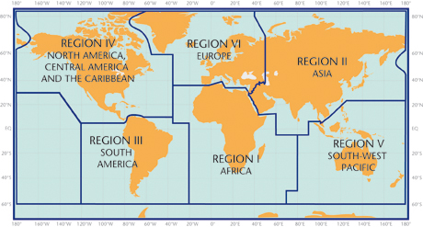
1.2 Statistics
The GAW Training and Education Centre (GAWTEC) & German GAW activities and monitoring
Since the first training course in 2001:
30 GAWTEC courses
341 participants
- 42% women
- 58% men
63 different countries
Origin of GAWTEC participants by WMO region
GAW affiliation
chart 1: GAW affiliation GAWTEC 1-30
figure 3: WMO regions I-VI
WMO Region I: 18% Africa
WMO Region II: 18% Asia
WMO Region III: 8% South America
WMO Region IV: 2% North, Central America,
Caribbean
WMO Region V: 13% South-West Pacific
WMO Region VI: 41% Europe
Notes:
Since the first training course in summer 2001:
30 GAWTEC courses
341 participants (42 % women, 58% men)
63 different countries
From where the participants came from?
41% of them came from institutes in predominantly eastern Europe
18% from Asia and Africa
13% from the Southwest Pacific region
8% from South America
and only a few from North- and Central America and the Caribbean
From what kind of station/ institutes the participants came from, depending on the GAW network?
Approximately 30% worked at Global Stations, Regional Stations or central facilities
14% were from other institutes

Slide 5
1.3 Main Topics
The GAW Training and Education Centre (GAWTEC) & German GAW activities and monitoring
Each course deals with two or three major topics:
Physical Properties of Aerosols & Aerosol Optical Depth
UV radiation
Reactive Gases (CO, surface O₃, VOCs, NO_{x}, NO_{y}, SO₂)
Precipitation chemistry
Greenhouse Gases
Data evaluation & Quality control
2 courses every year (2 week session)
10-12 trainees
Training by experts from the GAW community
chart 2: number of topics GAWTEC 1-30
Notes:
- The GAW Global station "Zugspitze/Hohenpeißenberg" is used for some practical work and theoretical knowledge
- There are two GAWTEC training sessions every year with the duration of 2 weeks and about 10-12 trainees for each
session.
The major topics include measurement techniques (sampling, direct instrument measurements), analytical techniques (chemistry and physical measurement techniques), quality assurance and data analysis for GAW parameters:
Physical Properties of Aerosols & Aerosol Optical Depth
UV radiation
Reactive Gases (CO, surface O₃, VOCs, NO_{x}, NO_{y}, SO₂)
Precipitation chemistry
Greenhouse Gases
Data evaluation & Quality control
figure: number of topics that took place in GAWTEC 1-30
The training is provided by experts from the GAW community.
Lessons are given by experts of
The German Weather Service
the German Environment Agency
The GAW World Calibration Centres (for NO2, VOC, Physical Aerosols)
The Swiss EMPA
For special topics, lecturers from national and international Universities and other institutes are invited

Slide 6
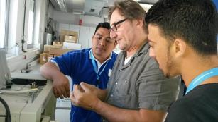
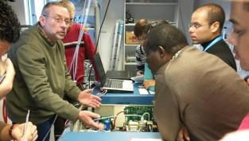
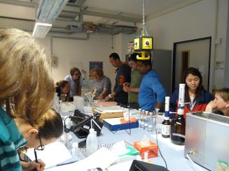
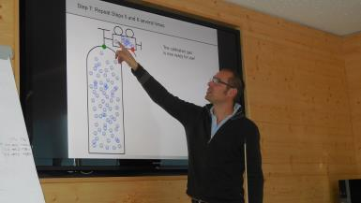
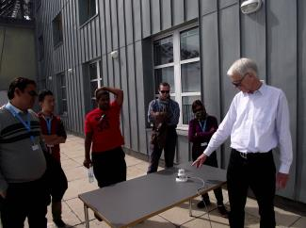
1.4 Objectives
The GAW Training and Education Centre (GAWTEC) & German GAW activities and monitoring
improvement of personal skills in
→chemical
→physical
→meteorological
measurement technique and data handling
providing a platform for GAW station personnel for
→ exchange of measurement related experiences
→ discussion of problems
understanding of atmospheric processes → ability for data interpretation
identify measurement errors → data quality
Notes:
The objectives of GAWTEC are:
The improvement of personal skills in chemical, physical and meteorological measurement technique and data handling
providing a platform for GAW station personnal for the exchange of measurement related experiences and the discussion of problems
Broadening the understanding of atmospheric processes to increase the ability for data interpretation
enhancing the ability to identify measurement errors to increase data quality within the GAW station network

Slide 7
1.5 Application & costs
The GAW Training and Education Centre (GAWTEC) & German GAW activities and monitoring
Application
via GAWTEC webpage www.gawtec.de
→ information for upcoming courses
Courses
→ are held in English
→ for technicians and junior scientists
Costs
No costs for trainees
→ Air fares by WMO
→ other expenses are covered by the German Environment Agency and the Bavarian
State Ministry of the Environment and Consumer Protection
Lecturers are funded by their scientific organizations
Notes:
How to apply?
Applications should be made via the GAWTEC webpage at www.gawtec.de
Upcoming courses will also be announced on this webpage
applicants can get an impression of the course on this homepage too (pictures of previous courses, short explanation about „what is GAWTEC“)
GAWTEC courses are held exclusively in English
→ Trainees must therefore have good English language skills to follow lectures, instrument instructions and discussions
Gawtec offers ist courses only to technicians and junior scientists who work at stations with instruments and data and is not meant for senior scientists
There are no costs for trainees, Air fares are paid by the WMO, all other expenses are covered by the German Environment Agency and the Bavarian State Ministry for Environment and Consumer Protestion
Lectures are funded by their scientific organizations
Selection of applicants:
→ measuring program
→ Hnweise von GAW country contacts und stationsleitern
→ hinweise von Twinningpartnern
Nach welchen Kriterien sollen die Teilnehmer ausgewählt werden?
fachliche Qualifikation
Aufgabengebiet
Englischkenntnisse
Anmeldezeitpunkt
Budget
Herkunftsland
Fragebögen während
des Kurses
Prüfungen
spätere
Rückmeldungen,
Nachfragen
5. Datenqualität

Slide 8
1.6 GAW Station Information System (GAWSIS)
The GAW Training and Education Centre (GAWTEC) & German GAW activities and monitoring
About GAWSIS
Aim: to improve the management of information about the GAW network
is the official catalogue of GAW stations and Contributing networks
serves as a repository
provides the GAW community and other interested people with an up-to-date, searchable data base of
→ station characteristics
measurements programs
and data available
→ instrument
→ contact people
bibliographic references
Notes:
-Presentation and explanation of GAWSIS during each GAWTEC course
GAWSIS is being developed and maintained by the Federal Office of Meteorology and Climatology MeteoSwiss in collaboration with the WMO GAW Secretariat, the GAW World Data Centres and other GAW representatives to improve the management of information about the GAW network
GAWSIS is the official catalogue of GAW stations and Contributing networks.
It provides the GAW community and other interested people with an up-to-date, searchable data base of
→ station characteristics
→ measurements programs and data available
→ instrument
→ contact people
→ bibliographic references
GAWSIS also serves as a repository for supporting documents
f.e.: World Data Centre for Greenhouse Gases in Tokyo, Japan
GAWSIS is a web-based network-tracking tool that hosts all GAW metadata on observatory managers, location and measurement activities

Slide 9
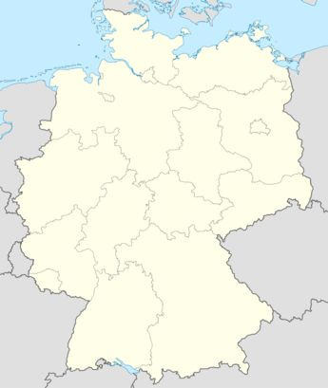
2.1 German Contribution to GAW
LEGEND
The GAW Training and Education Centre (GAWTEC) & German GAW activities and monitoring
Global/Regional/ Contributing Station
WCC
Central/ Regional Calibration Centre
Other GAW element
Contributing Station Westerland, UBA
Contributing Station Zingst, UBA
Regional Station Neuglobsow, UBA
Global Station Neumayer/ Antarctic, AWI Bremerhaven
Regional Station Gartow, DWD
WCC for Ozone Sondes, Jülich Research Centre
Contributing Station Waldhof, UBA
WCC for Aerosol Physics, tropos Leipzig
In-service Aircraft for a Global Observing System (IAGOS), Jülich Research Centre
Central Calibration Laboratory for molecular hydrogen in air (CCL H₂), MPI-BGC, Jena
QA/SAC Langen,
UBA
World Data Center for Remote Sensing of the Atmosphere (WDC-RSAT), DLR, Oberpfaffenhofen
Contributing Station Schmücke, UBA
Regional Dobson Calibration Centre Europe (RDCC-E), Hohenpeißenberg, DWD
Regional Station Schauinsland, UBA
c
Global Station Zugspitze/ Hohenpeißenberg, GAWTEC, UBA/DWD
Figure 4: Location of GAW quality assurance facilities and global/ regional or contributing stations in Germany
WCC for VOC, (N₂O), IMK IfU, Garmisch-Partenkirchen
Notes:
Germany operates 2 Global Stations, 1 is in Germany, 1 in the Atarctic
3 Regional Stations, Neuglobsow, Gartow and Schauinsland
4 Contributing Stations, Schmuecke, Yingst, Waldhof and Westerland
4 WCC for VOC, N20, Oyone Sondes and Phzsical properties of aerosols
GAWTEC, QASac, … contributes to GAW

Slide 10
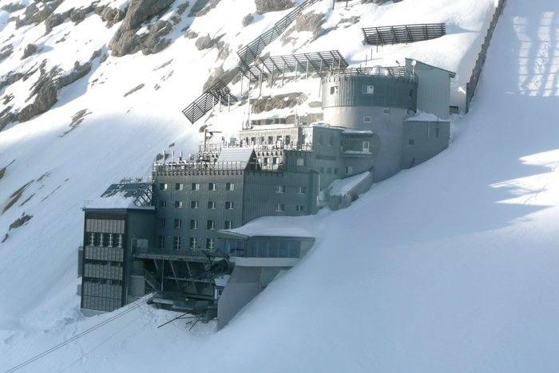
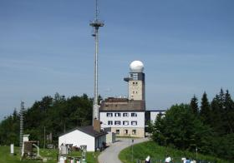
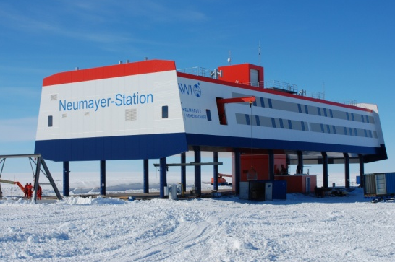
2.2 Global Stations – monitoring program
The GAW Training and Education Centre (GAWTEC) & German GAW activities and monitoring
Platform Zugspitze (1999) Tundra climate
Climate forcing atmospheric
gases
(CO₂, CH₄, N₂O, SF₆, CFC)
Reactive trace gases
(O₃, CO, NO, NO₂, NO_{x}, NO_{y},
SO₂, VOCs)
Aerosols
(size, number distribution, total,
light backscattering coefficient)
Meteorology
(temp., precip., pressure, humidity)
Platform Hohenpeißenberg, (1781) Warm temperate climate
Climate forcing atmospheric gases
(CO₂ CH₄, N₂O, ¹³C,¹⁴C, ¹⁸O)
Reactive trace gases
(O₃, CO, NO, NO₂, NO_{x}, SO_{2,} VOCs, PAN)
Aerosols
(mass, number, size distribution,
chem. Charact., optical charact.)
Precipitation chemistry
Solar radiation
(diffuse, global, UV)
Meteorology
(temp., precip., pressure, humidity)
Neumayer, Antarctic (1981)
Frost climate
Aerosols
(number, size distribution, total)
Greenhouse Gases
(CO₂, CH₄, ¹⁴C)
Ozone
(vertical profile, total column, surface,
Aerological sounding)
Radio nuclide
Solar radiation
(UV, light scattering coefficient,, light backscattering, global, direct, diffuse)
Meteorology
(surface wind direction and speed,
horizontal, pressure, temp.)
Notes:
Zugspitze
Starting in 1999
UBA built up the platform Zugspitze at the site Schneefernerhaus situated at 2650 m asl at the northerm rim of the alps, on the southern slope of Zugspitze summit
Measurement programme of the GAW Global Station Platform Zugspitze consits of
Climate forcing atmospheric gases: CO2, CH4, N2O, SF6, halogenated carbons
Reactive atmospheric trace gases: ozone, CO, NO, NO2, Nox, Noy, PAN, VOCs, carbonyl samples
Aerosols with size distributions of fine and ultrafine particles in range from 10-800 nm
Hohenpeißenberg
The HP station is situated in an observatory in the pre-alpine area about 40km north of Zugspitze, on a mountain top at 985 m asl
The observatory was founded in 1781, is the oldest in the network
Operated by German Weather Service
Since that year, meteorological data have been continiously recorded
GAW platform 1995
Reactive trace gases
Ozone
Aerosols (mass, number, size distribution, chemical characteristics, AOD)
Precip. Chemistry
Solar radiation
Meteorology
Neumayer, Antarctic (1981) Frost climate
In 1981 AWI started to run permanently mannend Neumayer Station next to the Atka Iceport on the Ekström Ice Shelf
Aerosols
(number, size distribution, total)
Greenhouse Gases (CO₂, CH₄, ¹⁴C)
Ozone
(vertical profile, total column, surface, Aerological sounding)
Radio nuclide
Solar radiation
(UV, light scattering coefficient,, light backscattering, global, direct, diffuse)
Meteorology
(surface wind direction and speed, horizontal, pressure, temp.)

Slide 11
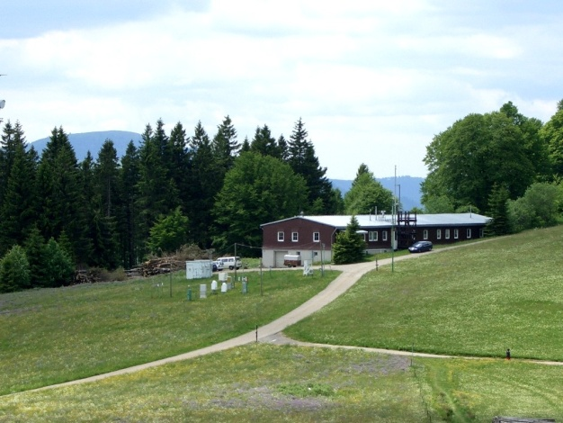
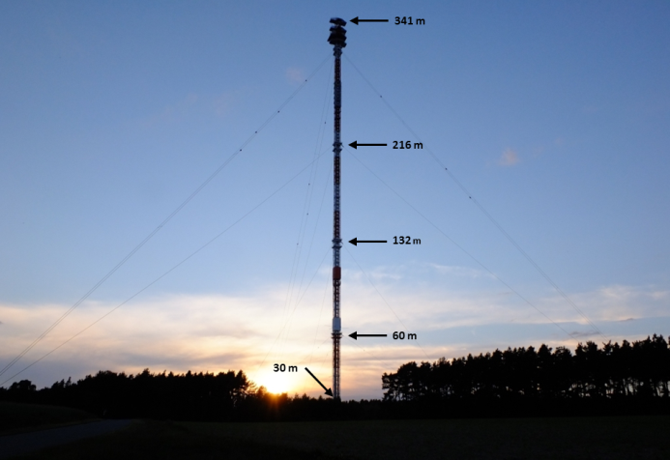
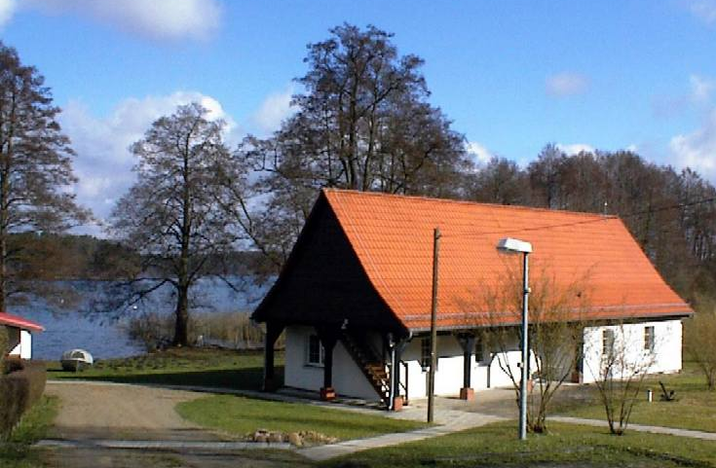
2.3 Regional Stations – monitoring program
The GAW Training and Education Centre (GAWTEC) & German GAW activities and monitoring
Schauinsland (UBA)
1988
Reactive gases
(SO₂, O₃, NO_{x}, CO, PAN, NH₃)
Greenhouse Gases
(CO₂, CH₄, N₂O, SF₆, ¹³C, ¹⁴C14, ¹⁸O)
Aerosols
(concentration & ingredients, particle number & size distribution)
Radiation
(solar radiation, UV-spectrum)
Neuglobsow (UBA)
1991
Reactive gases
(SO₂, O₃, NO, NO₂, CO, VOC,
carbonyls)
Greenhouse Gases
(CO₂, CH₄)
Aerosols
(PM₁₀ & ingredients)
Precipitation
(amount, pH, conductivity, major ions)
Meteorology
(temp., pressure, rel. humidity, wind speed & direction, prec. amount, global & reflex radiation, sunshine duration)
Integrated monitoring
Gartow (DWD)
Sept. 2016
Greenhouse Gases
(CO₂, CH₄)
Rn-222
Meteorology
(temp., pressure, humidity, wind:
surface, direction, speed,
horizontal)
Radiation
(global, solar)

Slide 12
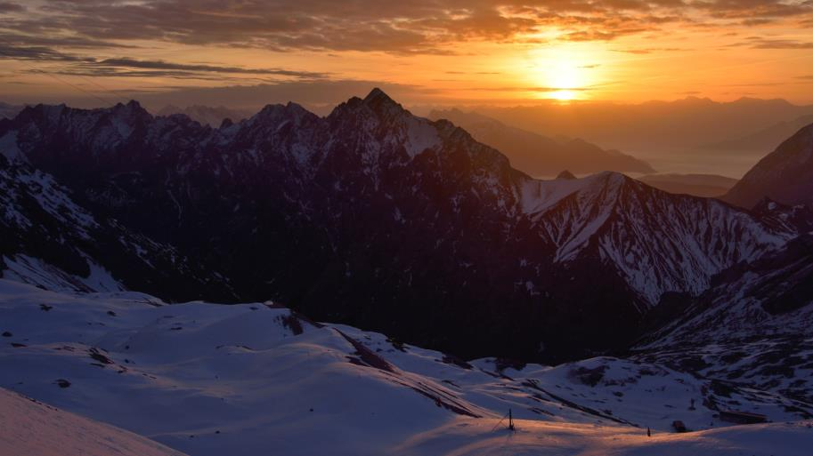
Thanks for your attention!
Mirella Glor
gawtec@schneefernerhaus.de
m.glor@schneefernerhaus.de

