Slide 1
30 Years of GAW Activities
in Korea
Chulkyu Lee, Sunae Jeong, Haeyoung Lee, Hye-Young Go, Sang-Rae Lee, Ho-Jeong Yang, Eun-Hye Lee, Hyo-Jin Park,
Mi-Ae Jang, Dong-Hyun Shin, Jun-Seok Cheong
Climate Change Monitoring Division (CCMD)
Korea Meteorological Administration (KMA)

Slide 2
Contents
01
Timeline of GAW Activities in Korea
02
Observations
03
WCC-SF₆ activities
04
Int’l Comparison Experiments & Audits
05
Other Activities
06
Summary

Slide 3
Timeline of GAW Activities in Korea (1/2)
1984
1984. 5. Total O₃ monitoring started at Seoul (SEO)
1986
1987. 1. Station established on the Mt. Soback
1990
1990. 8. GHGs monitoring started at Gosan (GSN)
1990. 11. GHGs monitoring started at Taeahn (TAP)
1992
1994. 1. UV and total ozone at Pohang (POH) started
1994
1995. 8. Real-time monitoring of GHGs started at Muan
1996. 9. Anmyeondo (AMY) station established
1996
1996. 12. 1st annual report on ozone monitoring issued
1997. 1. Atmospheric deposition monitoring started at AMY
1998
1997. 12. 1st annual report on GHGs monitoring issued
1998. 4. GHGs monitoring at AMY started
2000
1998. 10. 1st annual report on UV monitoring issued

Slide 4
Timeline of GAW Activities in Korea (2/2)
2000
2000. 12. 1st annual report on Korean GAW issued
2001. 9. 1st participation in CH₄ RRT (organized by JMA)
2004. 6. 1st participation in GHGs RRT (organized by NOAA)
2008
2009. 1. Jeju Gosan station established
2009. 12. 1st APGG held
2010
2011. 1. GAW-PFR Network participated
2012
2012. 10. WCC-SF₆ designated
2013. 12. AMY involved in NOAA Air Sampling Network
2014
2014. 5. Ulleungdo station established
2014. 10. 1st WCC-SF₆ training/education course held
2015. 3. KALION constructed
2016
2016. 5. Integration of Gosan GAW-related activities agreed

Slide 5
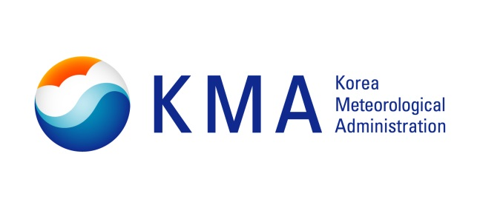
Climate Change Monitoring Division
Observations

Slide 6
Observation Programs of Interest
Greenhouse Gases
Reactive Gases
CO₂, CH₄, N₂O,
CFC_{11, 12, 113}, SF₆
SO₂, CO, NOx, O₃
Aerosols
Ozone & UV
Physical, chemical,
optical properties
UV-A, UV-B
Stratospheric Ozone
Total Atmospheric Deposition
Atmospheric Radiation
Acidity, Conductivity
F⁻, Cl⁻, NO₃⁻, SO₄²⁻,
Na⁺, NH₄⁺, K⁺, Mg²⁺, Ca²⁺
Direct/diffuse sunlight
Solar/terrestrial radiation
Net radiation

Slide 7
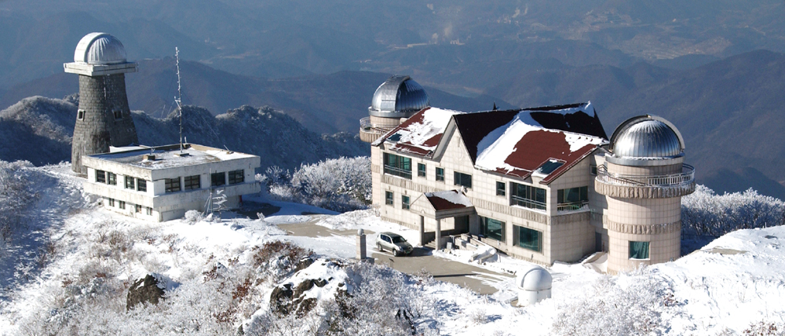
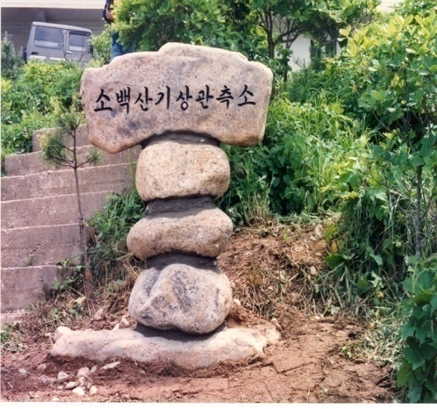
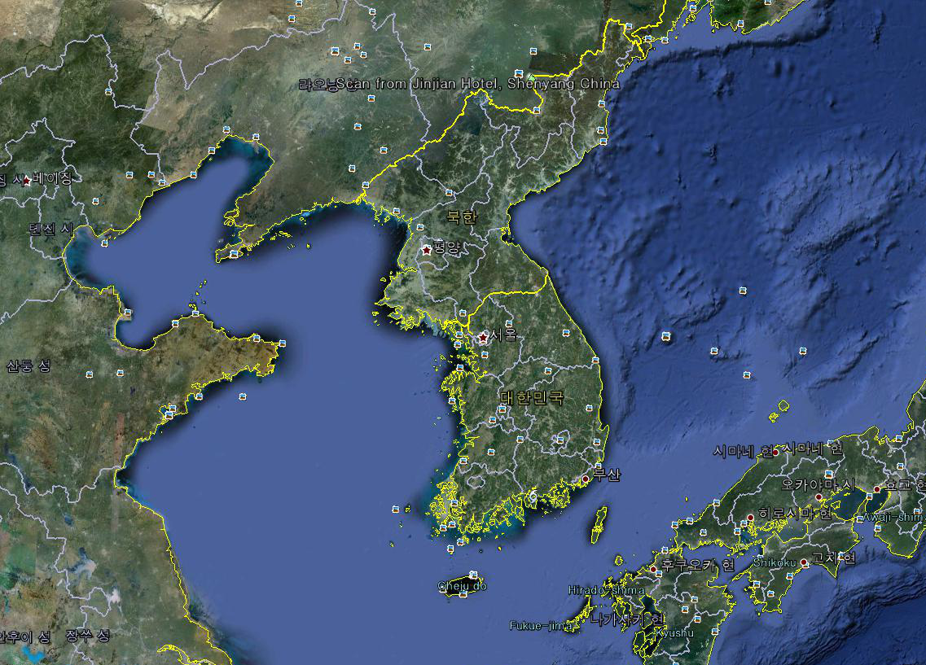
(KMA) 1987: Mt. Sobaek Station
KMA established it in 1987 on the Mt. Sobaek for the purpose of air pollution and meteorological measurements, and moved to the Anmyeondo in 1996
Notes:
Astronomical observatory

Slide 8
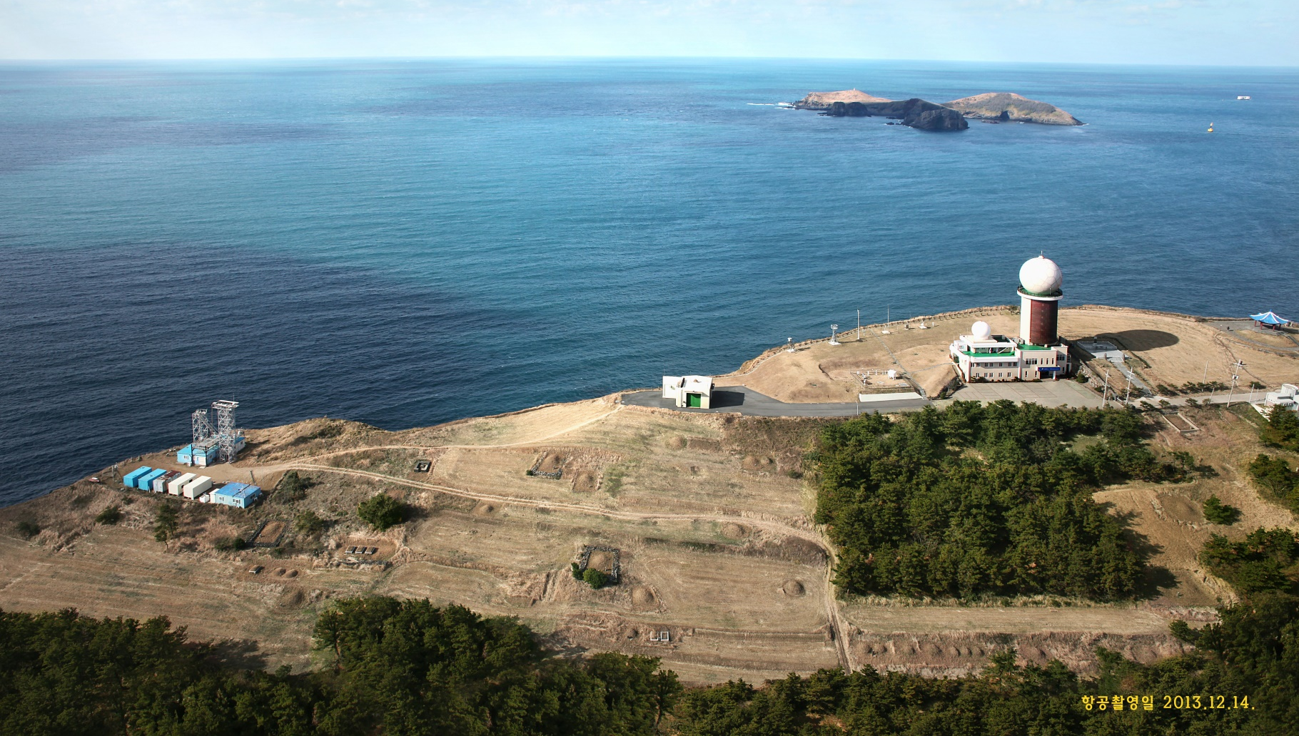
(KMA, Univ.) 1990: Gosan Station
Global Network
- AD-Net
- AERONET
- AGAGE
- EANET
- GALION
Gosan meteorological station
Radar observatory
ASOS
Super site
Global Network
- GAW-PFR
Established in 1990 and designated as the GAW regional station (GAW-ID: GSN) in 1990.

Slide 9
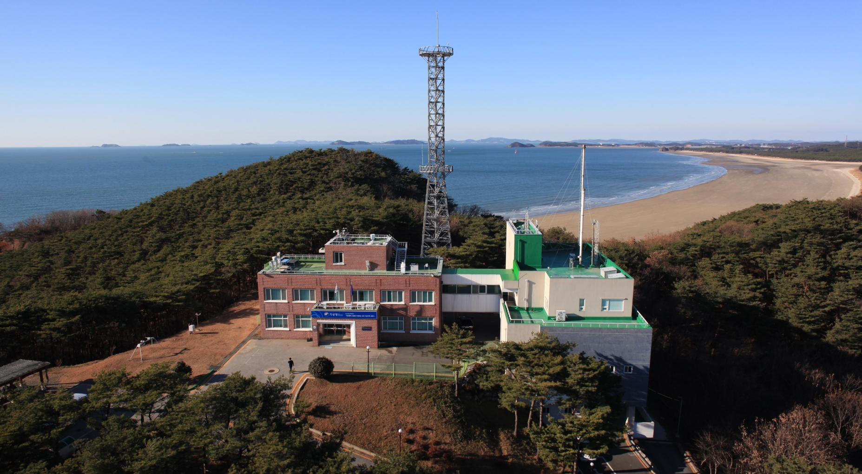
(KMA) 1996: Anmyondo Station
Lat./Lon.: 36° 32’/ 126° 19’
Air sampling tower (Jan 2003)
- 40 m AGL (86 m ASL)
Aerosol sampling inlets (Dec 2012)
Global Network
- GAW-PFR
- AERONET
- TCCON
Established in 1996 and designated as the GAW regional station (GAW-ID: AMY) in 1998
Notes:
Total Carbon Column Observing Network

Slide 10
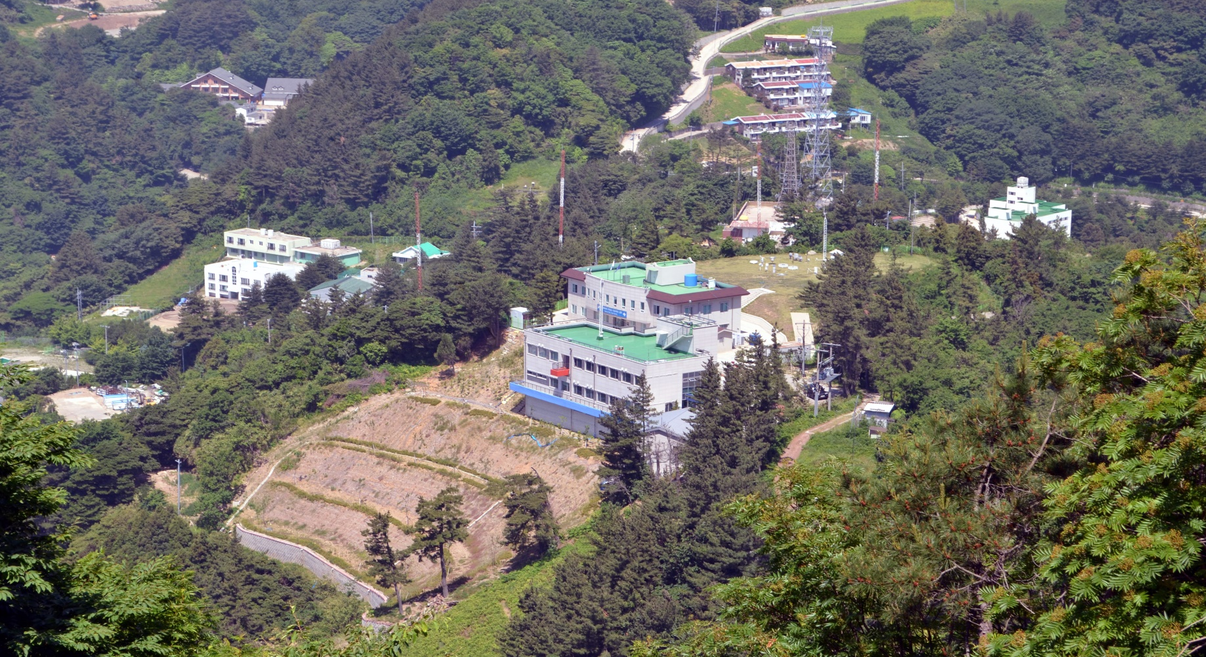
(KMA) 2014: Ulleungdo Station
Global Network
- GAW-PFR
Established in May 2014
Notes:
Astronomical observatory

Slide 11
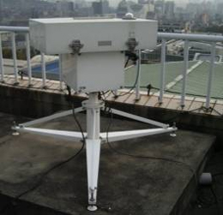
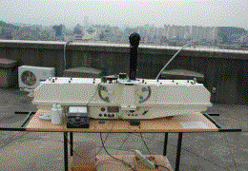
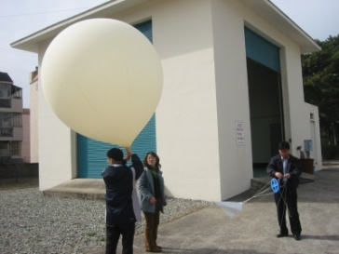
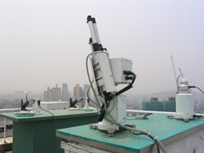
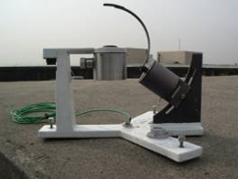
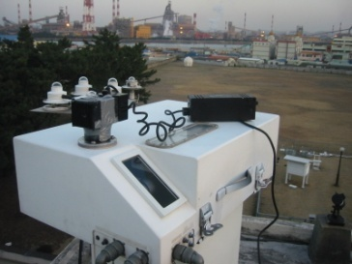
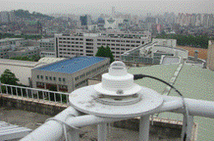
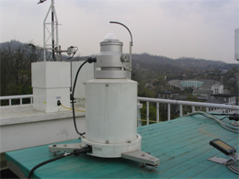
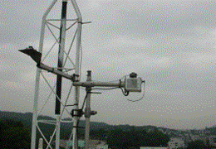
(KMA) Pohang (Yonsei Univ.) Seoul
Auxiliary station (1994~)
Data available since 1994
GAW regional station (ID: POH)
Auxiliary station of KMA (2004~)
Data available since 1984
GAW regional station (ID: SEO)
WMO/GAW/GO3OS,
AERONET
Ozone
- Total ozone column: Brewer
- Vert. distrib.: Brewer/Sonde
Atmospheric radiation
- UV-A,B
Dobson
Spectrophotometer
(Beck#124)
Brewer
Spectrometer
(MK-IV, No.148)
Skyradiometer
MFRSR
Sonde
UV-Biometer
Brewer
Skyviewer
RSR

Slide 12
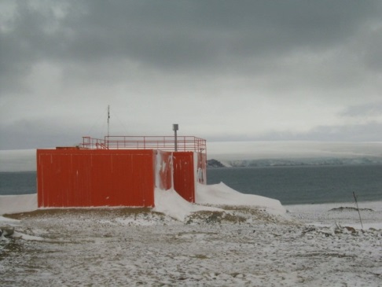
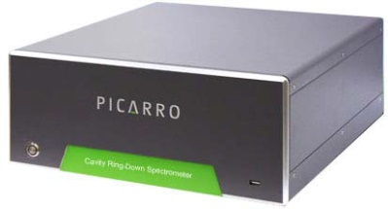
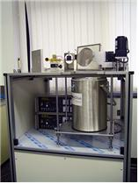
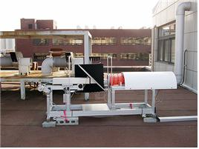
(KOPRI) King Sejong (SMWU) Seoul
* Korea Polar Research Institute
In Antartica
Auxiliary station of KMA (2010~)
Data available since 1988
GAW regional station (ID: KSJ)
* Sookmyeong Women’s Univ.
Auxiliary station of KMA (2015~)
Data available since 2006
NDACC
Stratospheric water vapor
- Vertical distribution
: Seoul Water Vapor Radiometer
(SWARA)
Ozone
- Vertical distribution
: Stratospheric Ozone Radiometer
in Seoul (SORAS)
Greenhouse gases
- CO₂, CH₄, N₂O, SF₆: Flask sampling,
weekly
- CO₂, CH₄: CRDS
Strat. ozone
- Total ozone column: Brewer
Reactive gases
- CO, O₃
Atmospheric radiation
- UV
SWARA
SORAS
Notes:
NDACC: Network for the Detection of Atmospheric Composition Change

Slide 13
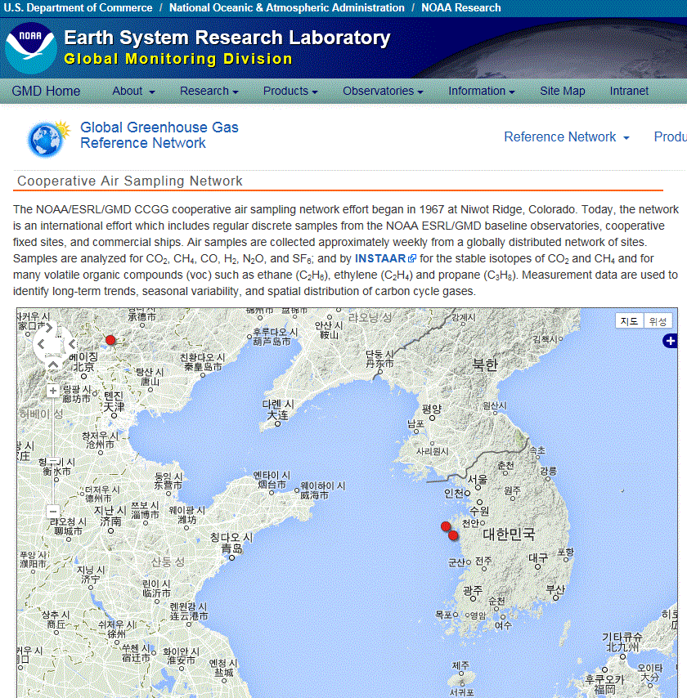
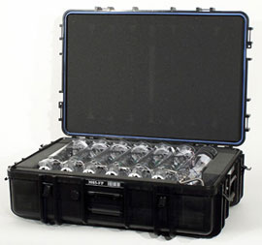
(KCAER) Taeahn
(Seoul Nat’l Univ.) Gwangleung
Established in 1990, NOAA/GMD
(KCAER, www.kcar.re.kr)
- Weekly-based flask sampling
Data available since 1990
GAW regional station (ID: TAP)
Auxiliary stations of KMA
Data available since 2006
Data: CO₂ flux
(GIST) Gwangju
Greenhouse gases
- CO₂, CH₄, C₂H₆, C₃H₈
Reactive gases
- CO
Auxiliary stations of KMA
Data available since 2004
Data: AOD (Sunphotometer)
Aerosol vertical profile (LIDAR)
(Jeju Nat’l Univ.) Gosan
Auxiliary stations of KMA
Data available since 2011
Data: Radon(²²²Rn)
http://www.esrl.noaa.gov/gmd/dv/site/TAP.html

Slide 14
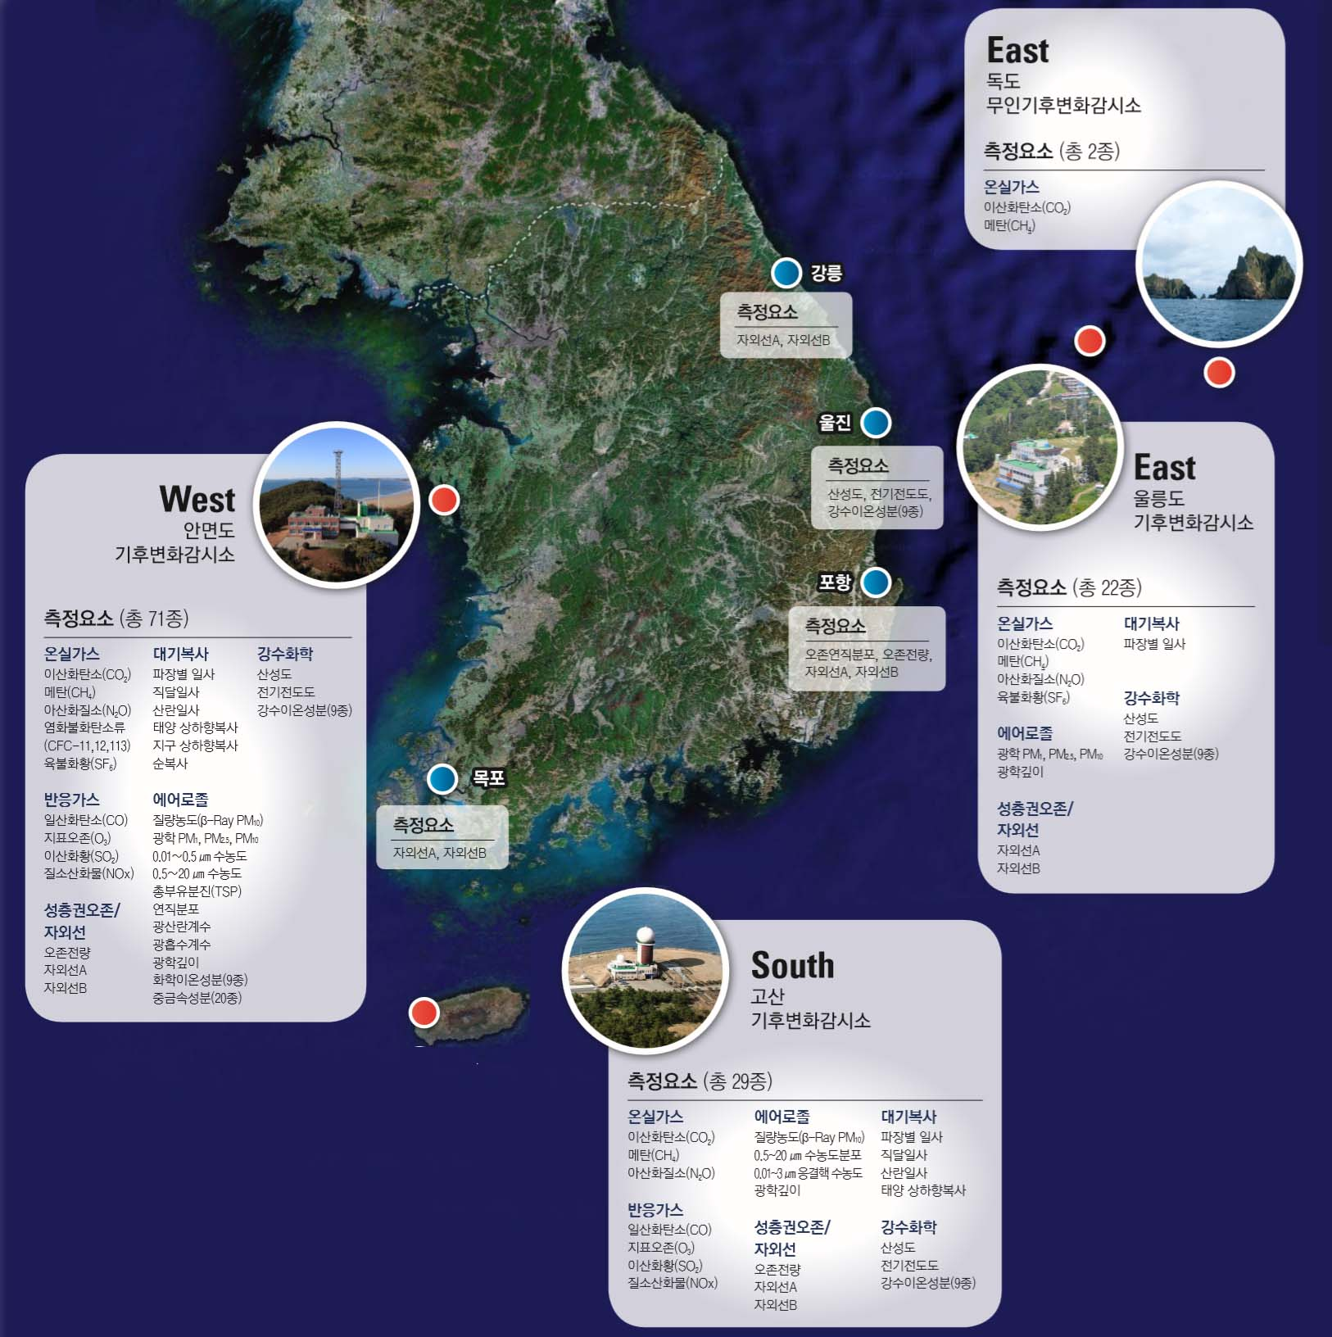
(KMA) 2016: Main and Auxiliary Stations
Main stations (KMA)
3 main stations and
8 auxiliary stations in the Korean Peninsula
1 auxiliary station in Antarctica
- AMY, JGS, ULL
- GHGs, Reactive gases,
Aerosols, Strat. O₃,
Radiation, Atmos. depos.
E,F,G
A
Ulleungdo (ULL)
Anmyeondo (AMY)
B
Auxiliary stations (KMA)
C
- A, D: UV
- B : Strat. Ozone, UV
- C : Atmos. depos.
- D : Ozone-sonde, UV
H
D
Auxiliary stations (Univ.)
I
- E: CO₂
- F: Strat. O₃, UV
- G: H₂O_{(g)}/Strat. O₃
- H: Aerosol LIDAR, AOD
- I: Radon
- J: CO₂, Strat. O₃
Jeju Gosan (JGS)
G
Antarctica (King Sejong)
(Main stations are run by EMRD, KMA/NIMS)

Slide 15
GAW Stations in Korea
6 regional stations &
1 contributing station in the Korean Peninsula
1 regional station in Antarctica
Seoul (SEO)
Taeahn Peninsula (TAP)
Daejeon (DJN)
- Aerosols
Anmyeon-do (AMY)
Pohang (POH)
Gosan (GSN)
Jeju Gosan (JGS)
King Sejong (KSG), Antartica

Slide 16
Climate Change Monitoring Division
WCC-SF₆ Activities

Slide 17
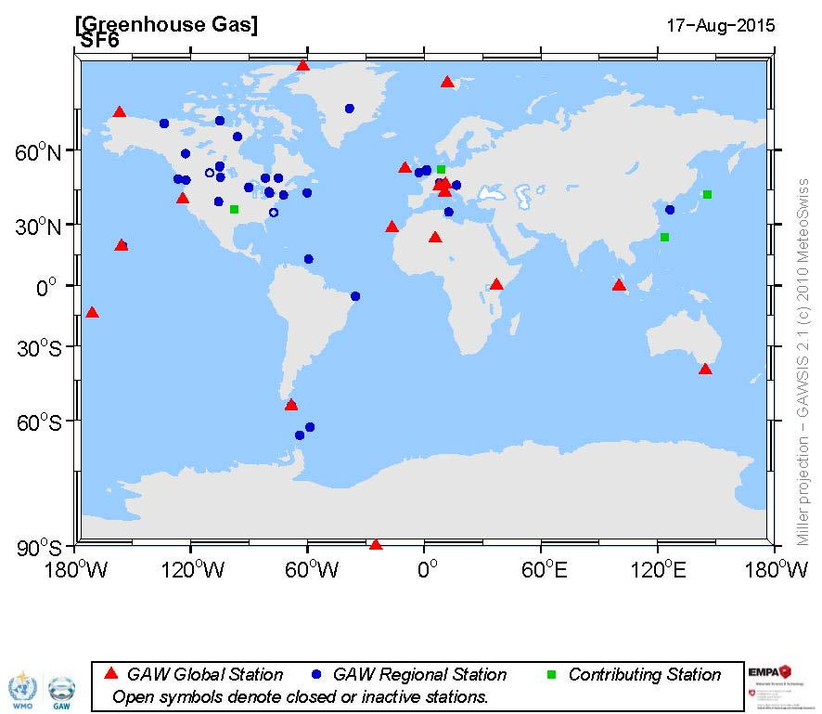
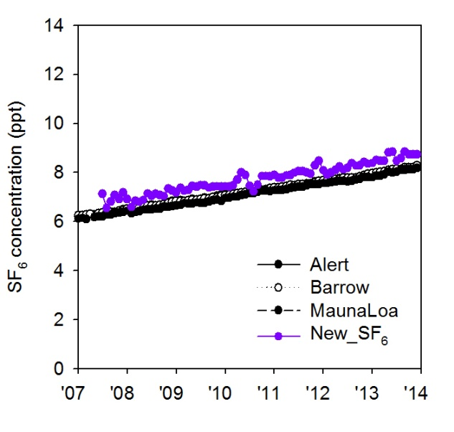
World Calibration Centre for SF₆ (WCC-SF₆)
55 stations
Global 17, Regional 33,
Contributing 4, Non-GAW 1
Anmyeon
SF₆ is a very potent and long lived greenhouse gas, now it is not great menace to climate change though due to its small amounts in atmosphere
KMA has measured SF₆ since 2007, was designated as the WCC-SF₆ by WMO in 2012, and has run it since 2013.

Slide 18
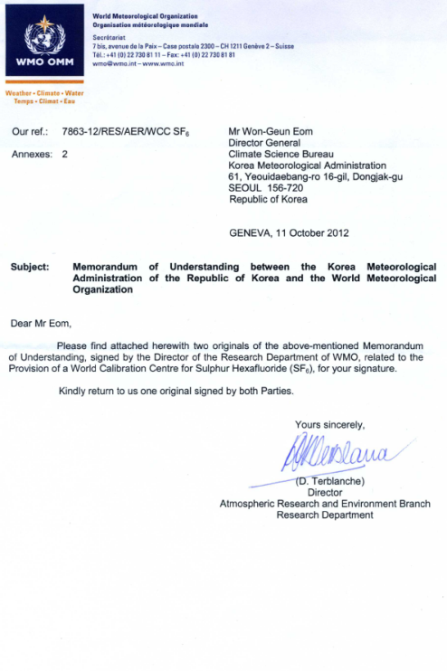
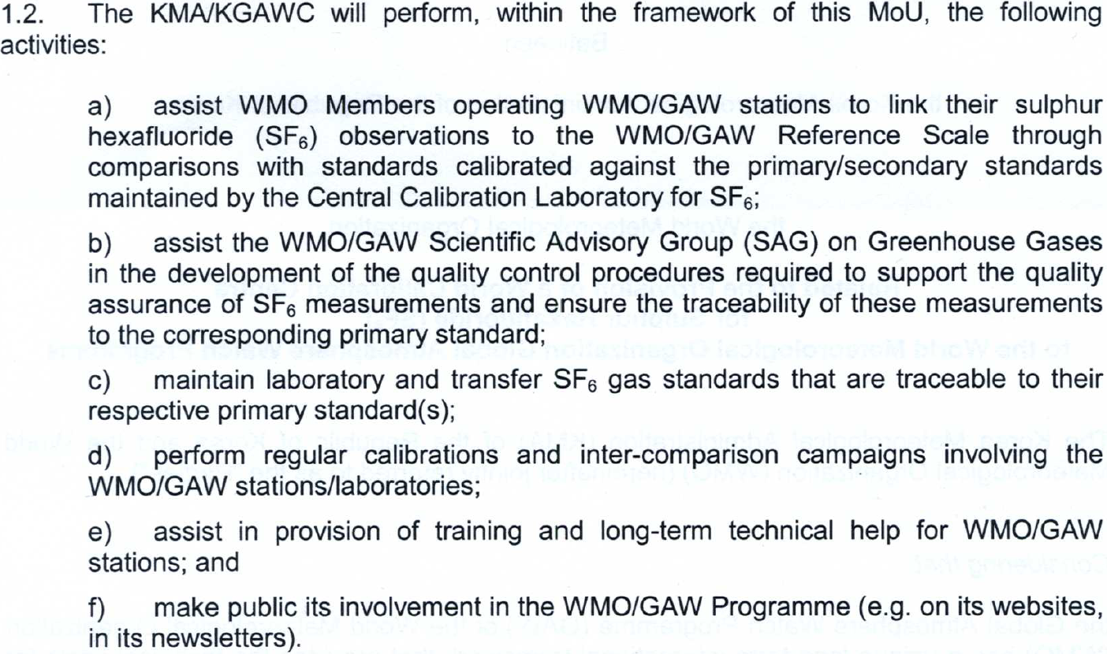
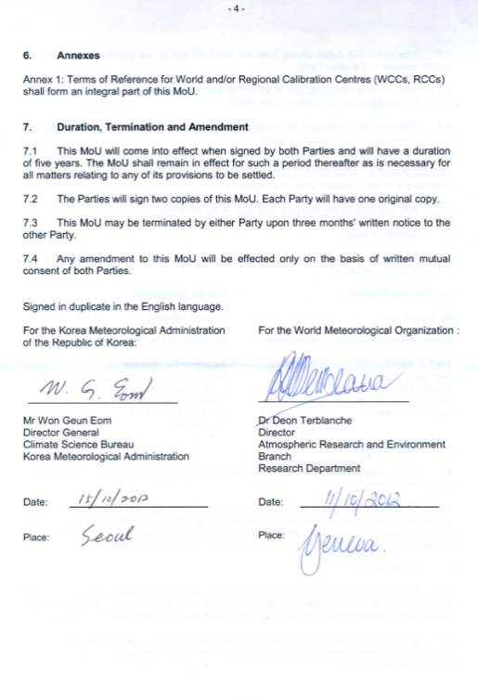
World Calibration Centre for SF₆ (WCC-SF₆)
(Agreed on 11 Oct. 2012)
a) → Distribution of the tertiary standards
Audit
b) → Development of the Q/C procedures
c) → Development of the tertiary standards
d) → Round-robin comparison experiments
e) → Training and education course,
Technical support
f ) → Publications, e.g., newsletters

Slide 19
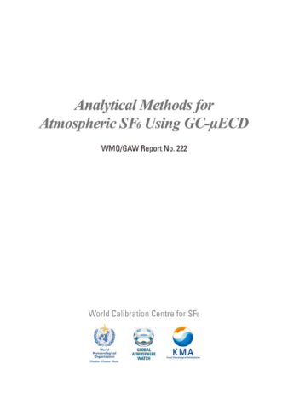
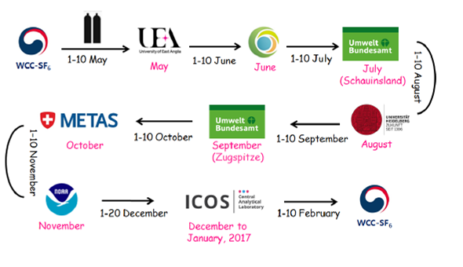
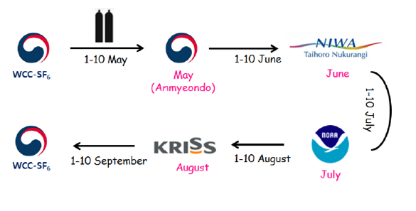
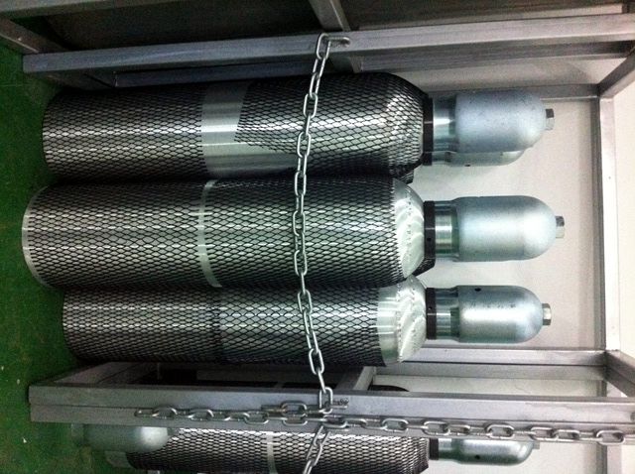
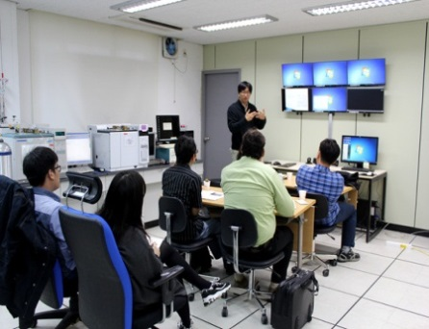
What WCC-SF₆ has done
Development of SOP
- Posted on the WMO GAW website
Distribution of the tertiary SF₆ standard gases
- in connection with audit and technical support
Audit and/or technical support
- Diagnose the measurement system
- Help build up and improve methodologies
; IITM in 2015, Cape Point in 2016
Round Robin Comparison
- Started in May 2016 (11 instit. from 7 countries)
Training and education course
- Annually hold the course linked with APGG
WMO/GAW
Report No. 222

Slide 20
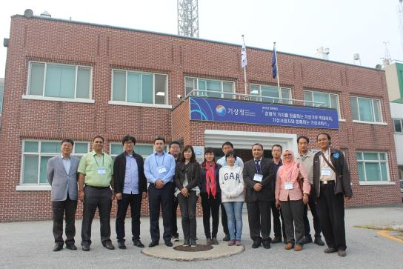
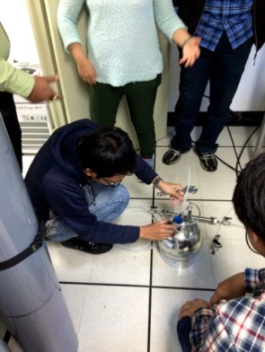
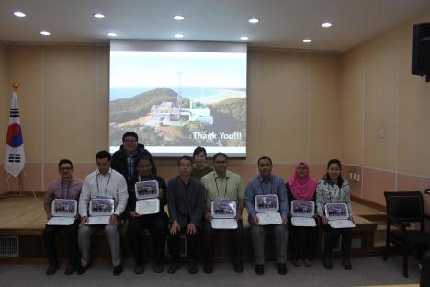
Training and Education Course
1st in 2014
2nd in 2015
October 19 – 21, 2014
Anmyeondo station
2 from India, Indonesia
October 19 – 21, 2015
Anmyeondo station
7 from Malaysia, Indonesia, Tadzhikistan, Jordan, India, Costa Rica, Vietnam

Slide 21
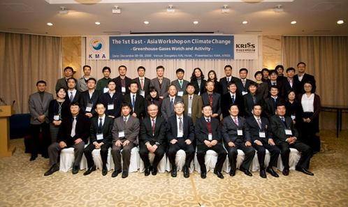
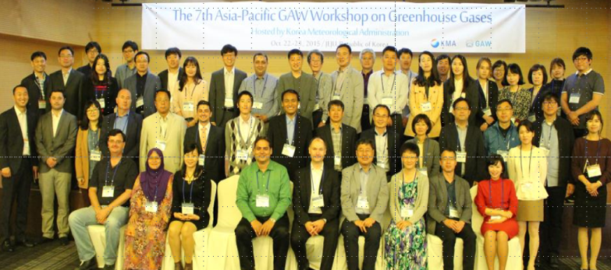
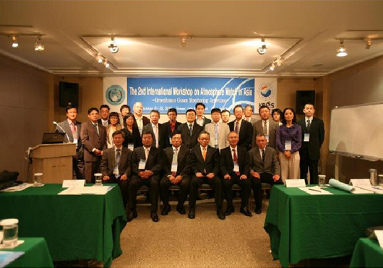
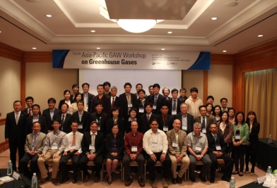
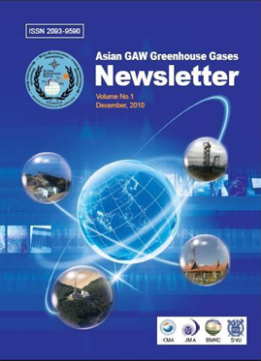
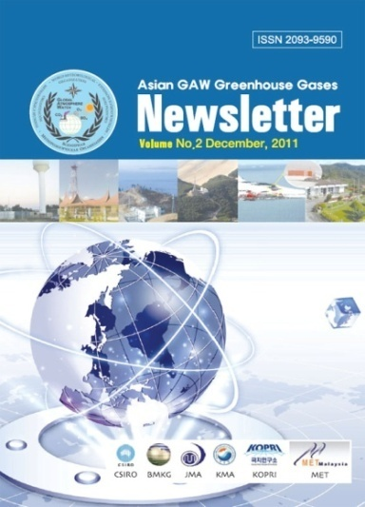
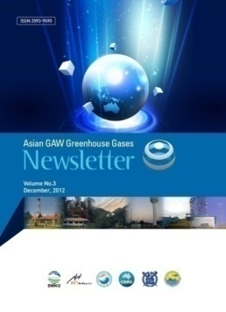
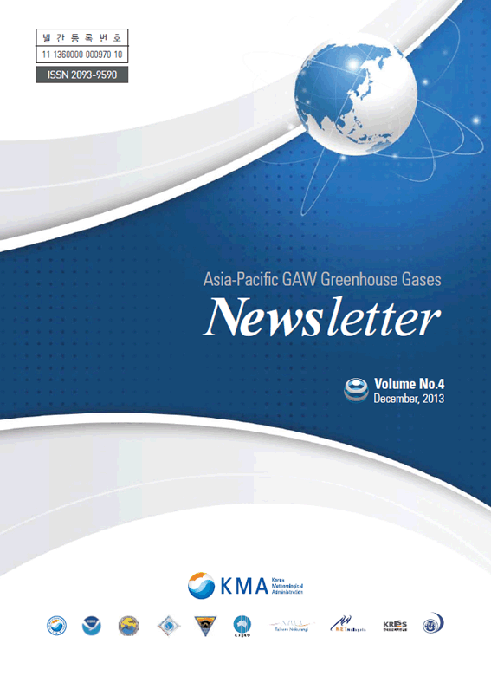
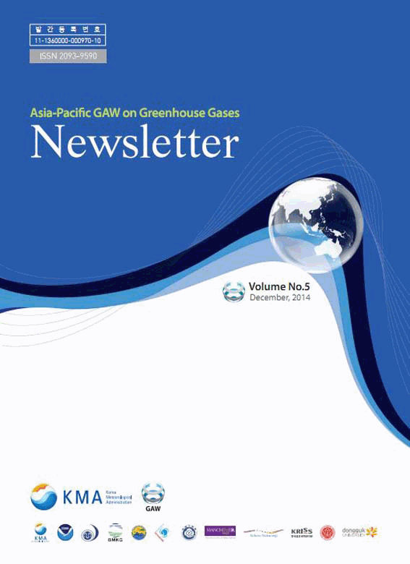
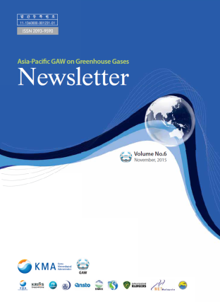
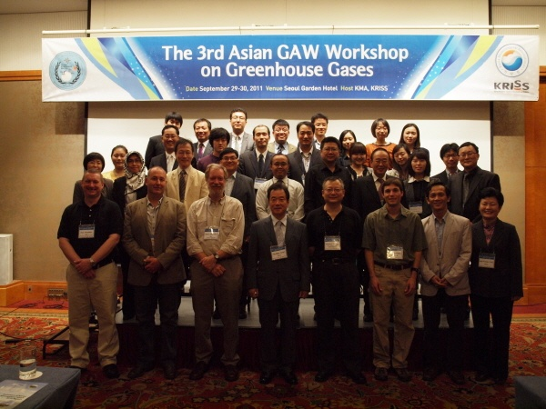
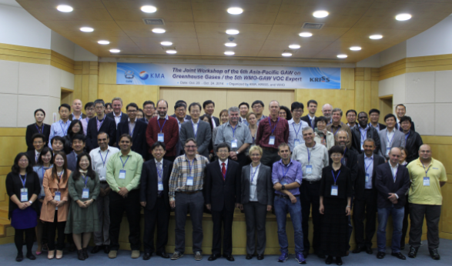
Asia-Pacific GAW Workshop on Greenhouse Gases
1st Asian GAW workshop in 2009
4th Asian GAW workshop in 2012
7th Asia-Pacific GAW workshop in 2015
2nd Asian GAW workshop in 2010
5th Asia-Pacific GAW workshop in 2013
http://www.wmo.int/pages/prog/arep/gaw_home_en.html
3rd Asian GAW workshop in 2011
6th Asia-Pacific GAW workshop in 2014

Slide 22
Climate Change Monitoring Division
Int’l Comparison Experiments &
Audits

Slide 23
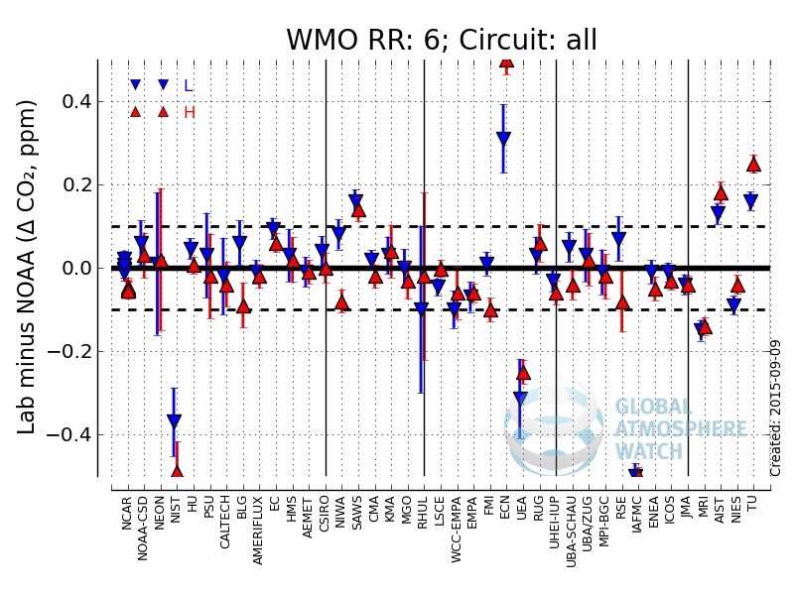
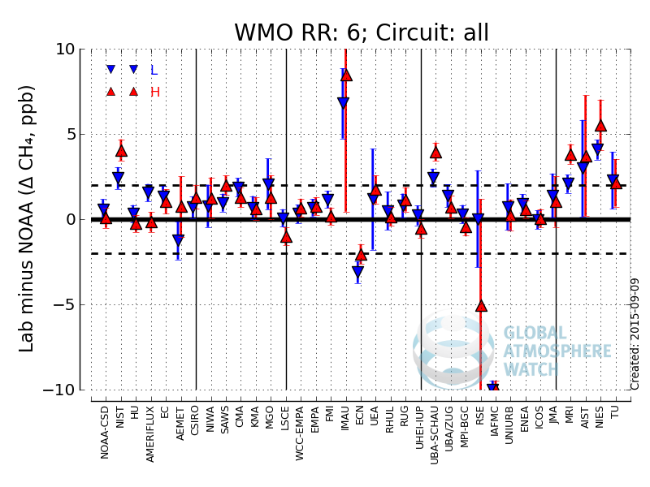
Participation in Round-Robin Comparisons
Participated Round-Robin Experiments since 2004,
organized by WMO-CCL in NOAA
; Jun. 2004: 4th RR (2002-2007) / CO₂
Jul. 2010: 5th RR (2009-2012) / CO₂, CH₄, N₂O, SF₆
Jan. 2015: 6th RR (2014-2015) / CO₂, CH₄, N₂O, SF₆
< ΔCO₂, ΔCH₄, ΔN₂O, ΔSF₆, ΔCO in RR6 >
(Source: http://www.esrl.noaa.gov/gmd/ccgg/wmorr/)

Slide 24
Participation in Methane Inter-comparisons
Taken part in Methane Reference Gas Inter-comparisons since 2001,
organized by WMO WCC-CH₄ in JMA
Sep. 2001
Apr. 2006
Nov. 2008
Jan. 2013
Apr. 2015
… KMA ….
(Source: http://ds.data.jma.go.jp/gmd/wcc/wcc.html)

Slide 25
Participation in Precip. Chem. Inter-comparisons
Taken part in Inter-comparison in Precipitation Chemistry since 1990,
organized by WDC-PC; once for 1990-2000, twice since 2001
<E.g.: Results of Inter-comparisons held in May 2015>
Sample 1
Sample 1
Sample 3
Good: IQR (Interquartile Range, 25th∼75th)
Satisfactory: within Median ± IQR/1.349
Unsatisfactory: out of Median ±IQR/1.349
Out of Detection Limit

Slide 26
Audit by World Calibration Centres
Taken on AMY aerosol observations by WCC-AP (LIFT) in 2006, and
CO₂/CH₄ by WCC-CO₂,CH₄ (Empa) in 2014
< Example of audit results, Empa, 2015 >
Conclusion of the report
The Regional GAW station Anmyeon-do comprises a very comprehensive set of measurements.
The combination of long-term measurements, the large number of measured parameters and the location of the site make the AMY station a very important contribution to the GAW programme.
The assessed GHG measurements were of high quality.
WCC-Empa strongly encourages this process, since the available data would be a very valuable contribution to GAW.
The continuation of the Anmyeon-do measurement series as well as the inclusion of the reactive gases measurement programme as GAW parameters is highly recommended.
Notes:
World Calibration Centre for Aerosol Physics, Leibniz Institute for Tropospheric Research

Slide 27
Climate Change Monitoring Division
Other Activities

Slide 28
Gosan (GSN), Supersite (SNU, KNU, JNU, KMA, etc.)
Jeju Gosan station
Super site

Slide 29
Gosan (GSN), Supersite (SNU, KNU, JNU, KMA, etc.)
Aerosols
- PM_{1,2.5,10}, EC/OC, Size distrib., No. density,
Scatt. coeff., Absorp. coeff., SSA, AOD, Vert. distrib.
- Chemical ions/elements (>30)
Greenhouse gases (AGAGE)
- CO₂, CH₄, Isotopes, Halogenated (CFCs, HCFCs, HFCs, PFCs)
Atmospheric radiation
- Direct/scattered solar radi., Terrestrial radi., UV.
Reactive gases
- CO, SO₂, NOx, O₃
Others: ²²²Rn, Total atmos. depos.
⇒ are integrating the measurements and sharing the data,
following construction of sampling inlets, laboratories, etc.

Slide 30
Korea Aerosol LIDAR Observation Network
KALION
- 9 institutes
- 12 sites
Gangneung-Wonju National University
Gwangju Institute of Science and Technology
National Institute of Environmental Sciences
National Institute of Meteorological Sciences
Mokwon University
Seoul National University
Research Institute of Public Health and Environment
Ulsan National Institute of Science and Technology
Hanbat National University
Asian dust
Fire plumes
Volcanic plumes
Monitoring of aerosols over the Korean Peninsula
Estimate effects on climate
Prediction the Asian dust & fine particles
Promote researches related to aerosols

Slide 31
Sharing Output from KALION
Backscattering
coeff.
Depolarization
ratio
Color ratio
Extinction
coeff.
(AOD data available)
Clouds
Asian Dust
Pollutants
Mass concentrations
Served via webpage
(under renovation)
(in collaboration with S. W. Kim, SNU)

Slide 32
Integration of Aerosol RS Networks (To be)
Monitoring of aerosols over the Korean Peninsula, using
Ground-based LIDAR network: 12 sites
Ceilometer network: 92 sites
Satellite-based observation: geostationary & polar-orbit satellites
(Uno et al., 2008; NASA)
Image Credit: John Holdzkom & Jim Szykman
(in collaboration with S. W. Kim, SNU & K. H. Lee, GWNU)

Slide 33
Integration of Observations over Korea (To be)
Geostationary Meteorological
Satellite (COMS)
Polar-orbit
Meteorological Satellite
Polar-orbit
Environmental Satellite
Aircraft
AMDAR
GAW Stations
(AMY, JGS, GSN, ULL, …)
Sonde
Ship
Nat’l Meteorological Satellite Center
AWS
Wind-profiler
AMDAR
ASOS
Doppler
RADAR
(WIGOS: WMO Integrated Global Observing System)

Slide 34
Summary
Anmyeon-do (Korea)
Gosan (Korea)
Ulleung-do 1 (Korea)
Ulleung-do 2 (Korea)
Mauna Loa
Global average
Scattering coefficients
at 450 ㎚ (blue), 550 ㎚ (Green), 700 ㎚ (Red)
Absorption coefficients
at 520 ㎚ (Blue-green), 880 ㎚ (Black)
Seasonal
variations of ions
for 1999 - 2014
We make these kinds of plots on other components in fields of GAW, and improve/develope techniques for the GAW activities

