Slide 1

Updates from WMO/GAW and New GAW Implementation Plan
Oksana Tarasova
WMO Research Department

Slide 2
Broad international agenda (2015)
“Transforming our world: the 2030 Agenda for Sustainable Development” - 17 Sustainable Development Goals with 169 associated targets
Sendai Framework for Disaster Risk Reduction 2015–2030 with seven global targets
Paris Agreement adopted by conference of parties to United Nations Framework Convention on Climate Change (COP-21)

Slide 3

Some goals are relevant to WMO activities (e.g. Goal 13: Take urgent actions to combat climate change and its impacts)
Challenges and opportunities:
WMO is a technical agency rather than a development one, the value is in scientific excellence and expertize
BUT
In many countries the national agenda is driven by SDGs
And there are associated funding opportunities

Slide 4

Disaster Risk Reduction
WMO contribution to the Sendai Framework (2015-2030)
  International network of multi-hazard early warning systems
    Multi‐stakeholder partnership that will foster cooperation, collaboration, and networking in strengthening MHEWS
    Sharing information about best practices and scientific, technical and social information to disseminate early warnings and enhance climate resilience
  Impact-oriented warnings
    Analysis of physical impacts of forecasted phenomena
    Specific precautionary measures
  From Disaster Risk Reduction to Adaptation
Notes:
Important contribution of WMO to the Third World Conference on Disaster Risk Reduction:
Launch of the International network of multi-hazard early warning systems
Promotion of the concepts of multi-hazard Impact-based forecast and warning services
WMO extends technical and operational support to NMHSs through its scientific and technical programmes/commissions, its Global Data-Processing and Forecasting System (GDPFS) provided by a network of three World Meteorological Centres (WMCs) and 12 Global Producing Centres (GPCs), 40 Regional Specialized Meteorological Centres (RSMCs) and the Regional Climate Centres (RCCs), and National Meteorological Centres (NMCs) as well as the WMO Information System (WIS) that is built upon the Global Telecommunication System (GTS).
Over the past decade, various capacity development initiatives for national EWS in over 50 countries have contributed to enhancing EWS and, in turn, to reducing substantially mortality risk from natural hazards.
Furthermore, to sustain this gain and further build the capacities of NMHSs to support DRR services, WMO is developing international standards and guidelines for weather, climate and hydrological hazard definitions and methodologies for statistical and forward-looking hazard analysis.
WMO is expanding on scientific advances to increase the availability and accuracy of user-friendly climate services to help countries and communities, especially the most vulnerable, to better manage climate risks and opportunities.

Slide 5

Paris Climate Change Conference (COP21)
Ahead of the meeting, 184 countries, responsible for 95% of global greenhouse gas emissions, had delivered their national climate action plans (INDCS)
196 parties to the UNFCCC reached an ambitious, dynamic and universal agreement that is designed to last
UN Secretary-General: “For the first time, every country in the world has pledged to curb emissions, strengthen resilience and join in common cause to take climate action”

Slide 6

GAW Implementation Plan
(2016-2023)
The plan concerns only implementation of the GAW Programme, WMO Strategic Plan is taken as an overall strategy
Focuses on the major principles, and includes Action Items for all GAW elements
Follows the concept “research enabling services” – the activities are around application areas rather than focused on GAW parameter specific areas
More focus on modeling tools and value added products
The plan was approved by WMO Commission for Atmospheric Sciences and endorsed by WMO Executive Council in 2016
Notes:
IF science does not have any impact on society, it becomes irrelevant

Slide 7
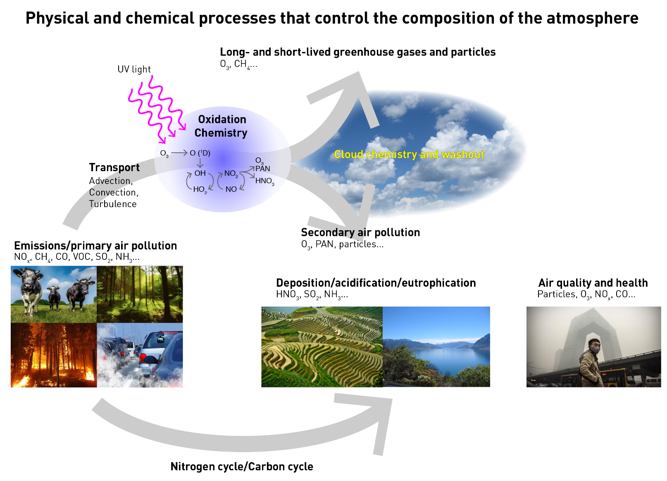
GAW Implementation Plan (2016-2023): “science for services”
IP builds upon the premise that atmospheric composition matters to:
climate,
weather forecasting,
human health,
terrestrial and aquatic ecosystems,
agricultural productivity,
aeronautical operations, etc

Slide 8

Main GAW Objectives
Meeting the growing need for atmospheric composition information and related services requires:
Increased efforts towards enhancing observing systems with broader use of GAW observations and research activities to support the development of services with high societal impact;
Enhanced modeling efforts;
Improved information management infrastructure;
Stronger efforts towards building collaborations, capacity and communications.
Promote a “value chain” from observations to services

Slide 9
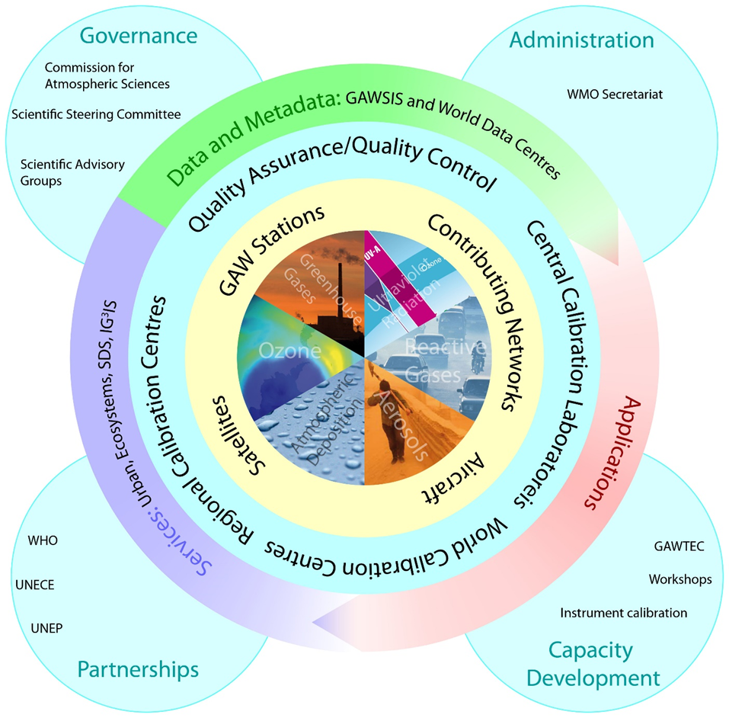
Transformation of the GAW Programme
New GAW Data Management strategy
New Scientific Advisory Group on Applications
New focal area – total deposition

Slide 10

Three broad application areas identified
The broad application areas to drive the plan:
“atmospheric composition forecasting”,
“atmospheric composition analysis and monitoring”
“urban services”.
They are used to streamline research and implementation strategies that build on the observations acquired under the GAW Programme.

Slide 11

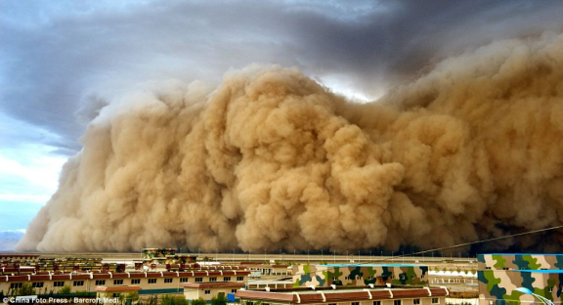

Example of the applications in GAW
Support of climate negotiations: Integrated Global Greenhouse Gas Information System
Ecosystem services: analysis of total deposition, nitrogen cycle, deposition to the oceans/marine geoengineering
Health: sand and dust storms, urban air quality (GURME), biomass burning
Food security: atmospheric composition and agriculture
Transport security: volcanic ash forecasting

Slide 12
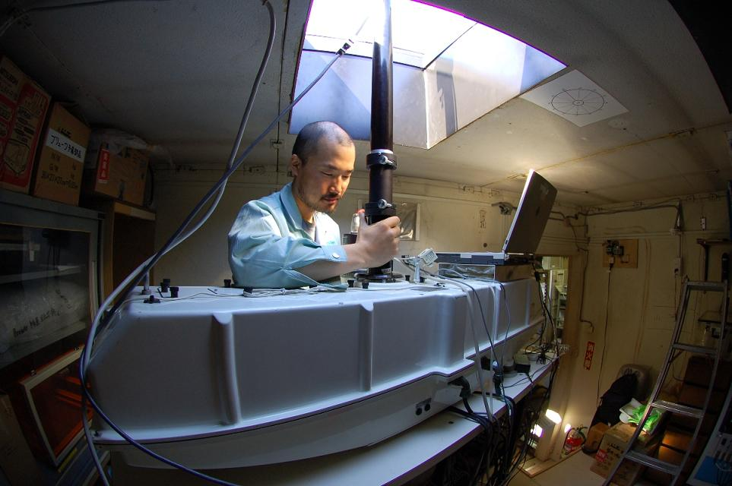
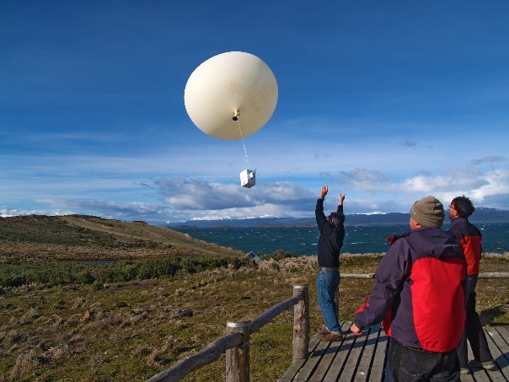

GAW – Observing System
Continue to improve observational systems and data using RRR and WIGOS/WIS (WMO Integrated Global Observing System and WMO Information System) to evolve the observing system for atmospheric composition to support the growing services to:
☑ allow near real-time provision of GAW data,
☑ support integration of surface, vertical profile and column datasets from different platforms to provide a unified understanding of aerosol and gas distributions,
☑ minimize gaps in the measurement networks in data-poor regions.

Slide 13
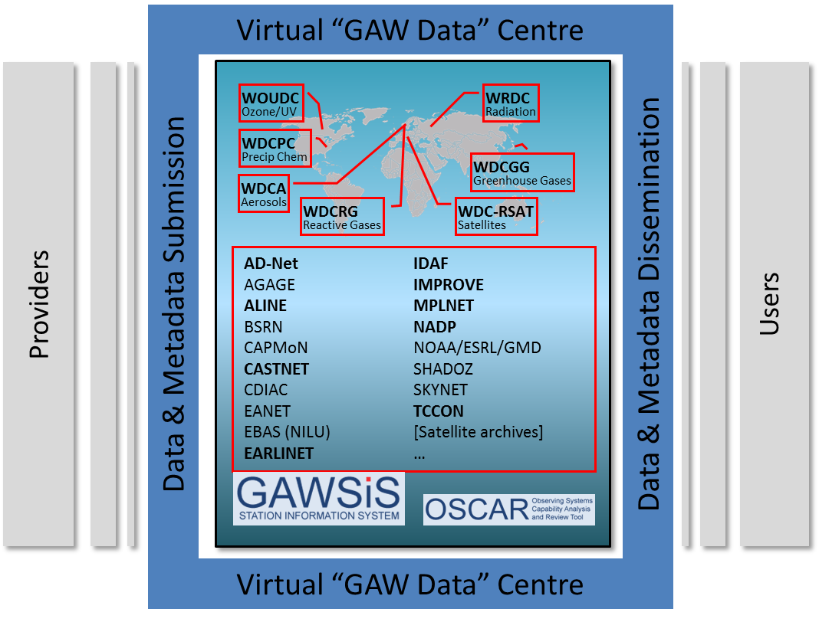
GAW Data Management
Key Element: Enhancing data management architectures to facilitate improved metadata exchange and interoperability, data discovery and analysis, and to promote and facilitate the near-real time delivery of data.

Slide 14

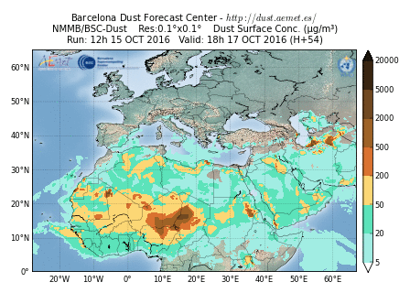
GAW – enhancing modeling
Expand GAW’s role in enhancing predictive capabilities (of atmospheric composition and its uses)
☑ through further developing urban air quality forecasting capabilities through (GURME) ,
☑ establishing a new SAG (“Apps”) – usefulness exchanging chemical observational data in NRT)
☑ expanding collaborations with World Weather Research Programme/World Climate Research Programme /Working Group on Numerical Experimentation and others
Notes:
Development of models (improved atmospheric chemistry and aerosol parametrization in NWP)
Development of data assimilation techniques
Improve atmospheric transport modelling
Improve inverse modelling methods

Slide 15
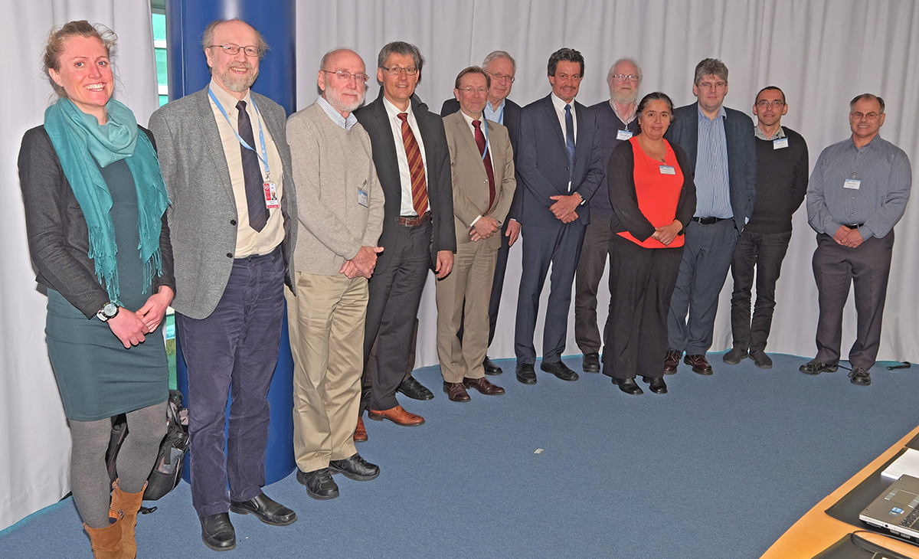
The Environmental Pollution and Atmospheric Chemistry Scientific Steering Committee (EPAC SSC) meeting, 15 -17 March 2016
The first day was focused on partnerships (external partners involved UNEP, WHO, SPARC, GESAMP)
Finalized GAW Implementation Plan (2016-2023)

Slide 16
EPAC SSC important action items
Develop a strategy on Nitrogen
Plan a Workshop on low costs sensors with UNEP/WHO/WMO
Work on UNEP/WHO/GAW joint data coordination
Develop concepts/business models for resource mobilization
Refine collaboration with Global Climate Observing System
Complete establishment of the Rolling Review of Requirements process for evolution of the observing network
Develop a strategy to further engage Young Scientist into GAW
Enhance GAW Communications
Develop an integrated strategy within GAW for aerosols
Details/challenges of the GAW implementation at will be discussed at the GAW Symposium 2017, 10-13 April, Geneva

Slide 17
SAG-Applications launched
The kick-off meeting of the SAG-Applications was organized at ECMWF in Reading, UK during 8-10 June 2016.
Some Challenges:
§ Align a large number of international initiatives that have their own agenda, plans…
§ Increase the visibility of GAW and document the usefulness of quality-controlled observations in the applications value-adding chains
§ Promote good practices and benchmarking capabilities for emerging applications
§ Identify current scientific deadlocks underpinning progress in the performance of applications
§ Support development of regional Air Quality monitoring and forecasting information in areas where they do not exist or struggle to emerge (with GURME)
§ Build up a portfolio compelling end-to-end cases of why (quality-controlled, NRT) atmospheric composition monitoring matters: NWP, Aviation, Health…

Slide 18
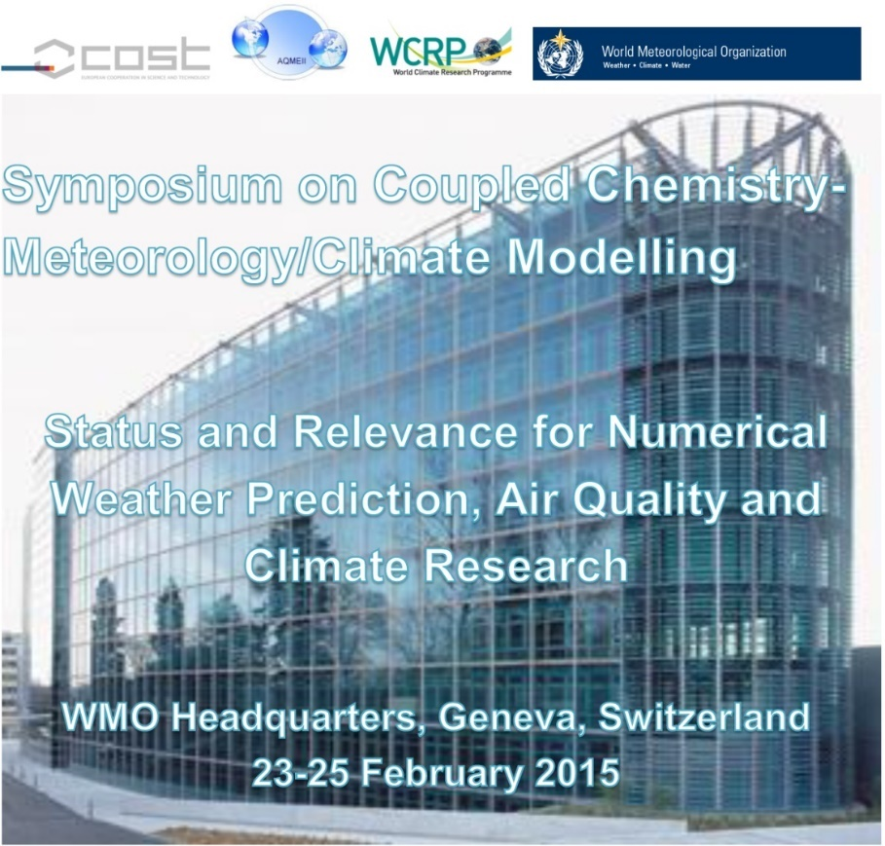
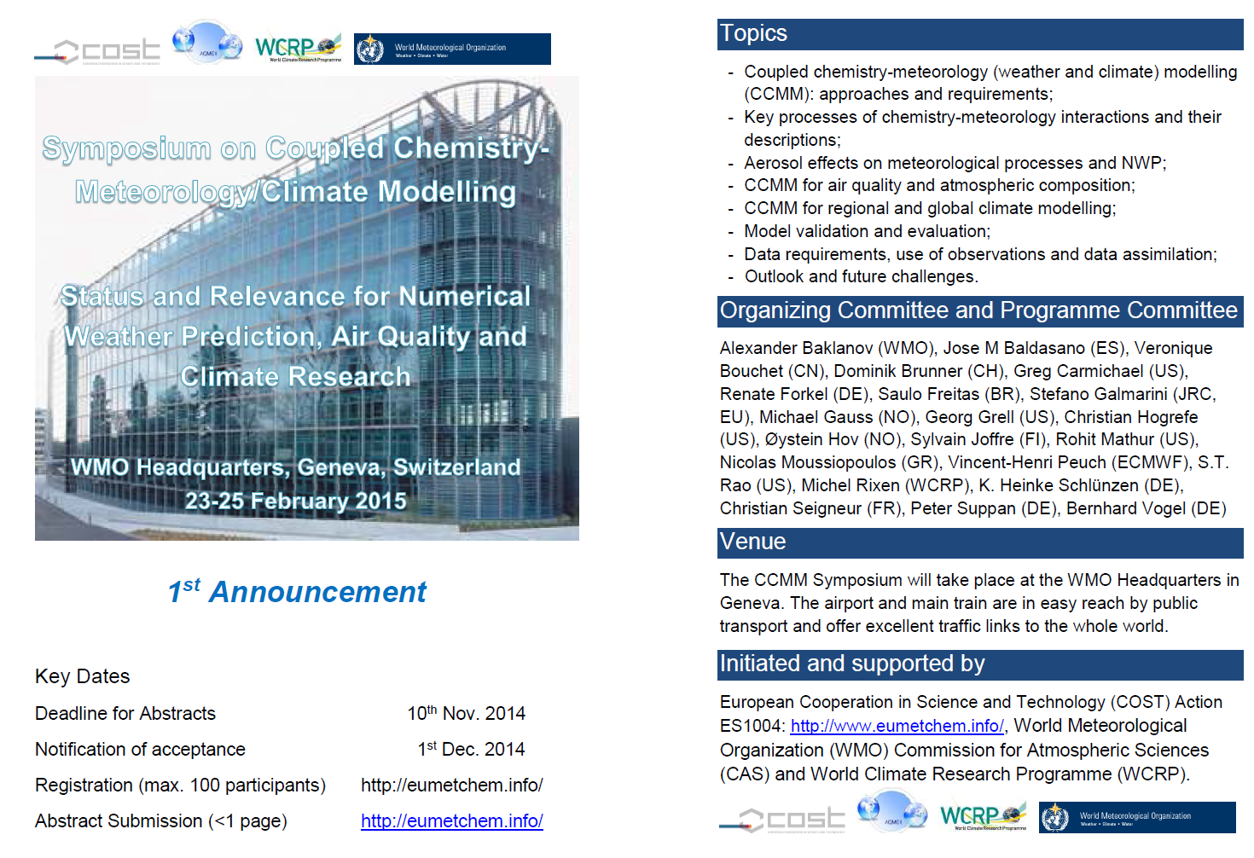
100 participants from all continents
46 oral talks, 36 posters,
All presentations are available on:
http://eumetchem.info/
7 topics brain-storm teams to conclude
WMO Report to be published
ACP & GMD Journal CCMM Special Issue
Outcomes provided for 17th WMO Congress

Slide 19
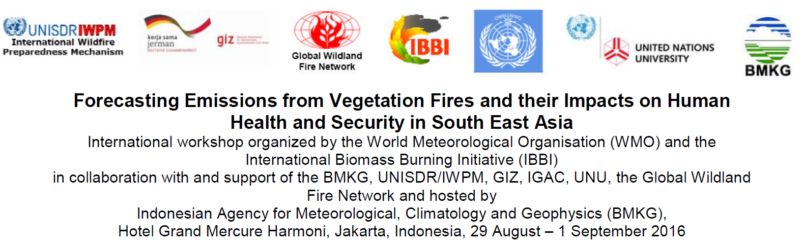
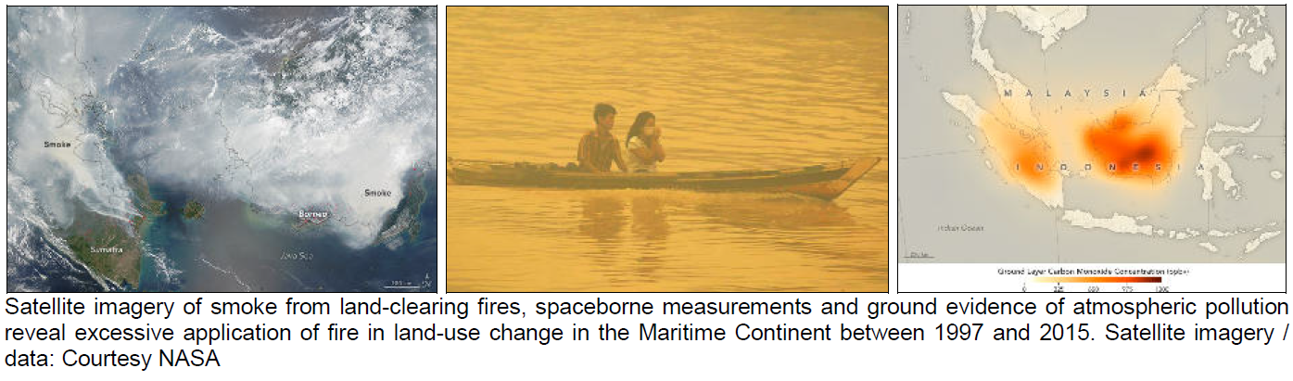

Slide 20
Status of greenhouse gas observations in GAW
18th WMO/IAEA Meeting on Carbon Dioxide, Other Greenhouse Gases, and Related Measurement Techniques (GGMT-2015), Scripps Institution of Oceanography, La Jolla, USA, 13-17 September 2015
Recommendations published as GAW Report No. 229
Report contains sections on observations in the areas of high emissions and on CO₂ observations from ship
19th WMO/IAEA Meeting on Carbon Dioxide, Other Greenhouse Gases, and Related Measurement Techniques (GGMT-2017)
27 – 31 August 2017 ■ Empa Dübendorf ■ Switzerland

Slide 21

Data Quality Objectives for GHG
Component | Compatibility goal | Extended compatibility goal | Range in unpolluted troposphere | Range covered by the WMO scale
CO₂ | ± 0.1 ppm (Northern hemisphere) ± 0.05 ppm (South. hemisphere) | ± 0.2 ppm | 380 - 450 ppm | 250 – 520 ppm
CH₄ | ± 2 ppb | ± 5 ppb | 1750 – 2100 ppb | 300 – 5900 ppb
CO | ± 2 ppb | ± 5 ppb | 30 – 300 ppb | 30 - 500 ppb
N₂O | ± 0.1 ppb | ± 0.3 ppb | 325 – 335 ppb | 260 – 370 ppb
SF₆ | ± 0.02 ppt | ± 0.05 ppt | 8 – 10 ppt | 2.0 – 20 ppt
H₂ | ± 2 ppb | ± 5 ppb | 400 – 600 ppb | 140 −1200 ppb
δ¹³C-CO₂ | ± 0.01‰ | ± 0.1‰ | -7.5 to -9.5‰ vs. VPDB-CO2
δ¹⁸O-CO₂ | ± 0.05‰ | ± 0.1‰ | -2 to +2‰ vs. VPDB-CO2
Δ¹⁴C-CO₂ | ± 0.5‰ | ± 3‰ | -50 - 50‰
Δ¹⁴C-CH₄ | ± 0.5‰ |  | 50 - 350‰
Δ¹⁴C-CO δ¹³C-CH₄ | ± 2 molecules cm⁻³ ± 0.03‰ | ± 0.2‰ | 0-25 molecules cm⁻³
δD-CH₄ | ± 1‰ | ± 5‰
O₂/N₂ | ± 2 per meg | ± 10 per meg | -400 to -900 per meg (vs. SIO scale)
Reviewed at GGMT-2015

Slide 22
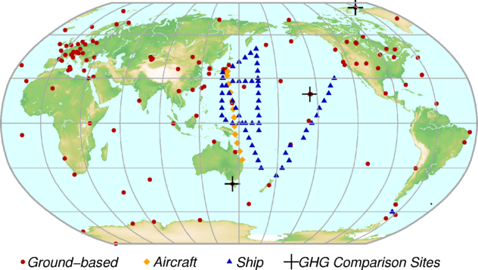
Status of greenhouse gas observations in GAW
Component | Number of stations
CO₂ | 125
CH₄ | 123
N₂O | 33
CFC-11 | 23
CFC-12 | 24
12th annual Greenhouse Gas Bulletin will be released on 24 October 2016
Cover story is on the impact of El Nino on GHG growth rates

Slide 23
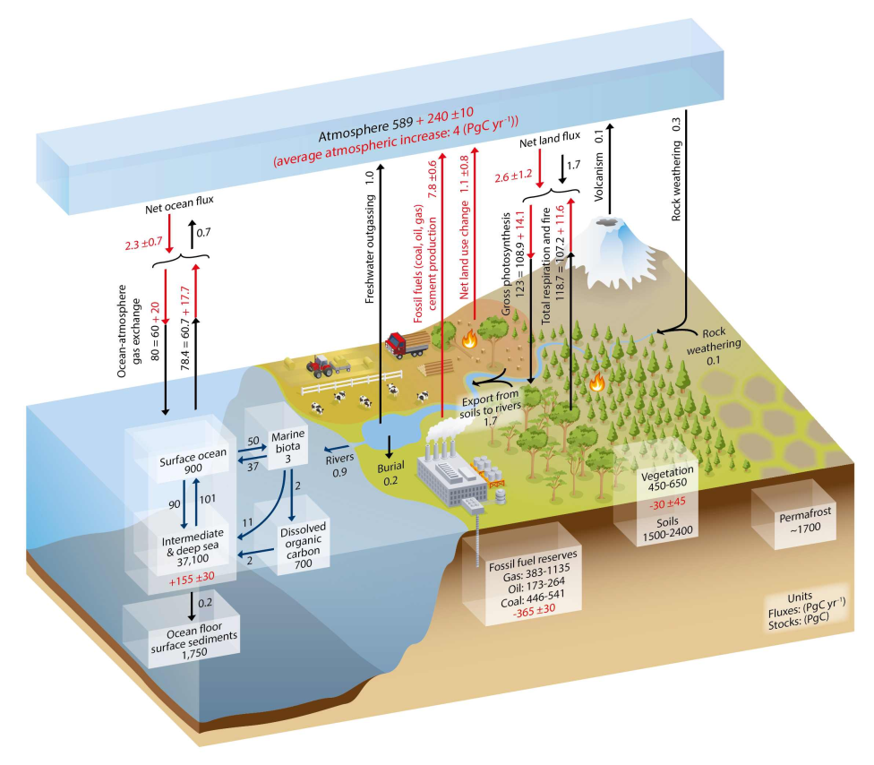
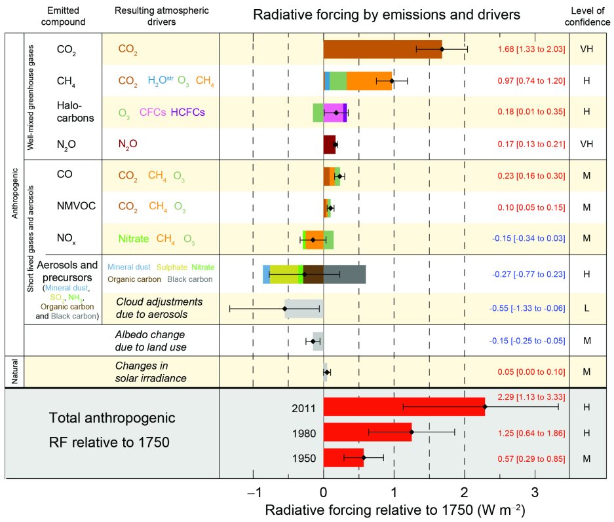
Paris Agreement – limit the temperature increase by 2C by limiting emissions
Fundamental problem – it is what you HAVE in the atmosphere, not what you PUT in the atmosphere, that controls the temperature
Human (9GtC in) – ocean (2.3GtC out) – biosphere(2.6GtC out)
Calculations are for year in 2011

Slide 24
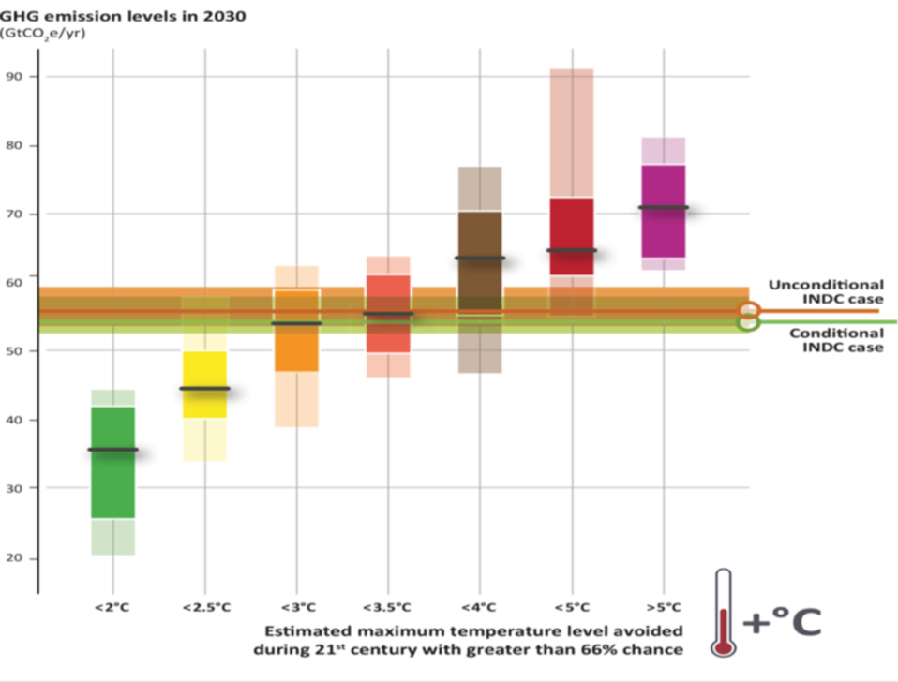
How to get emissions?
Assuming that we know ocean and biospheric uptake
“Bottom-up” measurements (SELF REPORTING)
  Emissions reporting
  Reported and “verified” offsets
  Site-specific measurements
“Top-down” measurements
  Comprehensive atmospheric observation system
  Ecosystem and ocean observations
  Inverse modelling
Combination of above
NDCs
NDC are evaluated every 5 years -> are we on the right track?
Where can we cut more?
Are oceans and biosphere are working as expected?
Notes:
Main Point:
For emission reduction efforts to be successful, there needs to be both independent verification in addition to inventories. It’s not a case of one or the other. We need to compare (verify) our reported inventories (like a checkbook) with top down measurements (like our bank statements) to make sure it is going the way we thought it was going on paper. If it is not, then we need to adjust our approach.
24

Slide 25
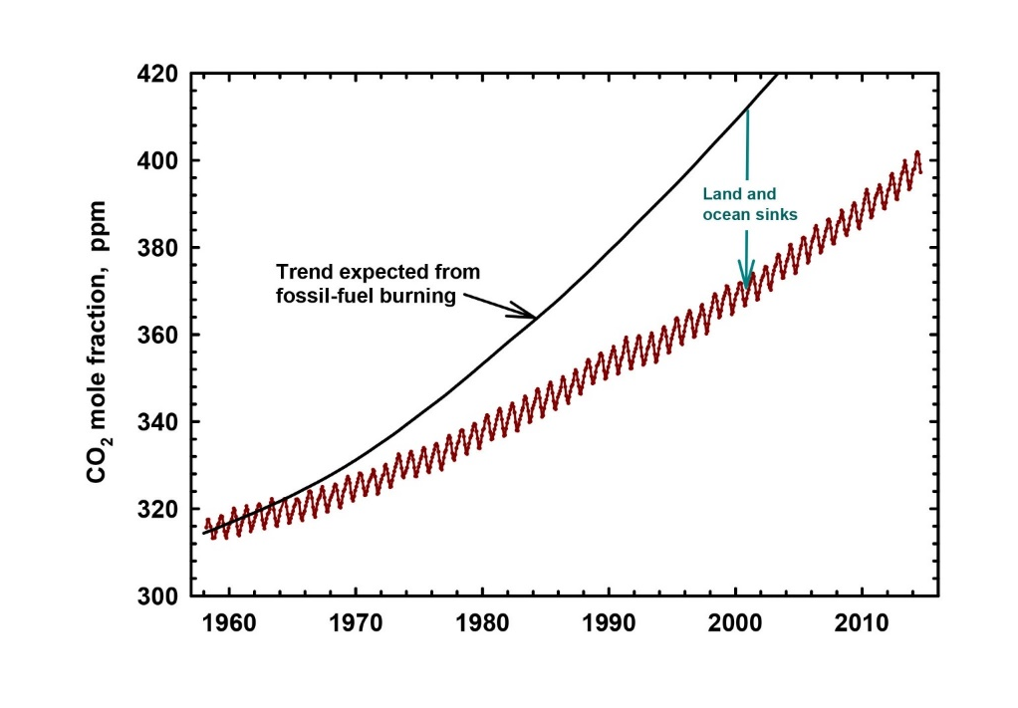
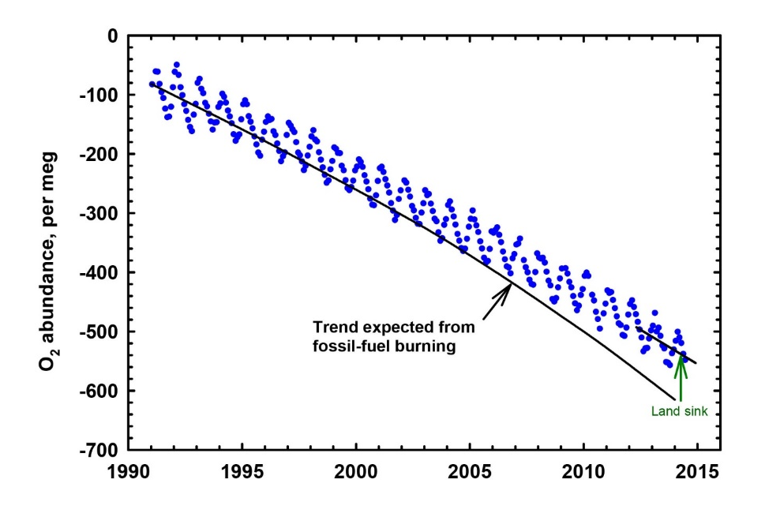
Complexity of carbon cycle
Identification of sinks needs dedicated measurements
CO₂ uptake by oceans lead to ocean acidicfication
Knowledge of terrestrial and ocean sinks is essential for definition of anthropogenic contribution

Slide 26


The Integrated Global Greenhouse Gas Information System (IG³IS)
Goal: Support the success of post-COP21 actions of nations, sub-national governments, and the private sector to reduce climate-disrupting GHG emissions through a sound-scientific, measurement-based approach that:
  reduces uncertainty of national emission inventory reporting,
  identifies large and additional emission reduction opportunities, and
  provides nations with timely and quantified guidance on progress towards their emission reduction strategies and pledges (e.g., NDCs)
  Concept paper approved by EC-68
Notes:
26

Slide 27
The Integrated Global Greenhouse Gas Information System (IG³IS)
  Principles
IG³IS will serve as an international coordinating mechanism and establish and propagate consistent methods and standards.
Diverse measurement and analysis approaches will fit within a common framework.
Stakeholders are entrained from the beginning to ensure that information products meet user priorities and deliver on the foreseen value proposition.
Success-criteria are that the information guides additional and valuable emission-reduction actions.
IG³IS must mature in concert with evolution of technology and user-needs / policy.
Notes:
27

Slide 28
IG³IS programmatic evolution within WMO
CAS Mgt
(May 2013)
WMO/GAW GGMT
(Jun 2013)
CAS
(Nov 2013)
Resolution Approved by
WMO Congress
(Jun 2015)
WMO Exec Council
(Jun 2014)
IG³IS Planning Team Established and Concept Paper Drafted
(July 2015 – May 2016)
Near-Term Pilot Projects and Implementation Plans for Each IG³IS Objective
(2016 – 2017)
Concept Paper Endorsed by WMO Executive Council
(Jun 2016)
UNEP Collaboration MOU
(Feb 2016)
Notes:
This is essentially a history and a plan for coordination within WMO, how we engage the scientific community in doing so, and how we developed the authority for our actions.
This concept was brought forward by the Commission for Atmospheric Sciences (CAS) Group in May 2013 and presented at a meeting of GHG experts the following month, then to the official commission of delegates (CAS).

Slide 29

Near-term IG³IS Objectives
(3-5 year horizon)
Support of Paris Agreement:
Timely and quantified trend assessment of NDCs in support of “Global Stocktaking”
Improved national inventory reporting by making use of atmospheric measurements for all countries
Key sub-national efforts and new mitigation opportunities:
GHG monitoring in large urban source areas (megacities)
Detection and quantifying large unknown CH₄ emissions
HOW: Upscale good practices through pilot projects
Notes:
We want to focus on a few near-term objectives where positive outcomes are expected and can be propagated. Some of these are already underway; others will take more time
Other IG³IS support for sub-national actions should include working with partners to establish methods, standards, and infrastructure for locating point-source methane “super-emitters” in the natural gas supply chain, thereby providing operational mitigation guidance, and improved certainty and transparency for emissions reporting.
attack the information latency problem and deliver “now-casting” of emission trends, and work toward forecasting emission trends.

Slide 30
How will UNFCCC “Global Stocktake” evaluate
greenhouse gas emissions reductions?
100
Enhance IG³IS
System
Develop IG³IS System
Maintain IG³IS System
Establish Baselines
Percent of 2016 Emissions
Critical Period for detection of progress toward global emission reductions
50
Higher fidelity info to track and fine-tune progress
20
2020
2030
2050
Time
2100
Notes:
How will Society Know they are reducing Greenhouse Gas Emissions??
Here is one scenario to describe the global picture.
Even as laws are passed quickly and international agreements are strong, there will be a delay in emission reduction for a number of years. Once systems go into place, strategies will be applied, and, whether driven by taxes or markets, policies will be adjusted as needed. If agreements are in place, GHGs should decrease after a decade of developing the system and establishing baselines. We should see a reduction in GHG emissions as systems are enhanced. We may find that we’re going off track, which is when we can ask ourselves, what’s going wrong? Help society make reductions that will set us back on track. After 80% of emissions are reduced, we’ll likely see smaller differences as we maintain the system.
30

Slide 31
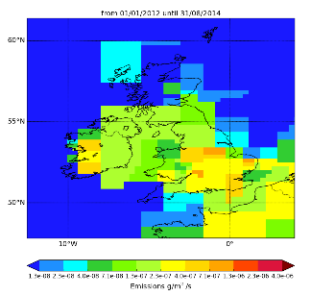
Example from UK report to UNFCCC: Methane
Early (1990s) mismatch with the inventory.
Difficult to understand, most likely cause is landfill emissions but retrospectively challenging to investigate.
Inspired DECC to expand the network from 1 to 4 stations.
Notes:
Need talking points

Slide 32
Example from Switzerland: Methane
Great match between national total (“bottom-up” and “top-down”) but incorrect spatial distribution
(S. Henne et al., 2016)
Notes:
Need talking points

Slide 33
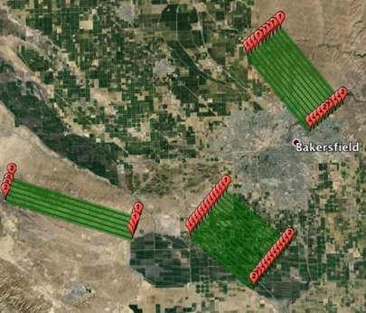
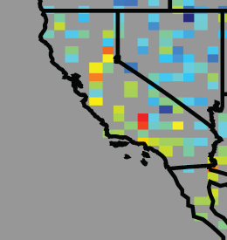
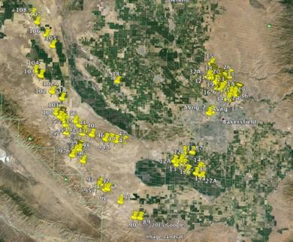
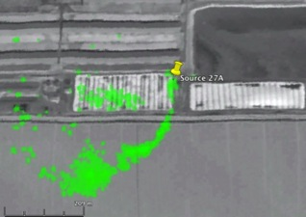
Example of additional emission reduction opportunities
Tier 1: Satelite detects hotspot region
Tier2 (Blue boxes):
Aircraft spectrometers estimates local fluxes & attributes source sectors
Kern River oil field
Turner et al 2015
Elk Hills oil field
Taft dairies
500 km
Oil fields
50 km
Enhanced
Activity Data
Tier 3: Plume Imaging aircraft map point sources
Dairies
Tier 4 (not shown):
Surface observations
Pixel size 1.5m
500 m
Notes:
A tiered strategy for monitoring methane leaks in the US. An EIA map illustrates onshore oil and gas production in key regions of the contiguous United States (CONUS). Red boxes indicate the focus of Tier 1: persistent monitoring for large leaks by a methane-imaging satellite in low-Earth orbit and ultimately geostationary orbit - enveloping key elements of the domestic oil and gas supply chain: well-heads, processing/ storage facilities, and distribution and consumption in urban areas. Other key methane sectors (e.g., major livestock areas and landfills) are also covered – ensuring proper source attribution. Methane leaks that significantly exceed EPA predictions are automatically detected, located within 500 meters, and communicated to facility operators within 3-15 days of onset. The inset offers a close-up of dense oil (orange) and gas (blue) wells with an overlay illustrating the size of satellite pixels. Tier 2 would apply targeted follow-up in selected areas with plume- imaging aircraft to pin-point locations and provide spatial maps of leaks. Tier 3: a national network of methane instruments on 15 tall towers (dark green triangles existing NOAA network; light green triangles indicate notional network expansion) would estimate the atmospheric methane budget of the CONUS every month, with a spatial resolution of about 50 km.
As the measurement methods that were validated in the the Barnett research are applied in other regions across the U.S. – and the world – they will provide a much clearer picture of the state of oil and gas methane emissions, and how to best address them.
Satellite data cannot be as accurate as ground-based estimates, but from space, global consistency is achievable

Slide 34
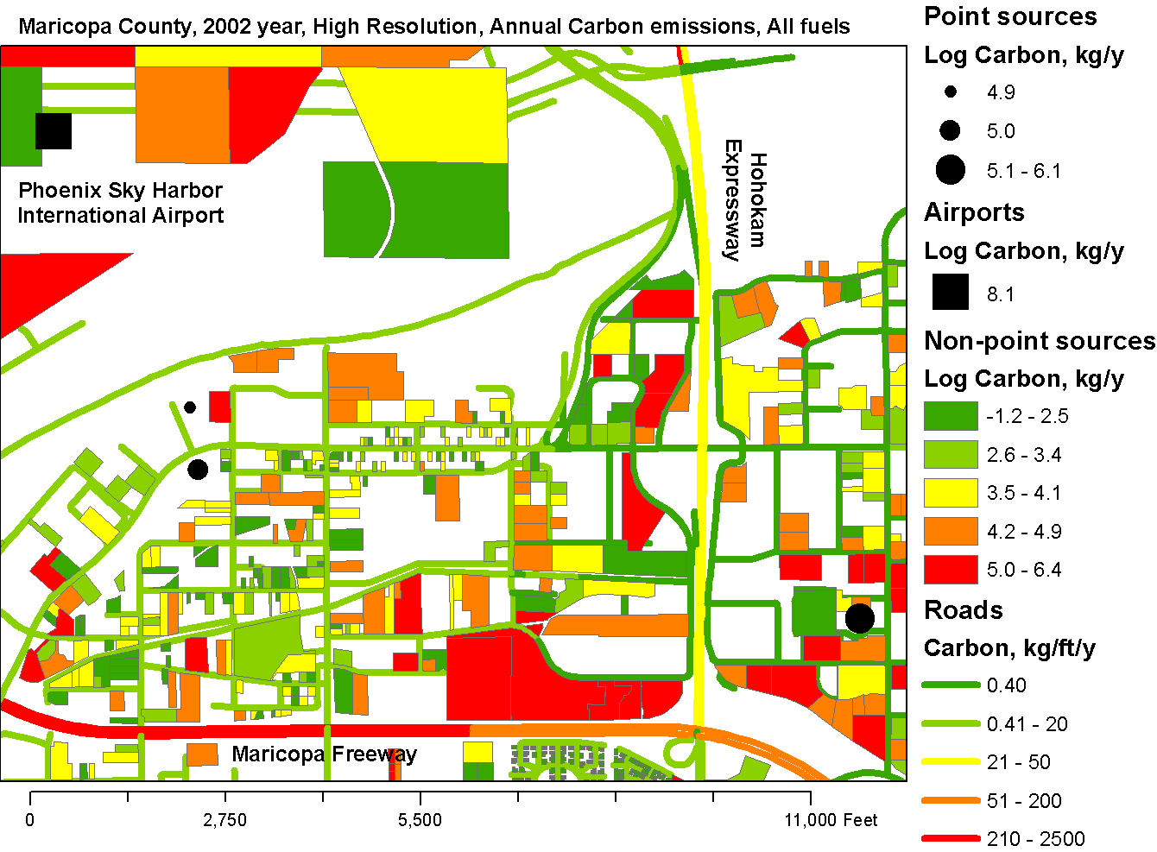
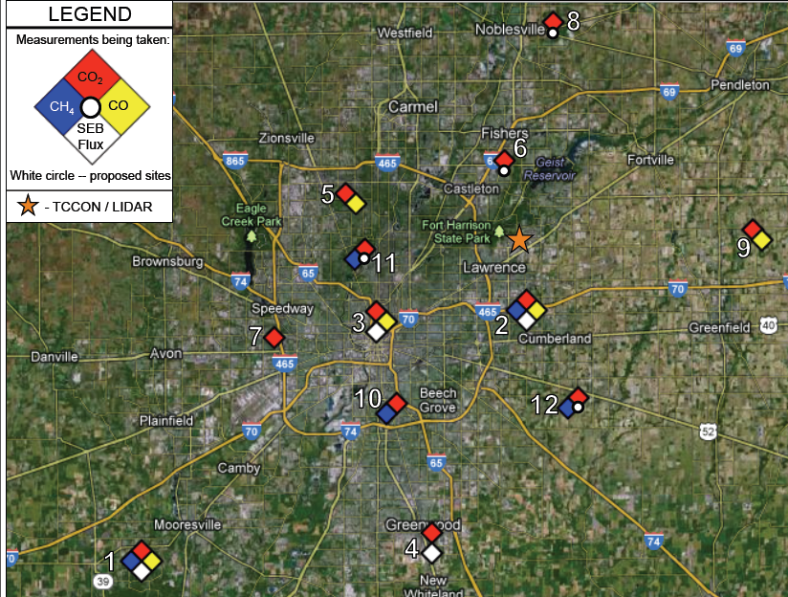
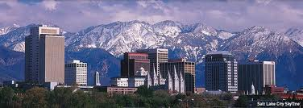

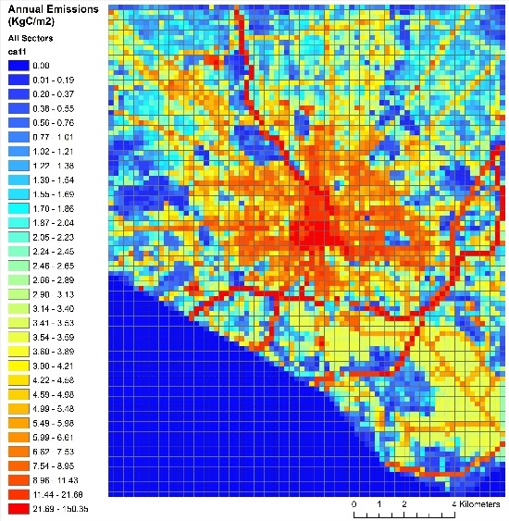







Multiple cities
Paris
Melbourne
Sao Paulo
Notes:
Consistent methodologies, standardized.

Slide 35
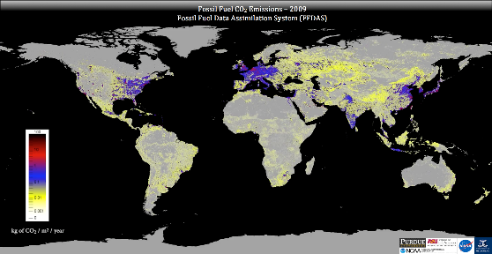
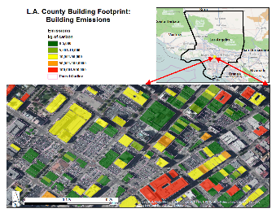
“Nesting” – from the planet to a building
Global consistency
Consistency across scales
standardization

Slide 36
Next steps
Build systems for future services that will meet society’s evolving needs to reduce GHG emissions:
Establish pilot projects (national and/or urban scale)
Define the detailed implementation plan
Prepare statement of work and budgets
  Actively entrain partners, users, and sponsors through all stages of development
  Coordinate with UNFCCC, IPCC, GCOS, GFCS and others.

Slide 37

Thank you
Merci

