Slide 1


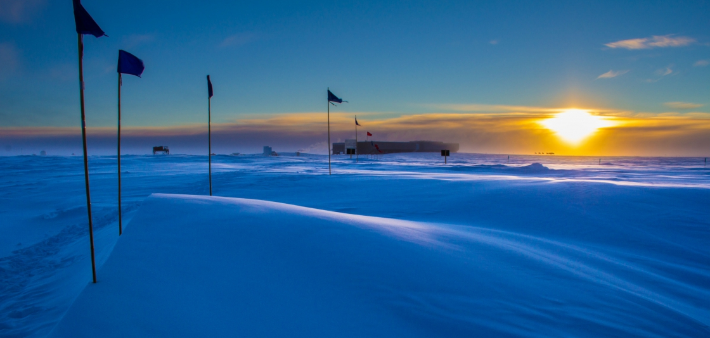
What can we learn from global measurements of SF₆?
Brad Hall, Ed Duglokencky, Ken Massarie, Geoff Dutton, James Elkins
NOAA Global Monitoring Division
Photos courtesy of GMD photo library

Slide 2
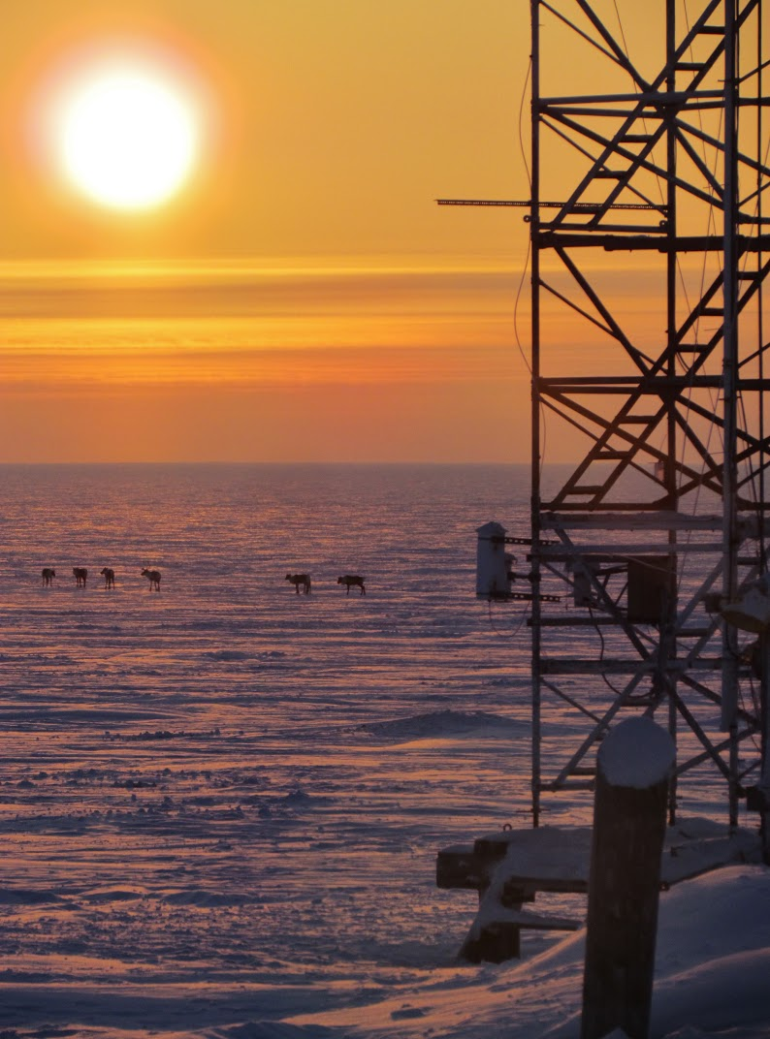
Outline
SF₆ background
Measurements
Global emissions
Using SF₆ to test models
Gradients/Transport

Slide 3
SF₆: lifetime 580-3200 yr
Increasing ~0.3 ppt/yr
High GWP
Notes:
Lifetime likely at lower end of this range. Eric Ray and Fred Moore will submit a paper soon.
Global warming component is small: Rad Forcing only ~2% of that for CFCs
Same order of magnitude as minor HFCs (20% of HFC total)

Slide 4
Measurements: Electron Capture Detector

Slide 5
Measurements: Calibration

Slide 6
ECD response is nearly linear
Using single reference standard can result in small errors
Error = 0.03 ppt for 1 ppt difference between Air and standard
Using two standards can give good results
Error = 0.01 ppt when Air is bracketed by 2 standards
Notes:
So this means that your standard would be obsolete in ~2 yrs. And excursions far above background would be subject to bias.

Slide 7
As WMO/GAW Central Calibration Laboratory:
We use multiple standards to define our ECD response: 2-20 ppt.
This leads to very good reproducibility.
Since 2006, 4-14 ppt
Analysis at least 6 mo. apart
Notes:
One outlier not shown on right plot.
Why do we need good precision and reproducibility?
Because the signals are small.

Slide 8
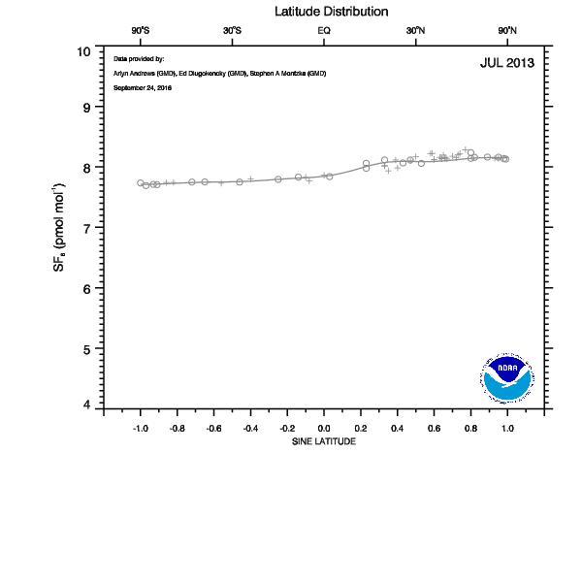
Signals are small: need precise, well-calibrated measurements
Niwot Ridge, Colorado (NWR)
Notes:
We want to resolve gradients, the seasonal cycle, and enhancements above background.

Slide 9
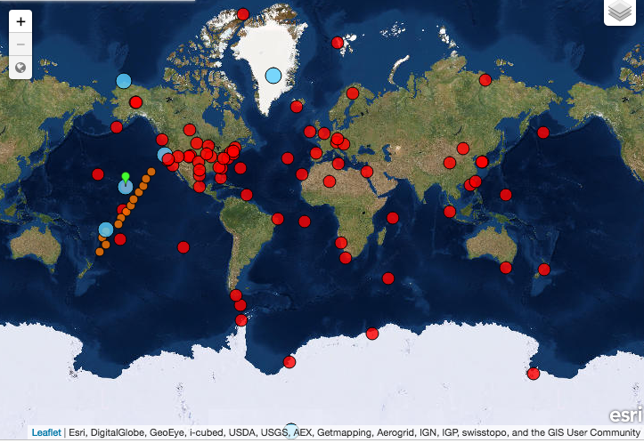
NOAA Cooperative Sampling Network

Slide 10
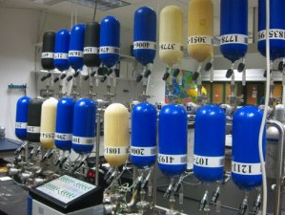
Global average SF₆ from from Marine Boundary Layer Sites

Slide 11
Global average SF₆ from from Marine Boundary Layer Sites
Red: linear fit

Slide 12
Global average growth rate

Slide 13
Global Emissions
Notes:
Since SF6 has such a long lifetime, the atmosphere contains most the SF6 emitted.

Slide 14
Using SF₆ to test models
Mole fraction
Seasonal cycle
Inter-hemispheric gradient
Exchange time
“age-of-air” (transport time)

Slide 15
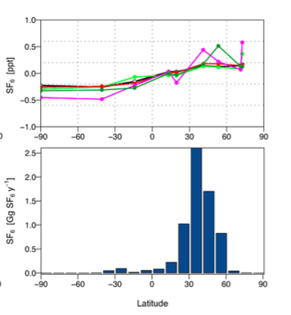
from Thompson et al (2014)
Notes:
Here are gradients simulated in various models, compared to the observed gradient in black, as shown by Thompson et al from their
N2O inversion paper. You can see that some models overestimate the gradient.

Slide 16
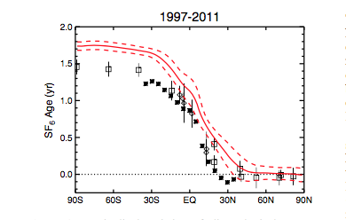
Use gradient to infer mean transit time (Age-of-Air)
From Waugh et al (2013)
Notes:
Another way to look at that same picture is to use the gradient to infer a mean transit time, or age-of-air. Traditionally, SF6 has been used to
infer age of air in the stratosphere. But more recently that idea has also been applied to the troposphere. Here we see that the model
used in Waugh et al (2013) does not quite match the mean transit time (too long), which, like the last slide, implies that the model gradients are
too large.

Slide 17
Use global MBL data to examine:
  changes in SF₆ source distribution
  interhemispheric exchange time

Slide 18
Average Normalized Gradient (2004-2014)
Notes:
This is a picture of the average gradient over about 10 years. But we could ask: Is that picture changing as SF6 emissions increase? Can we see
Changes in the gradients that would provide insight into regions of increasing emissions?

Slide 19
Global average growth rate

Slide 20
NOAA Cooperative Sampling Network
Notes:
For a preliminary look at the Northern Hemisphere, I compare the gradient observed in the Northern Pacific, defined by two stations in the tropics and two in the Arctic.
And compare that to the changes we see between the polar regions.

Slide 21
SF₆ regional averages

Slide 22
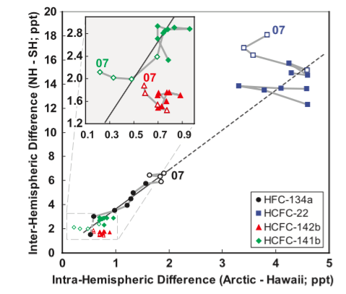
From Montzka et al (2008)

Slide 23
Arctic: BRW, ALT
Antarctic: SPO, PSA
Tropical Pacific: GMI, KUM
smoothing + gap-filling
(yearly averages)
Notes:
Hear we are looking at yearly average gradients. Much of this variability is seasonality, strong seasonal cycle in the NH

Slide 24
Arctic: BRW, ALT
Antarctic: SPO, PSA
Tropical Pacific: GMI, KUM
smoothing + gap-filling + deseasonalized
Notes:
If we remove the seasonal cycles, we get a much cleaner picture. In contrast, if emissions were increasing from areas mostly north of 30 deg,
We would expect to see the gradient in the NH increase as the polar to pole difference increases, as shown by Montzka et al for HFC-134a.

Slide 25
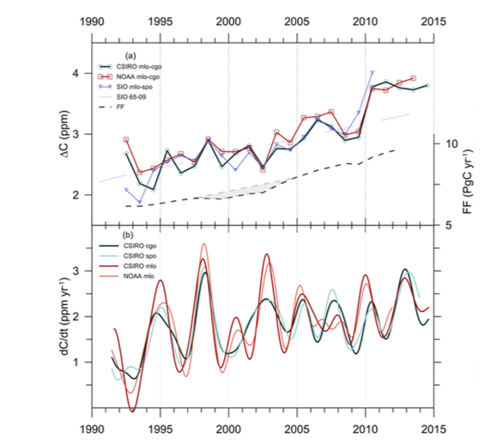
Interhemispheric Exchange
Effects the distribution of many trace gases
Influenced by ENSO
Figure 1 from Francey et al
(2016), Biogesciences
Notes:
They looked at upper tropospheric wind speed in the central Pacific, related to Rosby waves, and
concluded that a weakening of interhemispheric exchange led to the larger difference in 2010

Slide 26

Inter-hemispheric Exchange
Affects the inter-hemispheric differences of long-lived trace gases
Influenced by ENSO
from Patra et al (2009)

Slide 27
Inter-hemispheric exchange time derived from SF₆ observations

Slide 28
Summary
With precise SF₆ measurements around the globe we can:
- examine large-scale model transport
- infer inter-annual variability in hemispheric exchange
- infer changes in emissions patterns
Results:
- Increased in global SF₆ emissions are consistent with increased
emissions from lower latitudes in the N.H.

Slide 29
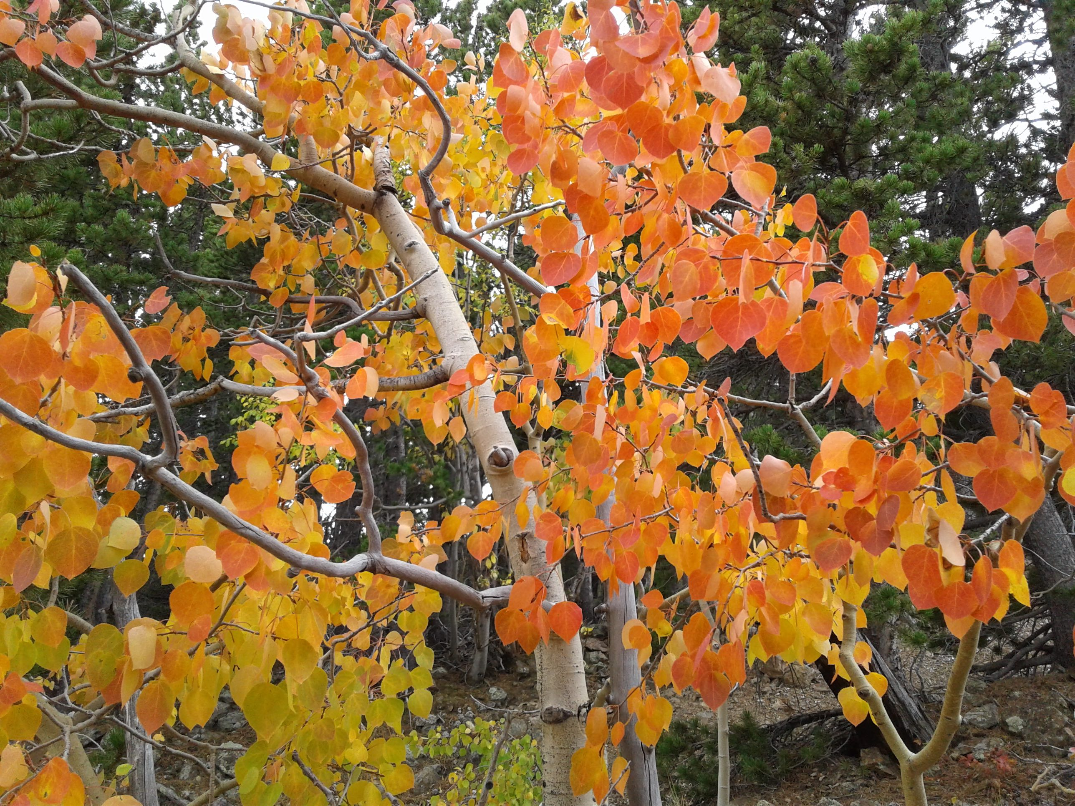
Thank You
Aspen at Niwot Ridge, September 30

