Slide 1


Characteristics and EEMD analysis of CO₂ and CH₄ at Lulin Atmospheric Background Station (LABS), Taiwan.
Chang-Feng Ou-Yang¹, Hsiao-Lan Wang¹, Jia-Lin Wang², Neng-Huei Lin¹, and Russell C. Schnell³
¹ Department of Atmospheric Sciences, National Central University, Taiwan.
² Department of Chemistry, National Central University, Taiwan.
³ NOAA/GMD, Boulder, CO, USA.
Mon, 20th Oct, 2014
in Daejeon, Korea

Slide 2
Outline
Background of Lulin Station (LABS)
Temporal variations of CO₂ and CH₄
Trending the data by EEMD analysis

Slide 3
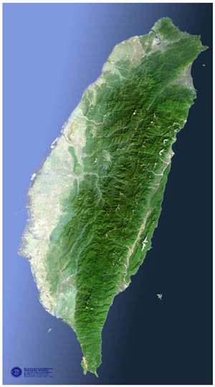
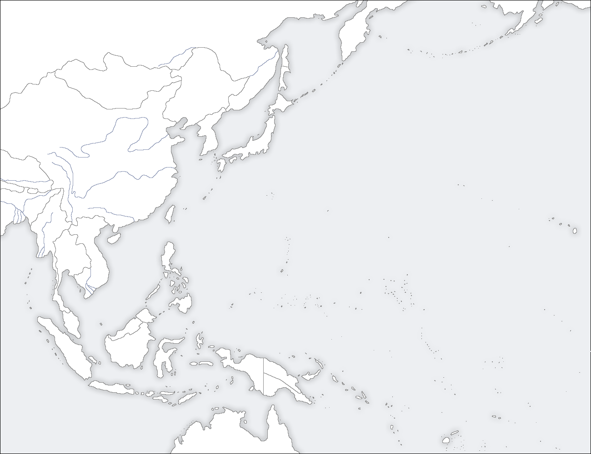
Lulin Atmospheric Background Station
(LABS, 23.47°N, 120.87°E, 2862 m a.s.l.)
LABS
Russia
Mongolia
Korea
Japan
China
Taiwan
Thailand
Hawaii
Philippines
Indonesia
1. Biomass burning from the SE Asia
2. Oceanic influences from the Pacific
3. Asian continental outflow from EA
Australia

Slide 4
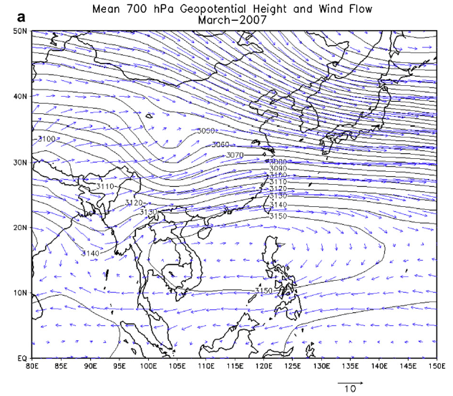
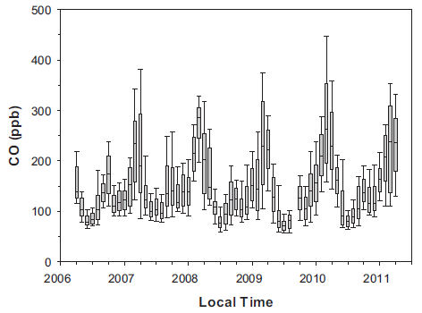
Ou-Yang et al., AE, 2012.
Ou-Yang et al., AE, 2014.

Slide 5
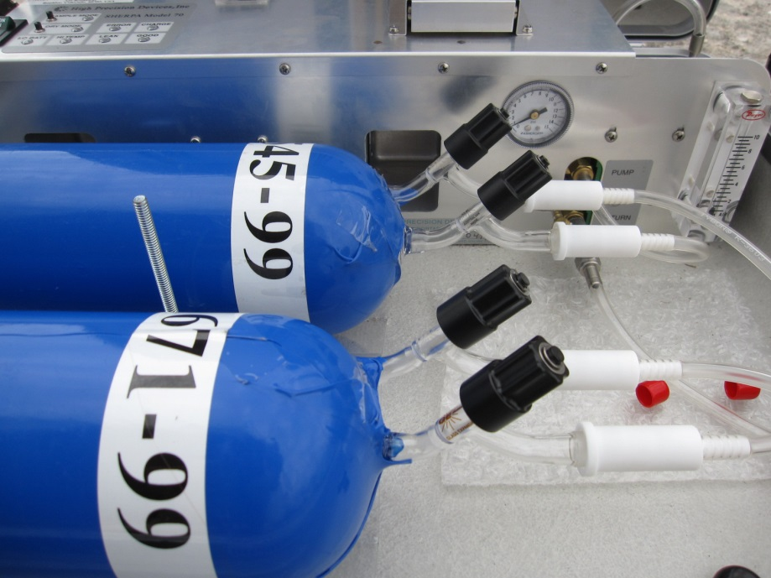
Experimental
Flask air sampling (NOAA/GMD)
  Started on 1st Aug, 2006.
  Two flasks of air sampled per week
  422 good pairs of CO₂ data
In-situ measurement (NCU)
  Started on 1st Mar, 2011.
  Picarro G1301 (CO₂ and CH₄)
  Working standards calibrated with tertiary standards made by NOAA/GMD

Slide 6
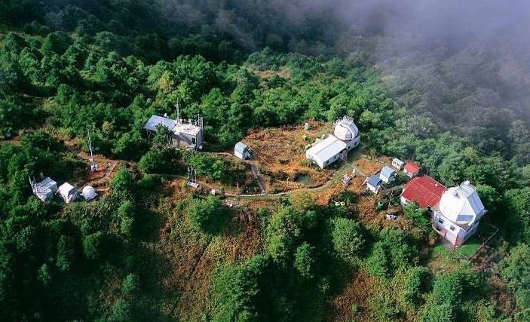
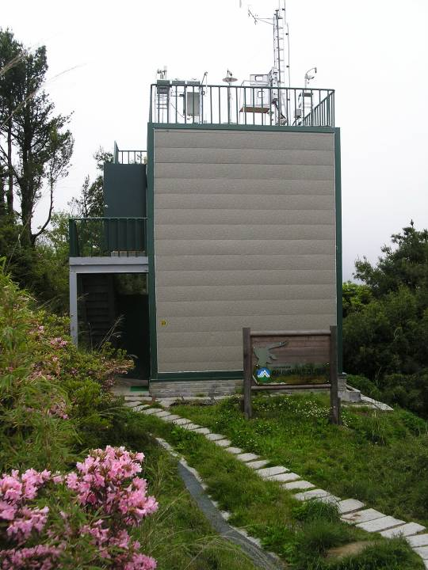
Lulin Atmospheric Background Station (LABS)

Slide 7
Outline
Background of Lulin Station (LABS)
Temporal variations of CO₂ and CH₄
Trending the data by EEMD analysis

Slide 8
CO₂ at LABS
Mean CO₂ in 2013
Flasks : 397.8 ppm
In-situ: 397.4 ppm
Mean growth rate:
Flasks: +2.5 ppm yr⁻¹

Slide 9
Sampling Time

Slide 10
δ¹³C of CO₂
Mean = -8.17 ‰
-8.48 ‰
less influenced
by local plants

Slide 11
CH₄ at LABS
Mean CO₂ in 2013
Flasks : 1847.9 ppb
In-situ: 1849.7 ppb
Mean growth rate:
Flasks: +6.4 ppb yr⁻¹

Slide 12
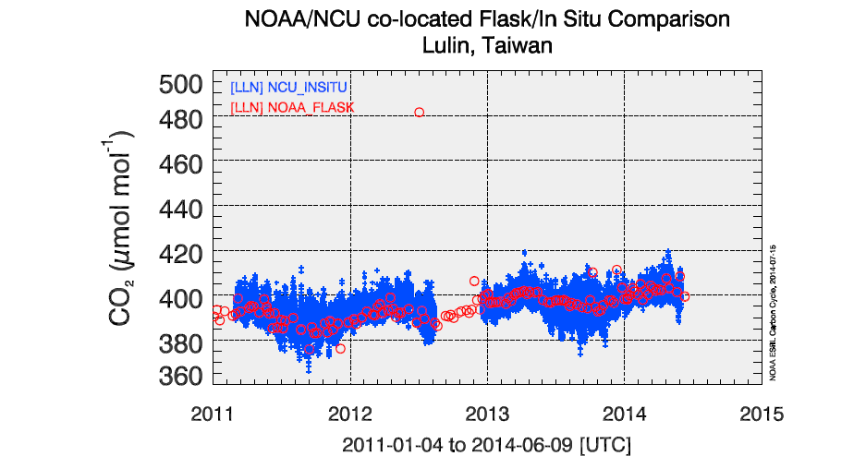
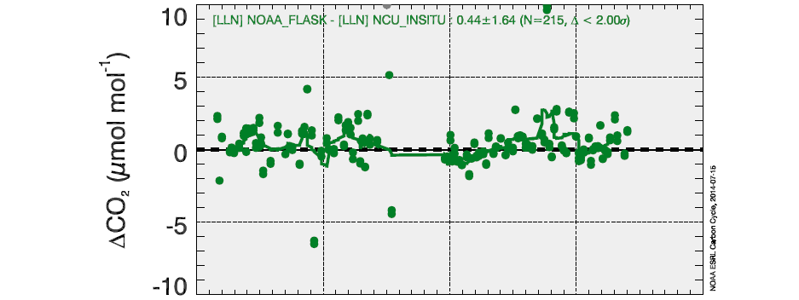
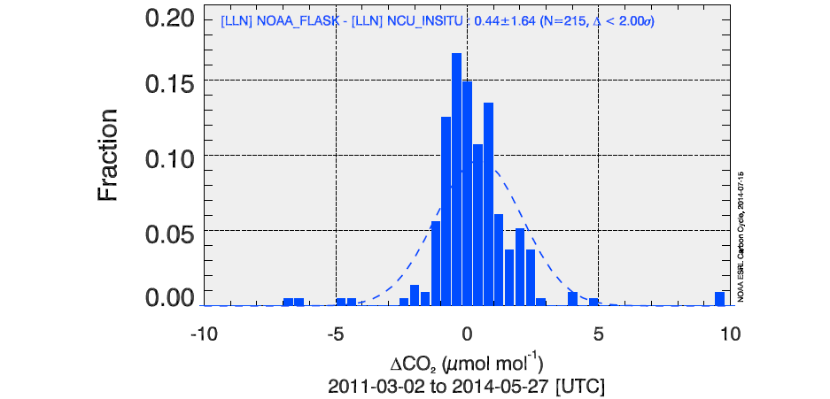
Inter-comparison
Mean difference:
+0.05±1.84 ppm CO₂
-0.16±7.90 ppb CH₄

Slide 13
Seasonal cycle of CO₂ and CH₄
Monthly averages of in-situ data

Slide 14
Variability of CO₂ within an hour

Slide 15
Variability of CH₄ within an hour

Slide 16
Diurnal cycle

Slide 17
Diurnal spectrum

Slide 18
Outline
Background of Lulin Station (LABS)
Temporal variations of CO₂ and CH₄
Trending the data by EEMD analysis

Slide 19
Ensemble Empirical Mode Decomposition (EEMD)
Hilbert-Huang Transform (HHT)
  1. Raw continuous data
  2. Decompose (instantaneous frequency data)
    intrinsic mode functions (IMF)
  3. Combine the IMFs needed (C7~C12)
Strength:
  Works well for non-stationary and non-linear time-serious data.

Slide 20
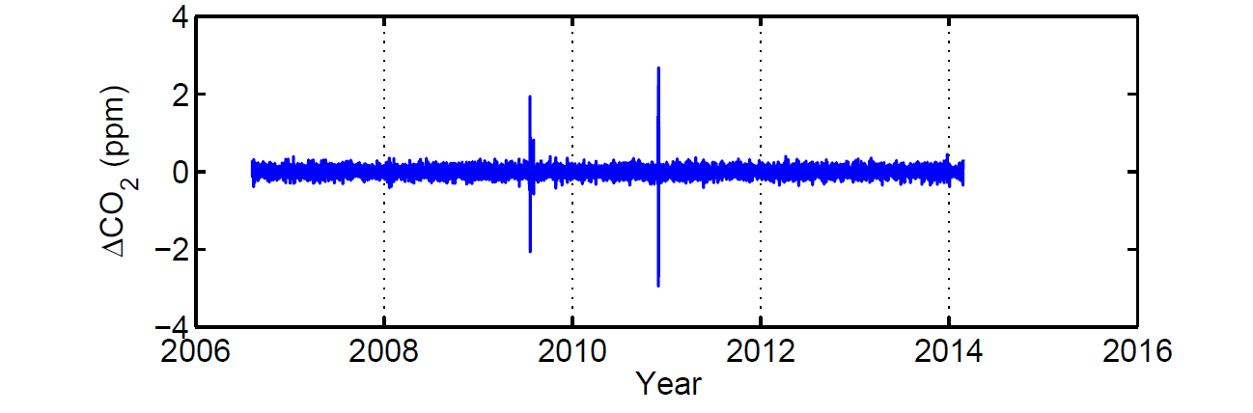
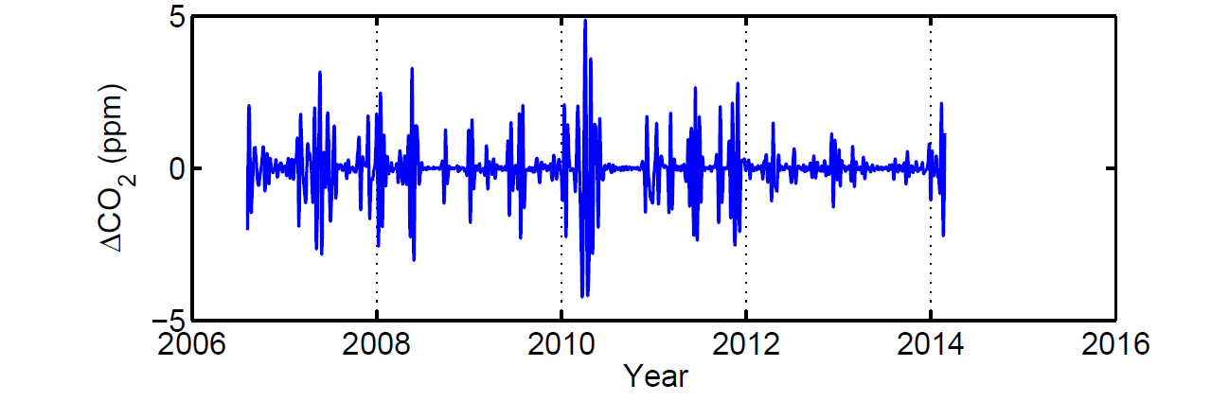
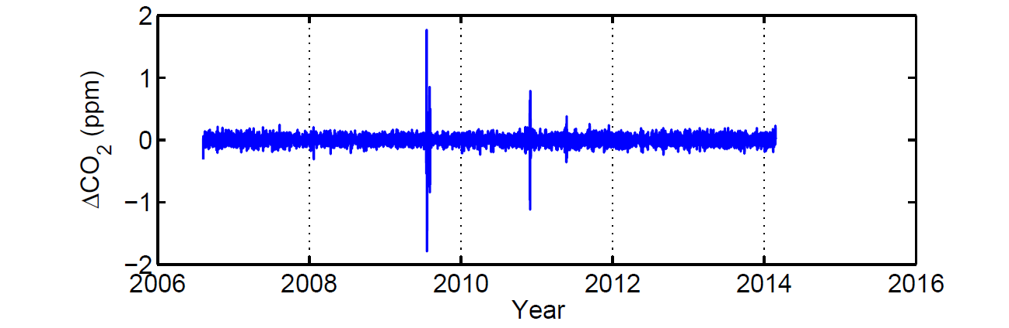
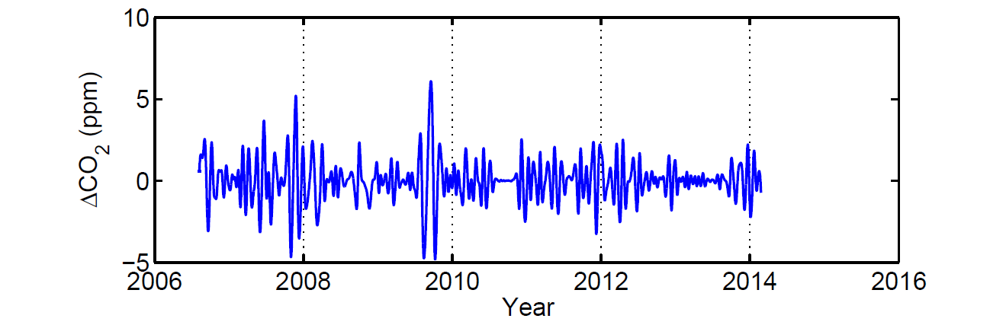
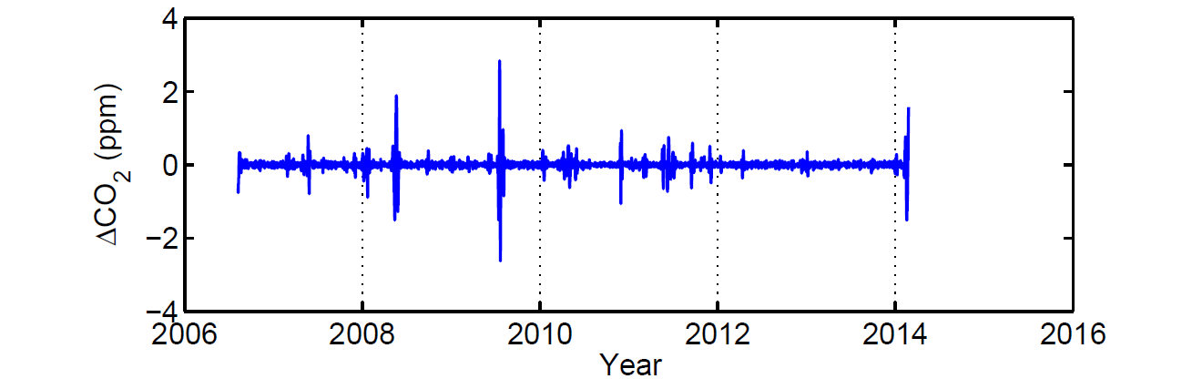
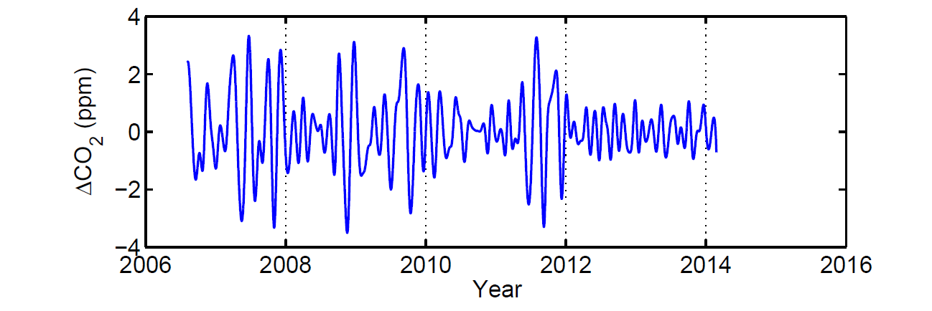
Components of flask CO₂ data
C1
C4
C2
C5
C3
C6

Slide 21
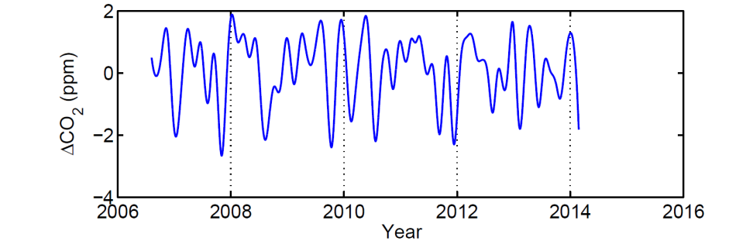
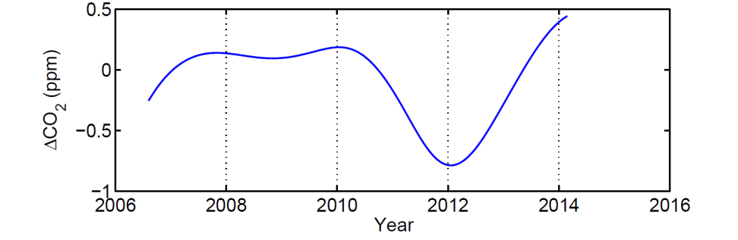
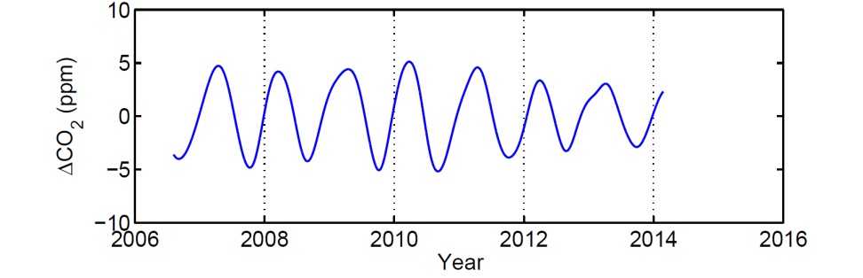
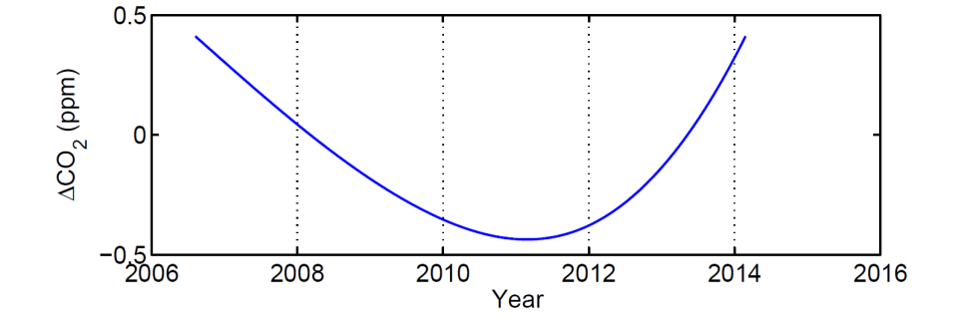
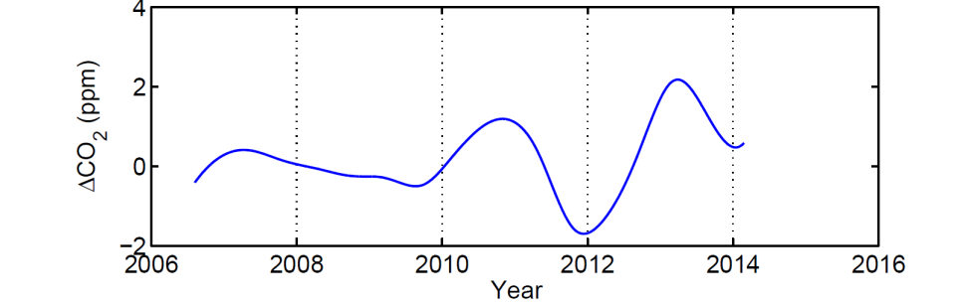
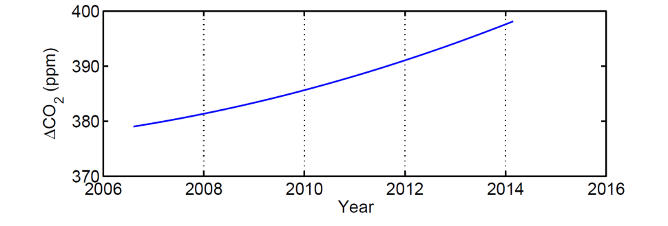
Components of flask CO₂ data
C7
C10
C8
C11
C9
C12

Slide 22
5 components (C8-C12)

Slide 23
6 components (C7-C12)

Slide 24
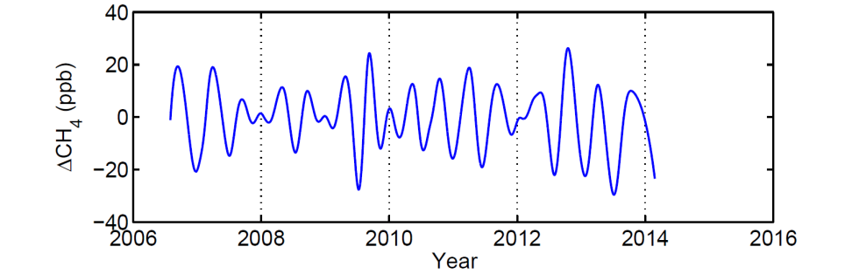
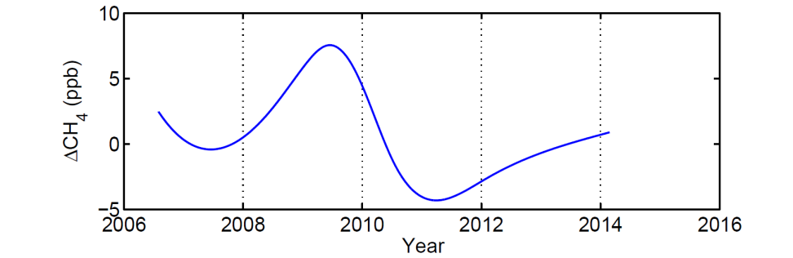
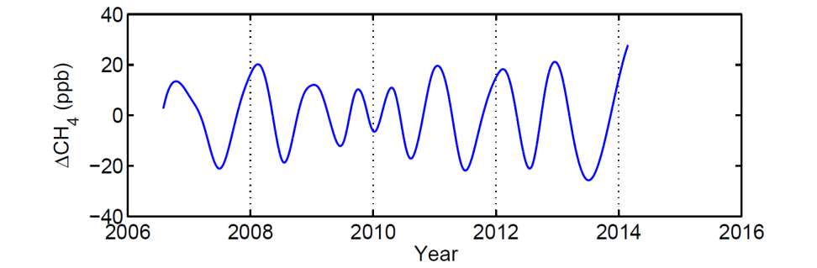
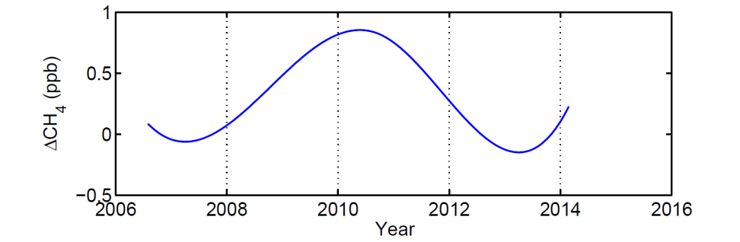
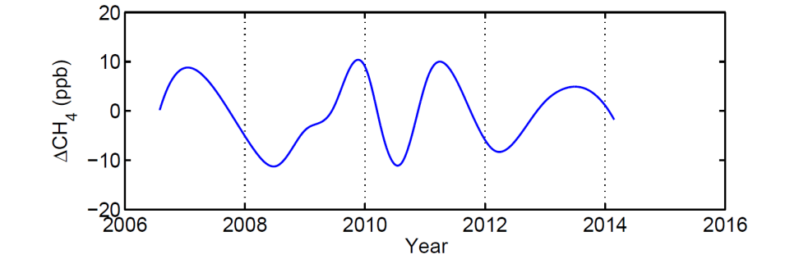
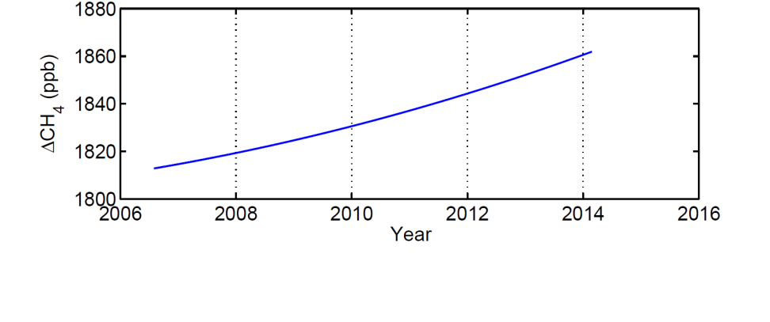
Components of flask CH₄ data
C7
C10
C8
C11
C9
C12

Slide 25
6 components of CH₄

Slide 26
Summary
CO₂ and CH₄ mole fractions are measured at LABS.
Enhanced CO₂ and CH₄ levels were found in spring.
EEMD analysis was employed for investigating the variation patterns and trends of the flask CO₂ and CH₄ data at LABS.
Contact: cfouyang@cc.ncu.edu.tw

