Slide 1
Development of Remote Controlled Dehumidification System for GHG Analyzers
Min Kyo Yin, Haeyoung Lee(KMA), and Jung Shik Lim(KRISS)
5th session. Carbon Cycle, Other Trace Gases and New Technology
JEJU, 24 October 2013.
1

Slide 2
Introduction
Greenhouse gas (GHG) observation stations are established mainly in the island or secluded place in the mountains for minimizing pollution of GHGs produced in neighboring environment and precise monitoring of GHGs.
GHG observatories need a lot of operators and budgets to maintain these GHG analysis systems and sample conditioning systems.
In Korea, the temperature and the humidity are high during the summer time. Also, large amount of particles are flowed in Korea due to topographic characteristics in spring. So that, GHG observatory in Korea needs further efforts to remove them.
We developed remote controlled sample treatment system for GHG analyzers. This system automatically removes moisture and particles.
The cold trap type dehumidification system can remove moisture in air sample continuously without any maintenance and operator.
This system is remotely controlled by a network PC.
This systems are used at Korea Global Atmosphere Watch Stations.
2

Slide 3
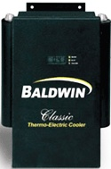
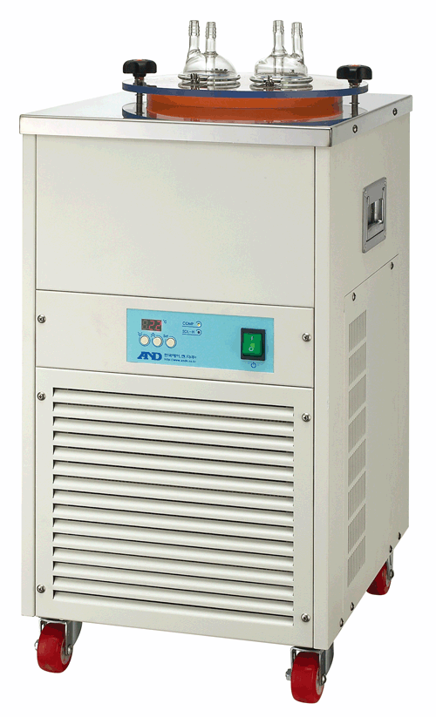
Recent Dehumidification Methods
Cold trap with impinger
Temp. : -40 ~ 60C
Glass impinger
Thermo-Electric Cooler
Temp. : -2C ~ +3C
Nafion Dryer
Membrane Filter
Chemical Trap
Mg(ClO₄)₂
Dryerite
TEC + Nafion Dryer + Chemical Trap
3

Slide 4
Development of Dehumidification System
KMA and KRISS developed this system together and GnL received this idea by technology transfer contract. And we produced an optimum dehumidification device for the high humidity sample.
We solved the impinger clogging phenomenon by frozen ice for the long-term operation and impinger maintenance problem.
Two cold traps and two pumps are used in the system. When the first cold chamber is freezing the moisture, the ice in the other chamber is melted by the pumped air with ambient temperature. This melted water is automatically drained .
The PLC program with a remote control function is included in order to operate the system by unmanned.
To change the time sequence, we can connect the remote PLC program and easily control the system.
4

Slide 5
Detailed explanation of Dehumidification System
5

Slide 6
Construction of Dehumidification System
PLC Controller
Pump A
Pump B
Dry Fan A
Dry Fan B
Chamber A
Chamber B
Solenoid Switching Valves
Cold Trap A
Cold Trap B
6

Slide 7
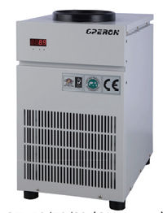
Specification of Cold Trap
Cold Trap Specification (Operon / Korea)
Model | CT-90
Trap Temperature | -90 ºC
Dimension | 350(W)x490(D)x550(H)
Trap Size | Ø155 x 195
Capacity | 1.8L
Compressor | 1/2ph x 1
Weight | 50kg
7

Slide 8
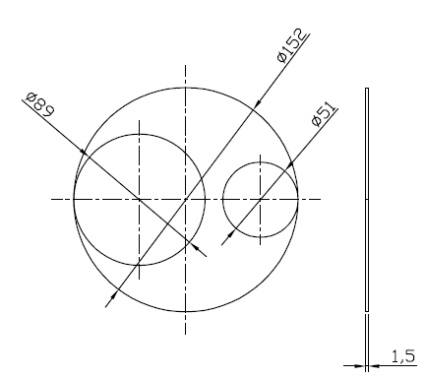
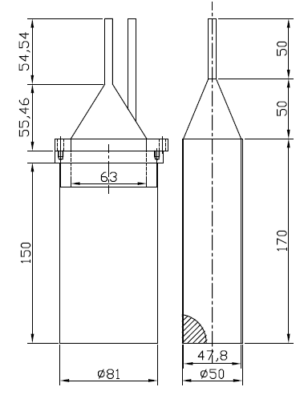
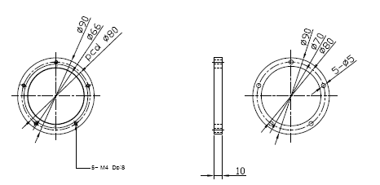
Drawing of Cold Chamber
8

Slide 9
Dehumidification Process
1. Cold Trap Turn On : - 80 ºC
2. Sample Intake
3. 1st Trap : ~ -20 ºC
4. 2nd Trap : ~ -50 ºC
5. Cold Trap Turned Off : Ambient +
6. Melting of ice
7. Pressurized and water drained
9

Slide 10
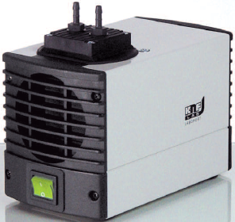
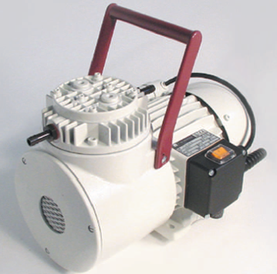
Specification of Pump
Diaphragm Pump (KNF / Germany)
Model | N 86
Delivery(L/min) | 6
Operating Pressure | 2.4 bar g
Power | 60 W
Weight | 1.9 kg
CRDS or NDIR
Diaphragm Pump (KNF / Germany)
Model | N 145
Delivery(L/min) | 27
Operating Pressure | 7 bar g
Power | 320 W
Weight | 12 kg
CRDS or NDIR + GC
10

Slide 11
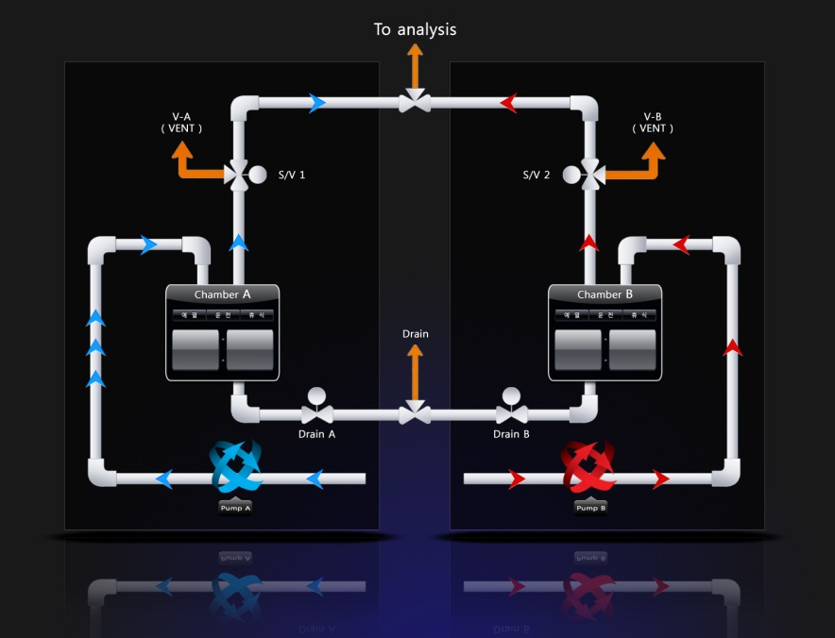
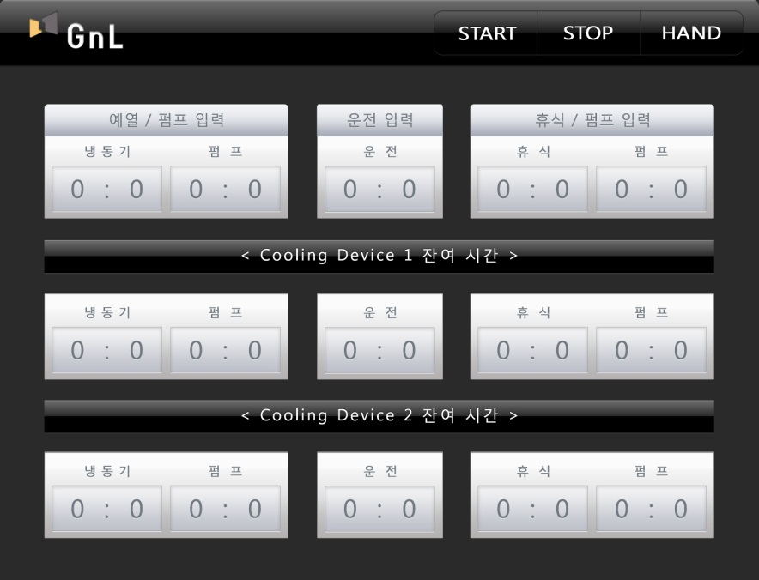
PLC Control Module (Sequence Program)
Graphic Mode
Sequence Setting Mode
11

Slide 12
Step 1 : Stream A turn On
Step 1
Sample Inlet
Stream A
Vent
Vent
Pump A
Pump B
By-pass
Cold Trap A
Cold Trap B
GHG Analyzer
12

Slide 13
Step 2 : Stand-by Stream B
Step 2
Sample Inlet
Stream A
Stream B
Vent
Vent
Pump A
Pump B
By-pass
Cold Trap A
Cold Trap B
GHG Analyzer
13

Slide 14
Step 3: Stream A Turn Off / Melt Ice
Step 3
~ 21 Hour
Sample Inlet
Stream B
Vent
Vent
Pump A
Pump B
By-pass
Cold Trap A
Cold Trap B
GHG Analyzer
14

Slide 15
Step 4 : Trap A Pressurize & Water drain
Step 4
1 Hour
Sample Inlet
Stream A
Stream B
Vent
Vent
Pump A
Pump B
By-pass
Cold Trap A
Cold Trap B
GHG Analyzer
15

Slide 16
Step 5: Stand-by Stream A
Step 5
Sample Inlet
Stream A
Stream B
Vent
Vent
Pump A
Pump B
By-pass
Cold Trap A
Cold Trap B
GHG Analyzer
16

Slide 17
Performance (Test Data)
17

Slide 18
REMOVAL EFFICIENCY
Moisture Trap
Off mode
Moisture Trap
On mode
Conc. (μmol/mol)
Solenoid Valve
Switching time
 | wet gas | dry gas
H₂O Conc. (μmol/mol) | 4179.69 | 19.14
Removal efficiency (%) | 98.9
18

Slide 19
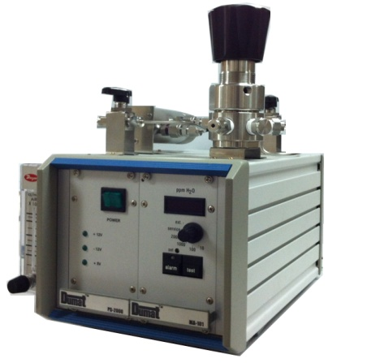
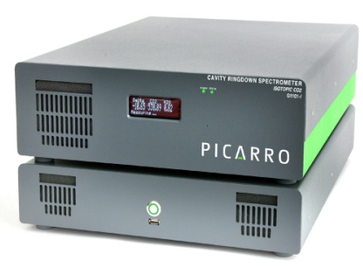
COMPARISION OF MOISTURE DATA
 | CRDS | Moisture Analyzer (P₂O₅ type)
Averaged conc. (μmol/mol) | 19.14 | 45.74
SD | 5.54 | 0.057
%RSD | 28.95 | 0.13
%Difference | 58.1
19

Slide 20
MOISTUER ANALYZER DATA
Conc. (μmol/mol)
Time (min)
20

Slide 21
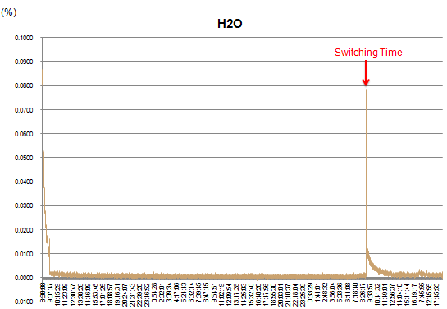
DAY 1
DAY 2
DAY 3
21

Slide 22
Sample Inlet
Stream A
Stream B
Vent
Vent
Pump A
Pump B
By-pass
Cold Trap A
Cold Trap B
GHG Analyzer
22

Slide 23
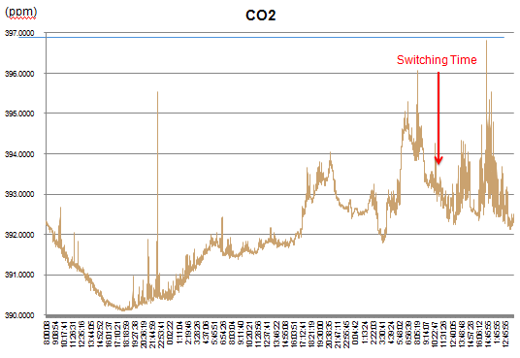
DAY 1
DAY 2
DAY 3
23

Slide 24
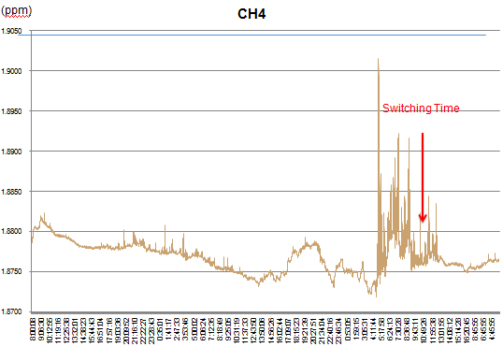
DAY 1
DAY 2
DAY 3
24

Slide 25
Pictures of Dehumidification System
25

Slide 26
27

Slide 27
Remote Control System
30

Slide 28
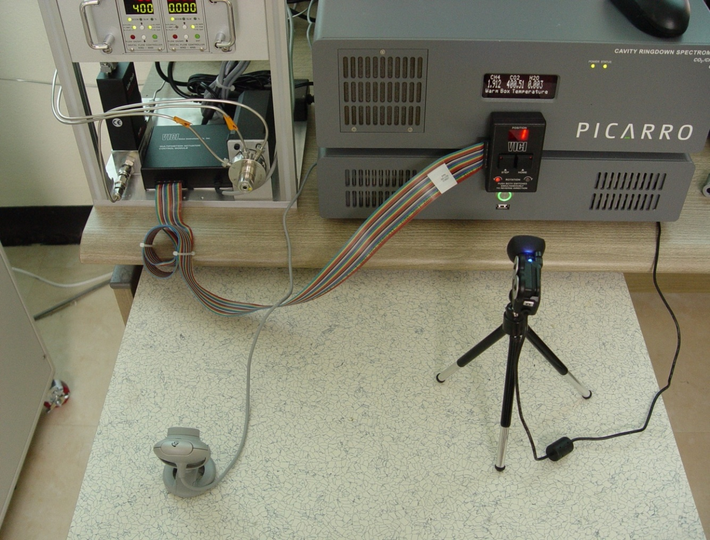
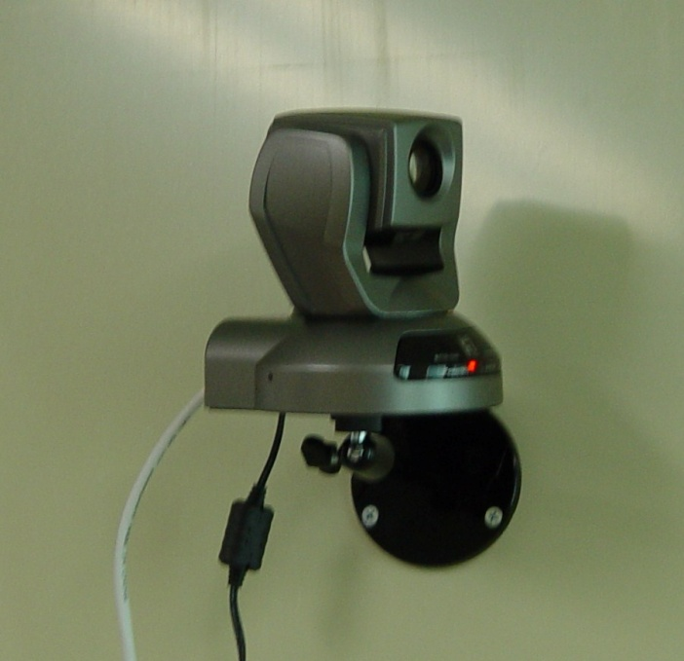
Monitoring Camera
Fixed Camera
Remote Control Camera
Lab monitoring
Network Control Camera
Rotation/Zoom IN & Out
Real-time sample flow
CRDS Data & MPV position monitoring
32

Slide 29
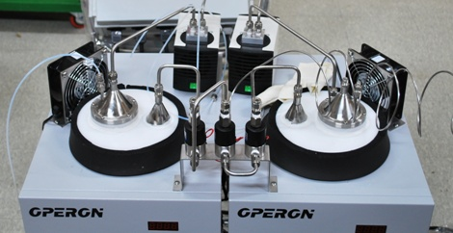
Dehumidification System
Particle Filter
Dehumidification
Decarbon Tube
Diaphragm Pump 1
Cold Trap 1(-80 C)
Sampling Port
Automatic Switching
Analyzer
Diaphragm Pump 2
Cold Tap 2 (-80 C)
Remote Sequence Control
33

Slide 30
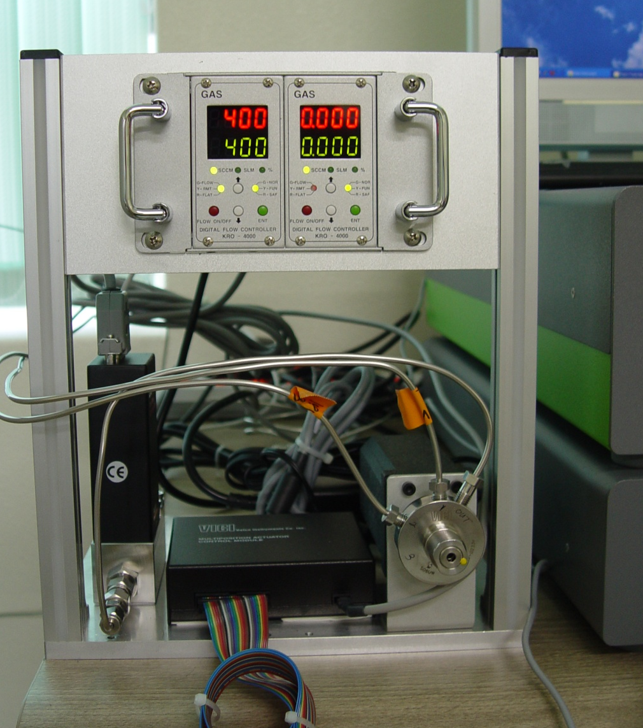
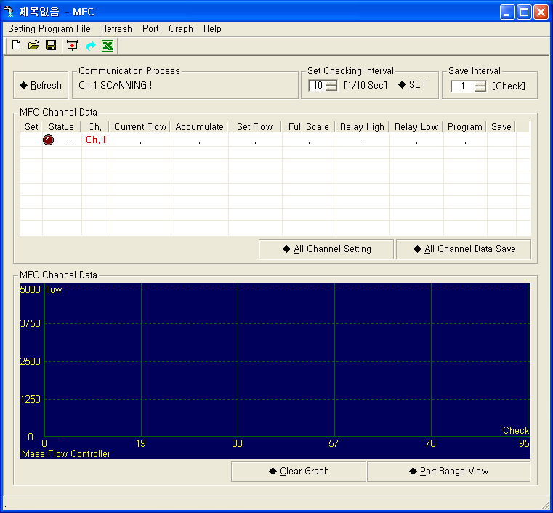
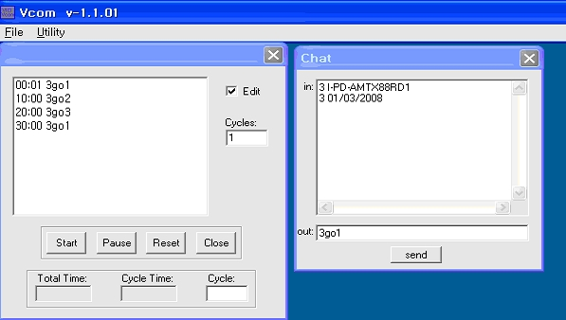
Calibration System
MFC & Controller
Sample & STD Flow setting
Remote Control
MFC Control Program
Remote Sample Flow Control
Multi Position Valve
Sample, Standard1, Standard2 switching
Remote control
Remote Calibration
MPV valve control
Program
34

Slide 31
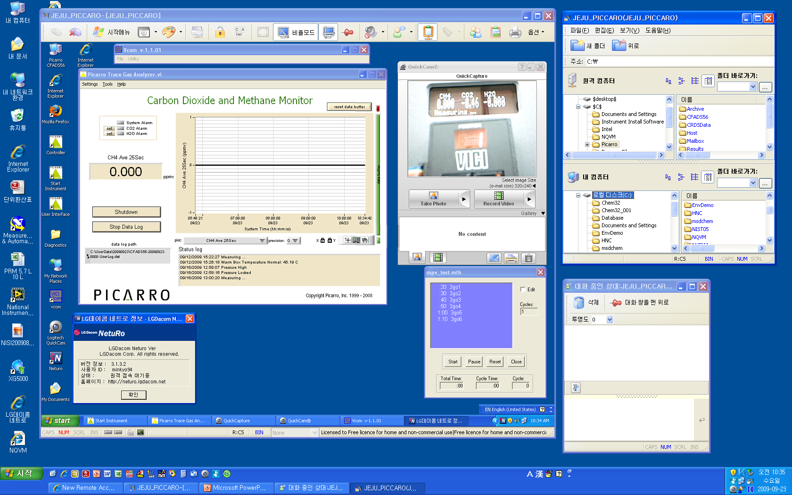
Remote Control Program
CRDS Program
CRDS & MPV Monitoring
Data Transformation
MPV Program
35

Slide 32
Conclusion
We developed the cold trap type dehumidification system . It can remove moisture continuously without maintenance.
This system is working well in Korea Global Atmosphere Watch Stations.
We constructed the remote control GHG analysis system in the remote stations like islands.
The cold trap type dehumidification system can remove moisture in the air sample continuously without any maintenance and operator.
40

Slide 33
GnL Products

Slide 34
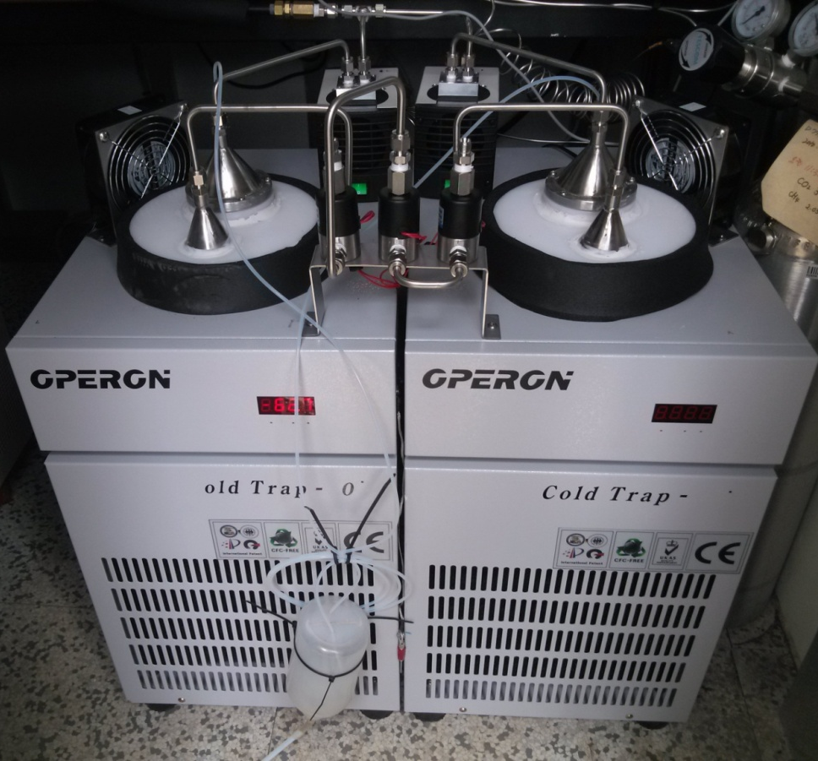
SPECIFICATIONS OF MRS-CT(Research)
Cold Trap temp. : ~ - 90 ℃
Dehumidification Capacity
: 10 L (Max 20L)
Dehumidification efficiency
: 50 ppm @ 10 L
Dimension
: 700mm Ⅹ 490mm Ⅹ 750mm
Weight : 110 kg
Available gas analyzer
: GC, NDIR, CRDS …

Slide 35
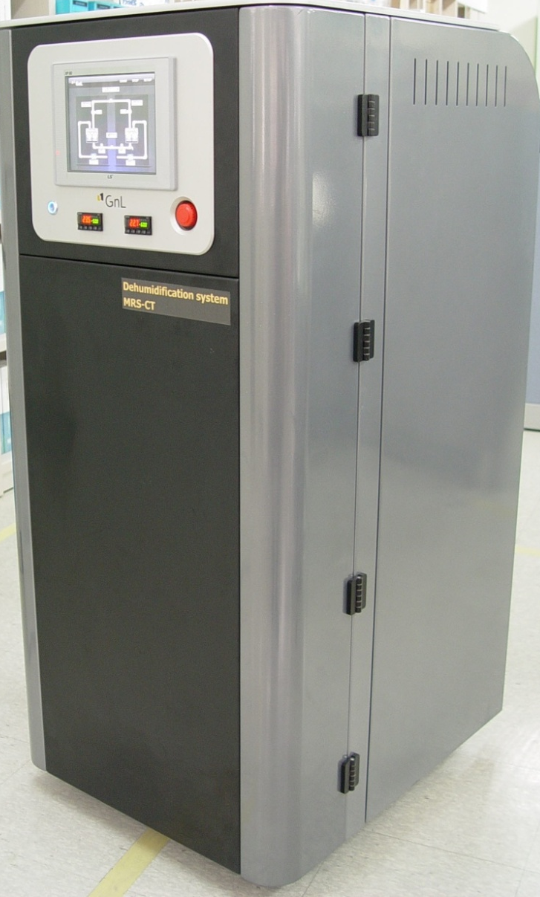
SPECIFICATIONS OF MRS-CT
Cold Trap temp. range : ~ - 60 ℃
Dehumidification Capacity
: 5 L (Max 10L)
Dehumidification efficiency
: 50 ppm @ 5 L
Dimension
: 588 mm Ⅹ 1230mm Ⅹ 695 mm
Weight : 95 kg
Available gas analyzer
: GC, NDIR, CRDS …

Slide 36
MRS-CT (BREND NEW)

Slide 37
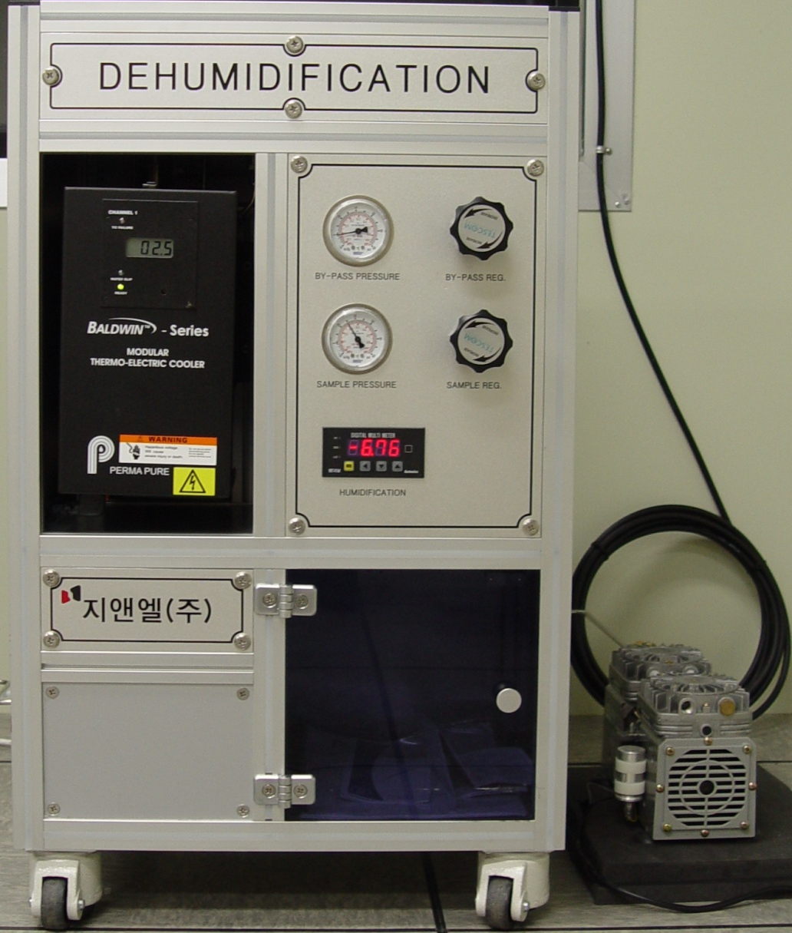
SPECIFICATIONS OF MRS-TEC
TEC temp. range : ~ -2℃
Dehumidification Capacity
: 5 L (Max 10L)
Dehumidification efficiency
: <10 ppm @ 5 L capacity
Dimension
: mm Ⅹ mm Ⅹ mm
Weight : 95 kg
Available gas analyzer
: GC, NDIR, CRDS …

Slide 38
PORTABLE TEC DRYER

Slide 39
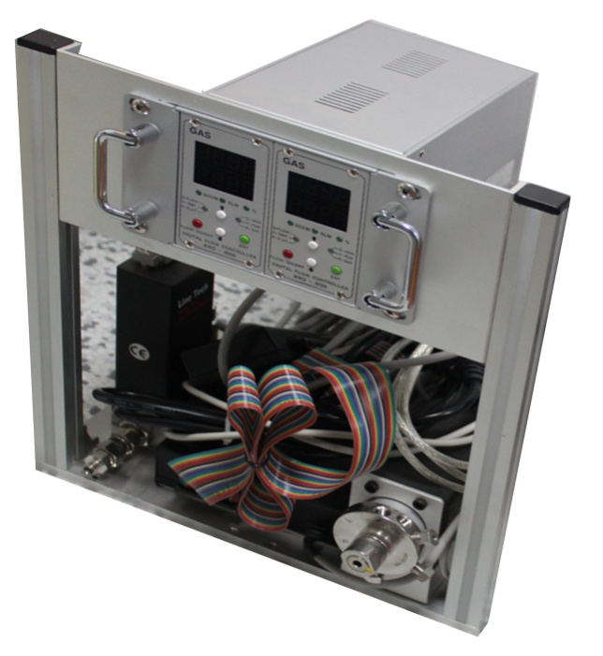
STREAM SELECTION – VICI MPV
6-port multiposition valve
Mass flow controller
2-channel read out box
Weight : 12 kg
Dimension
: 250 mm Ⅹ 350 mm Ⅹ 300 mm
GnL Instruments MIS-MPV

Slide 40
Exhibition

Slide 41
KMA(2012)

Slide 42
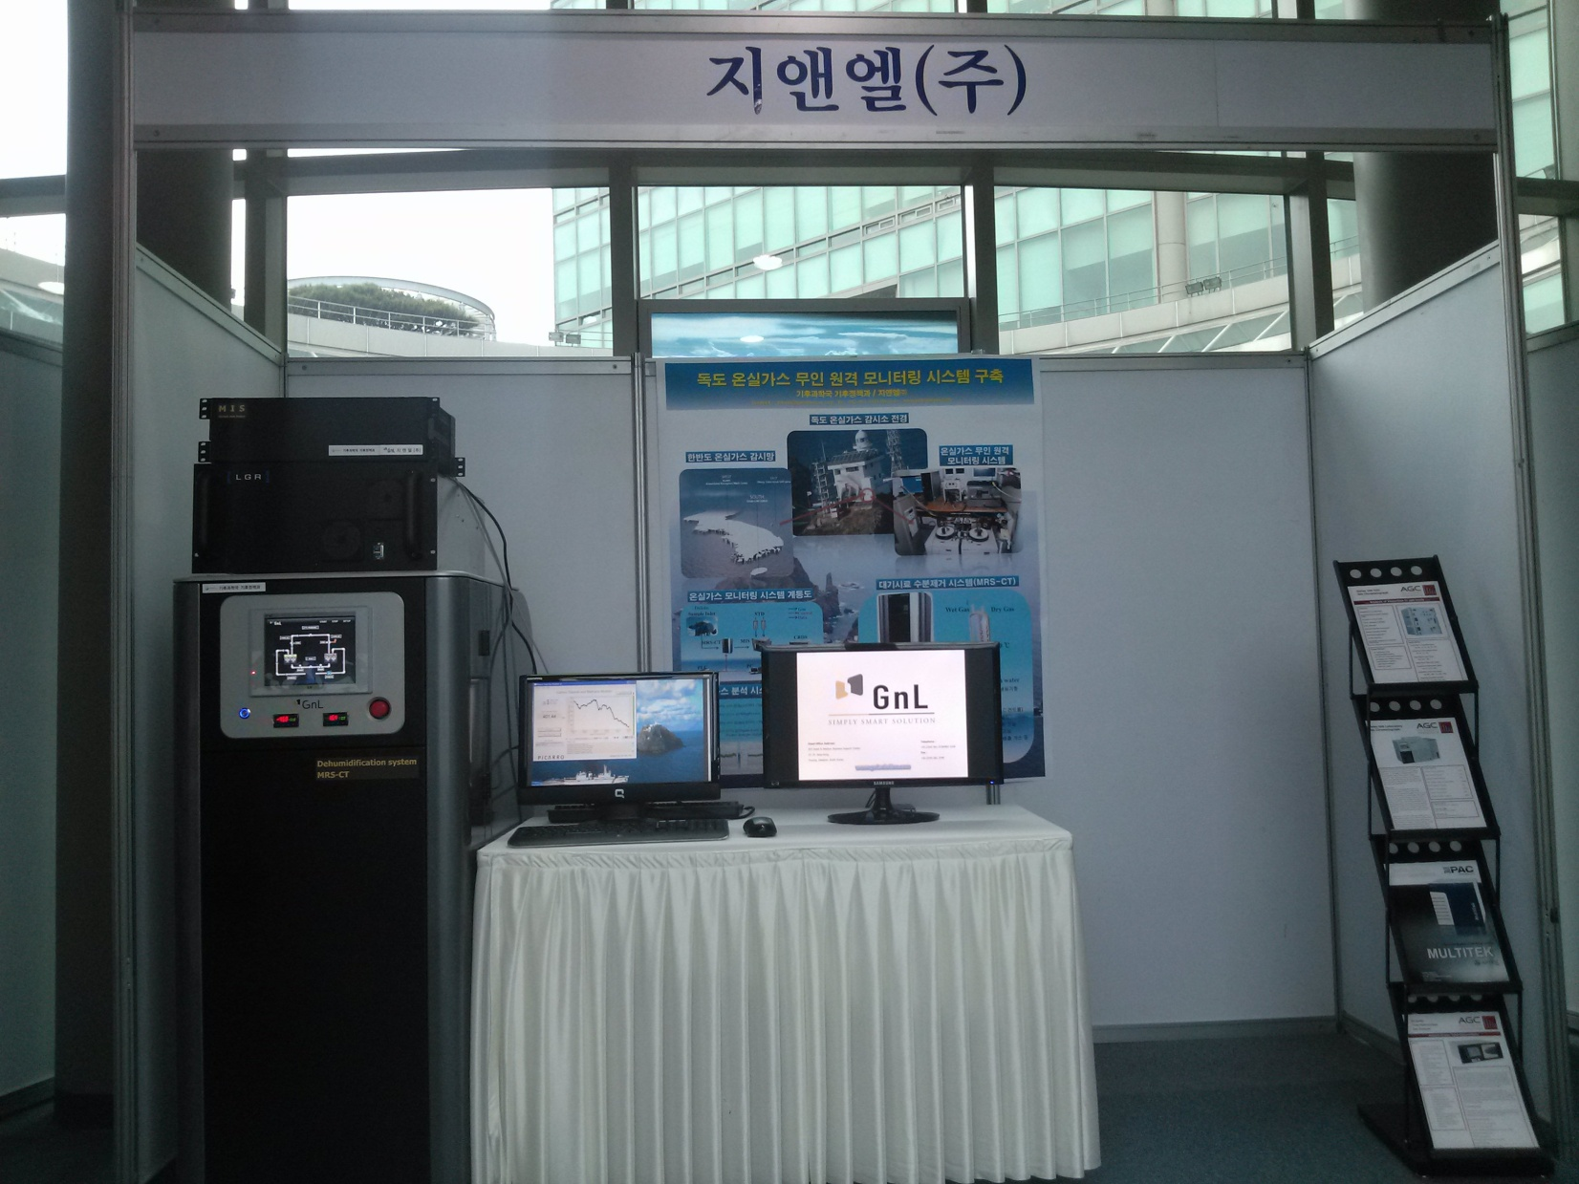
GREEN TECH FORUM(2012)

Slide 43
APMP (2012)

Slide 44
Head Office Address:
503 Small & Medium Business Support Center,
23-14, Jang-dong,
Yusung, Daejeon, South Korea
Telephone :
+82.(0)42.861.5538/863.5538
Fax :
+82.(0)42.861.5548
www.gnlsolution.com
(mkyin@gnlsolution.com)

Slide 45
Thank you !

